Slide 1
Masaryk University Libraries
Miroslav Bartošek
bartosek@ics.muni.cz
Library and Information Centre – Institute of Computer Science MU

Slide 2
ToC
      MU Libraries
      IT support for libraries
      Aleph-MU
      ER – Electronic Resources
      Digital Libraries
      Open Access at MU

Slide 3
1. MU Libraries

Slide 4

Masaryk University at glance
MU
rector’s office
faculties
institutes
specialized units
Arts
Institute of Computer Science
Hostels/Canteens
Science
CEITEC*
MuniPress
Medicine
Telč Centre
Law
other units
Education
MU-Archives
Economics
Disabled Students
Informatics
Language Centre
Social Studies
Technology Transfer
Sports Studies
Mendel Museum
* Central European Institute of Technology

Slide 5
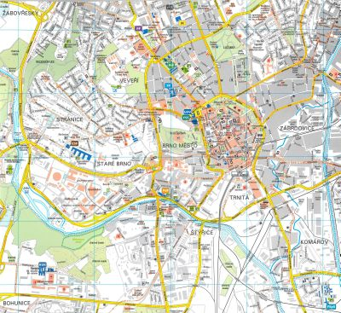
Masaryk University at glance
Locations
      MU scattered all over the city
      ~ 60 sites
      each faculty in different location/s
      University campus Bohunice
          medicine, sports + chemistry, biology
Numbers
      43 253 students
      229 degree programmes
      4 989 employees
2nd biggest Czech university

Slide 6
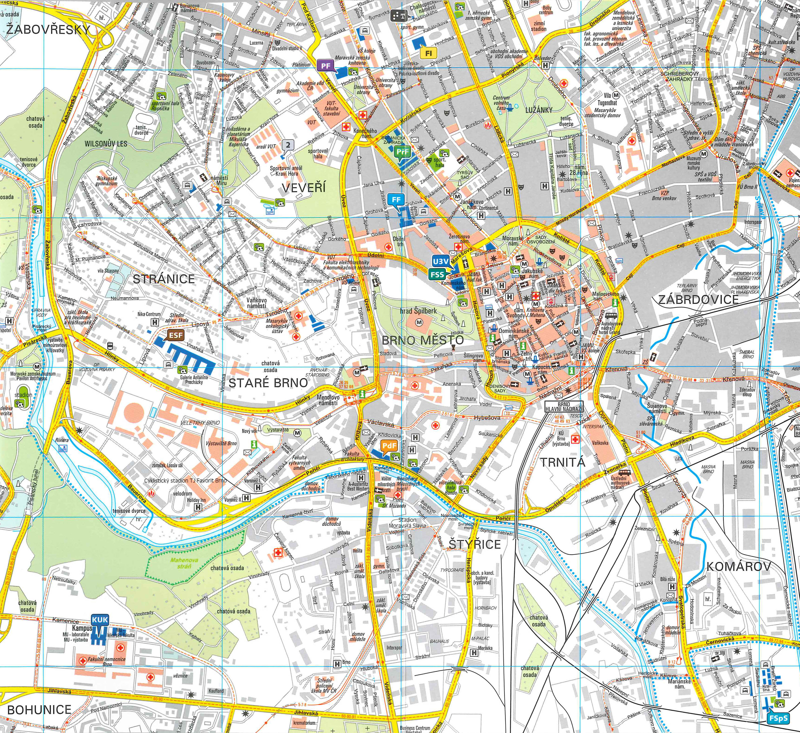

Slide 7
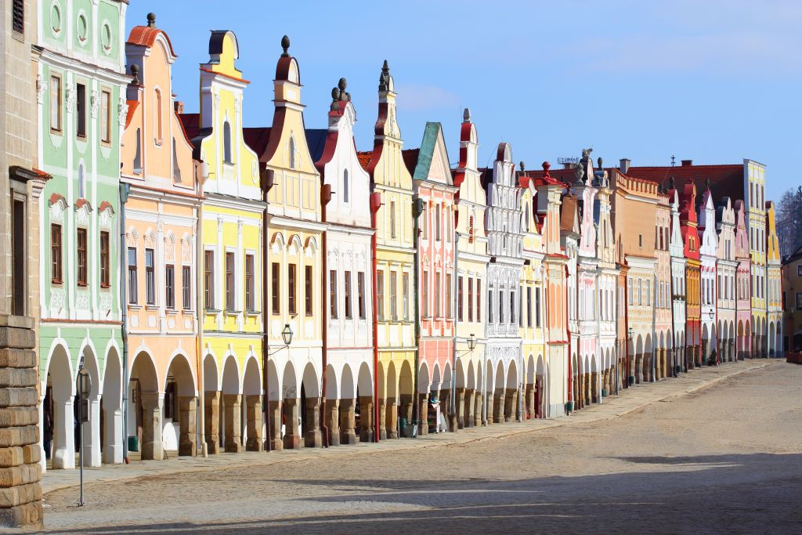
Telč University Center

Slide 8

MU Libraries
0 university library
      9 faculty libraries
      116 branch/subject libraries
      Library for students with special needs
    Autonomously managed yet integrated into university system
Library and Information Centre MU
      coordinating body
      central LMS
      common IT infrastructure
      coordinated ER acquisition
LIC-MU@ICS-MU

Slide 9
MU Libraries Structure
MU
rector’s office
faculties
institutes
specialized units
Arts
ICS-MU
Hostels/Canteens
Science
CEITEC*
MuniPress
Medicine
Telč Centre
Law
other units
Education
MU-Archives
Economics
Disabled Students
Informatics
Language Centre
Social Studies
Technology Transfer
Sports Studies
Mendel Museum

Slide 10
MU Libraries in figures (2013)
      9 faculty libraries
      116 branch/subject libraries
      111 librarians
      2.175 seats in study rooms
      1,8 mil of books (0,81 arts, 0,36 science)
          38.735 new books in 2013
      45.161 registered users
      665.817 loans

Slide 11
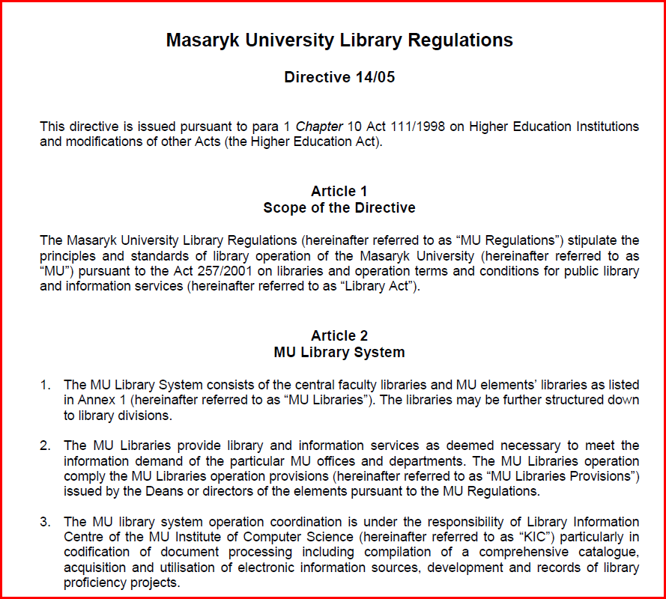

Slide 12
MU Libraries Tour
New and reconstructed libraries
      2002 new Faculty of Arts Library
      2005 new Faculty of Science Library
      2007 new University Campus Library (medicine, sport)
      2015 new Faculty of Law Library
      2014 new Faculty of Education Library
      2013 reconstr Faculty of Economics Library
      2014 new Faculty of Informatics Library
      2005 new Faculty of Social Sciences Library

Slide 13
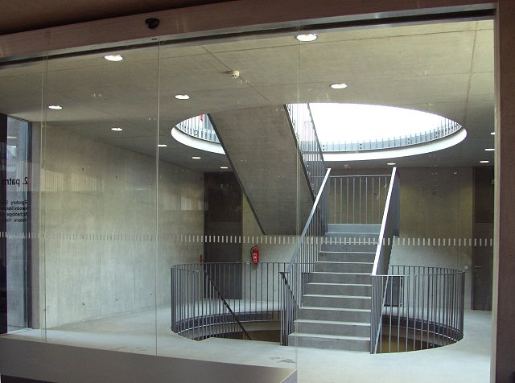
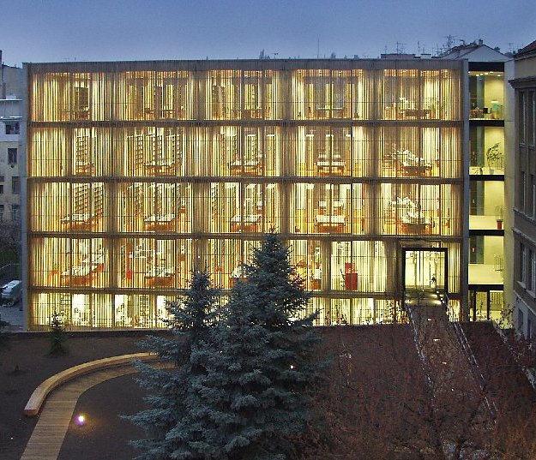
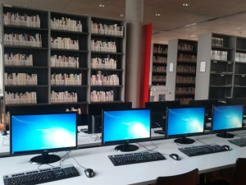
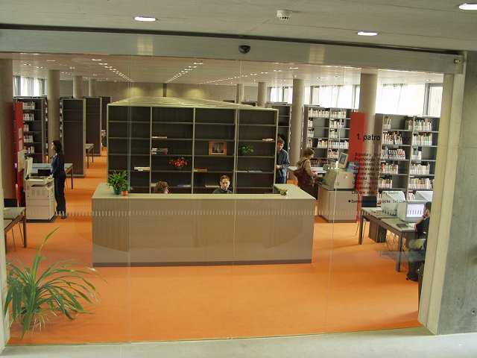
Humanities Library
2002 new library

Slide 14

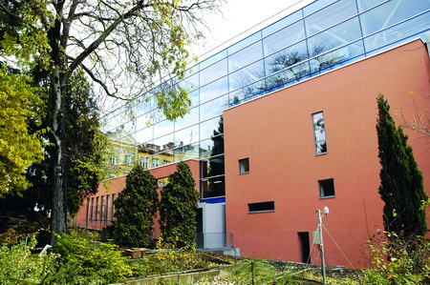
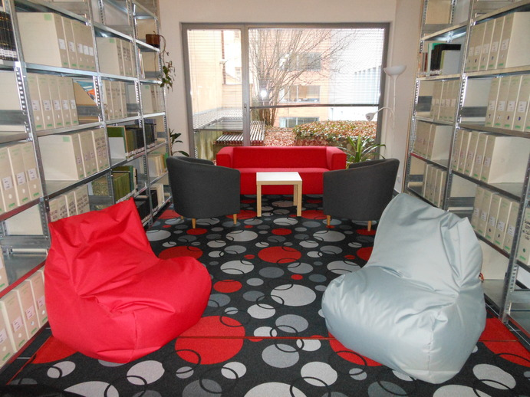
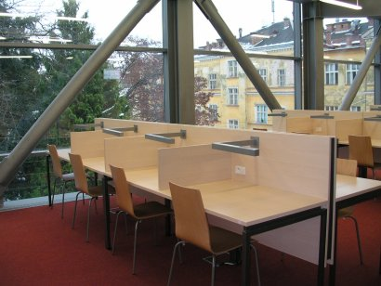
Science Library
2005 new library

Slide 15
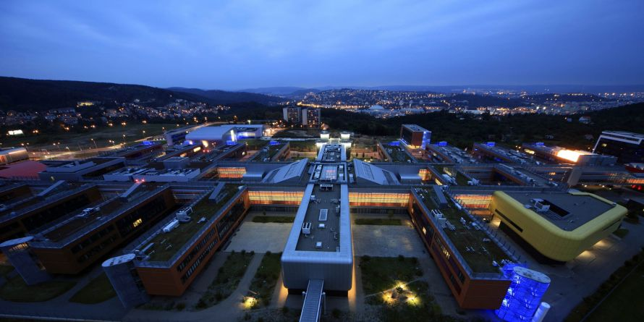
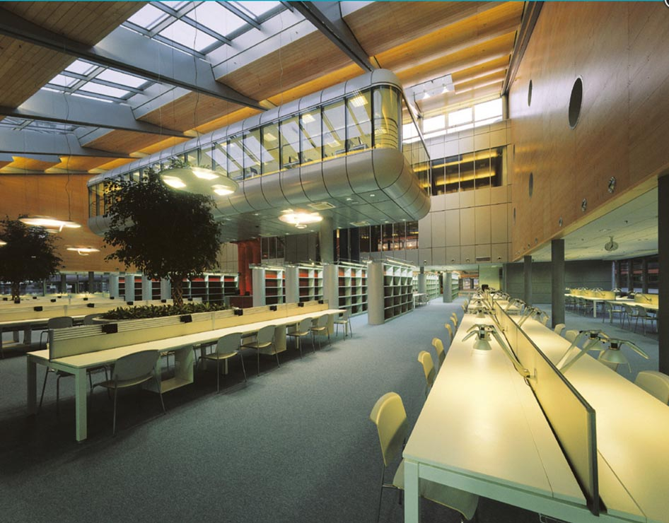
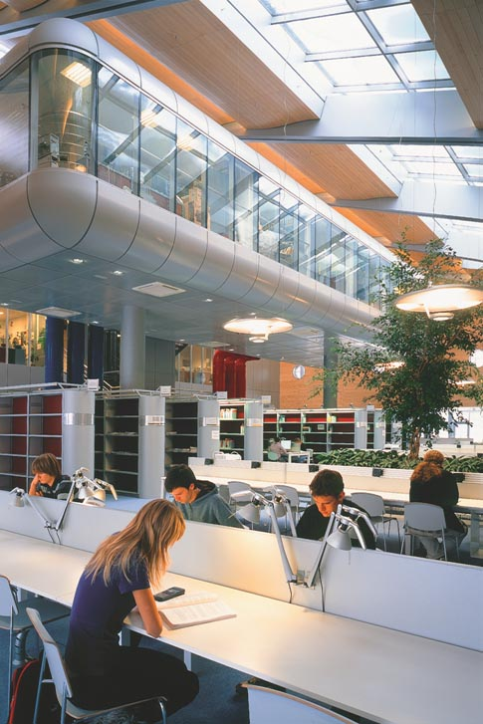
Campus Library
2010 new library

Slide 16
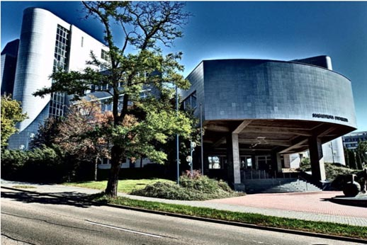
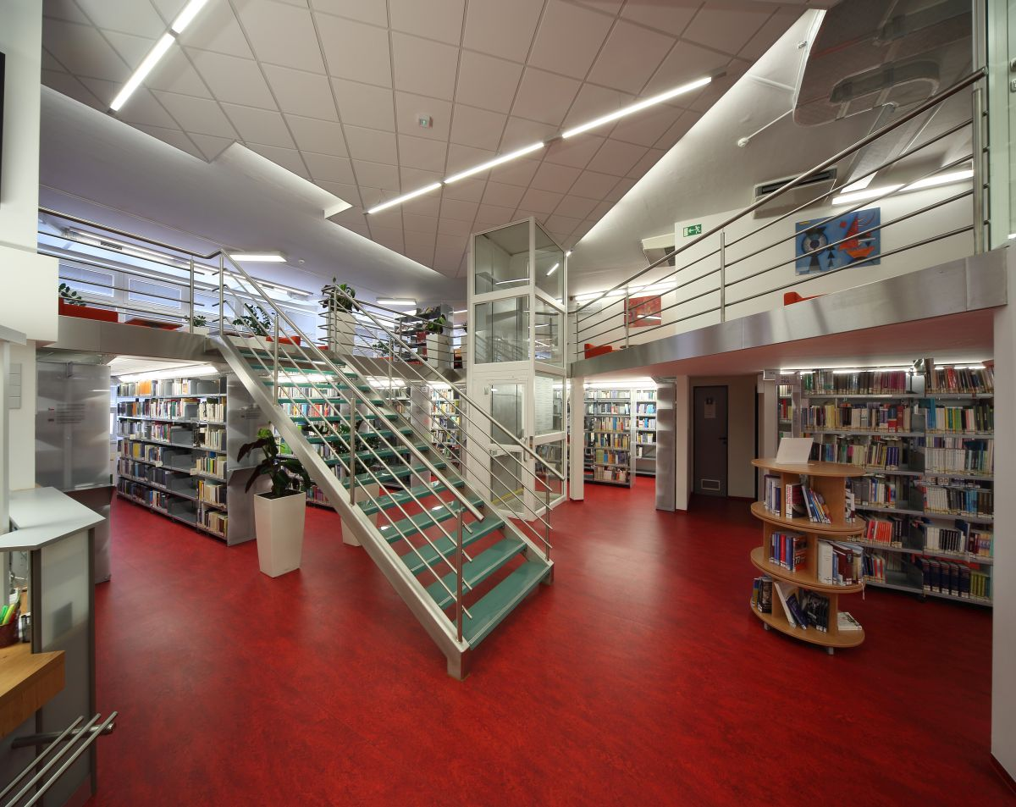
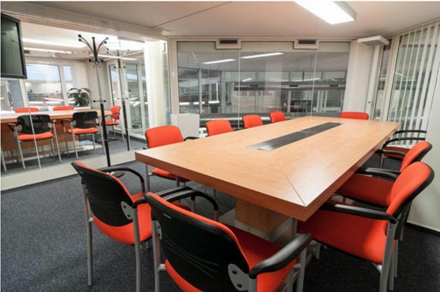
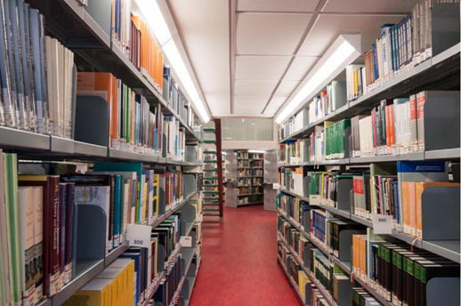
Economics Library
2013 reconstructed

Slide 17
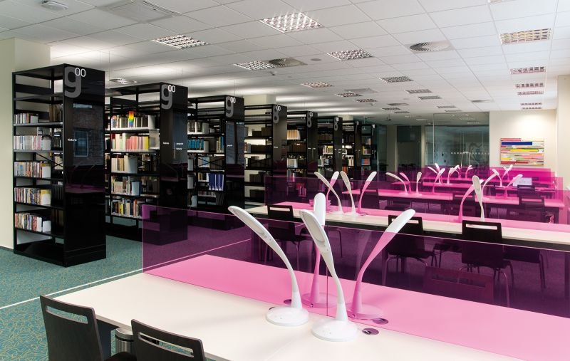
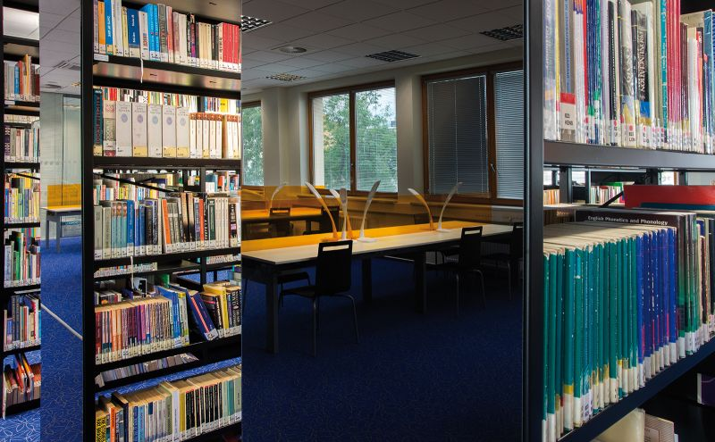
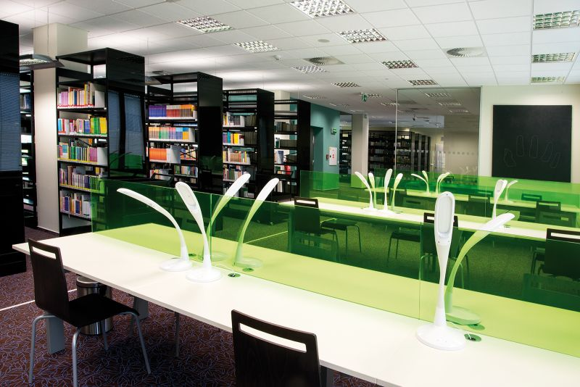
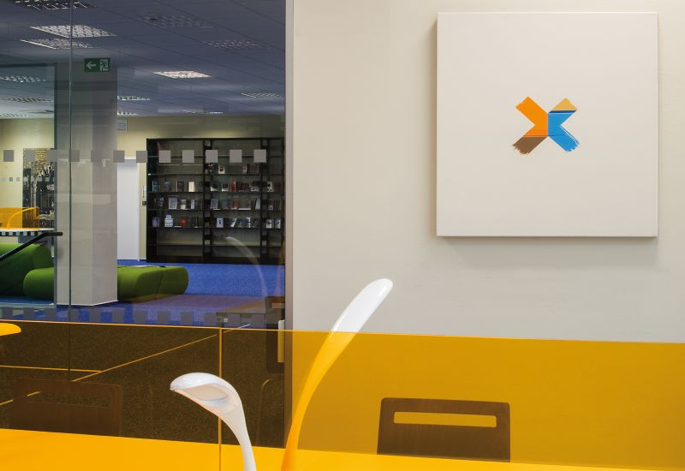
Education Library
2014 new library

Slide 18
2. IT support for libraries

Slide 19
IT units supporting libraries
Institute of Computer Science
    Library and Information Centre MU
      Library management system Aleph MU
      ER technologies
      Digitizing and digital libraries
      Computer study rooms
      Network infrastructure, …
Faculty of Informatics
    IS MU – university study-supporting system
      E-theses archive
      Institutional Repository
Local IT support

Slide 20
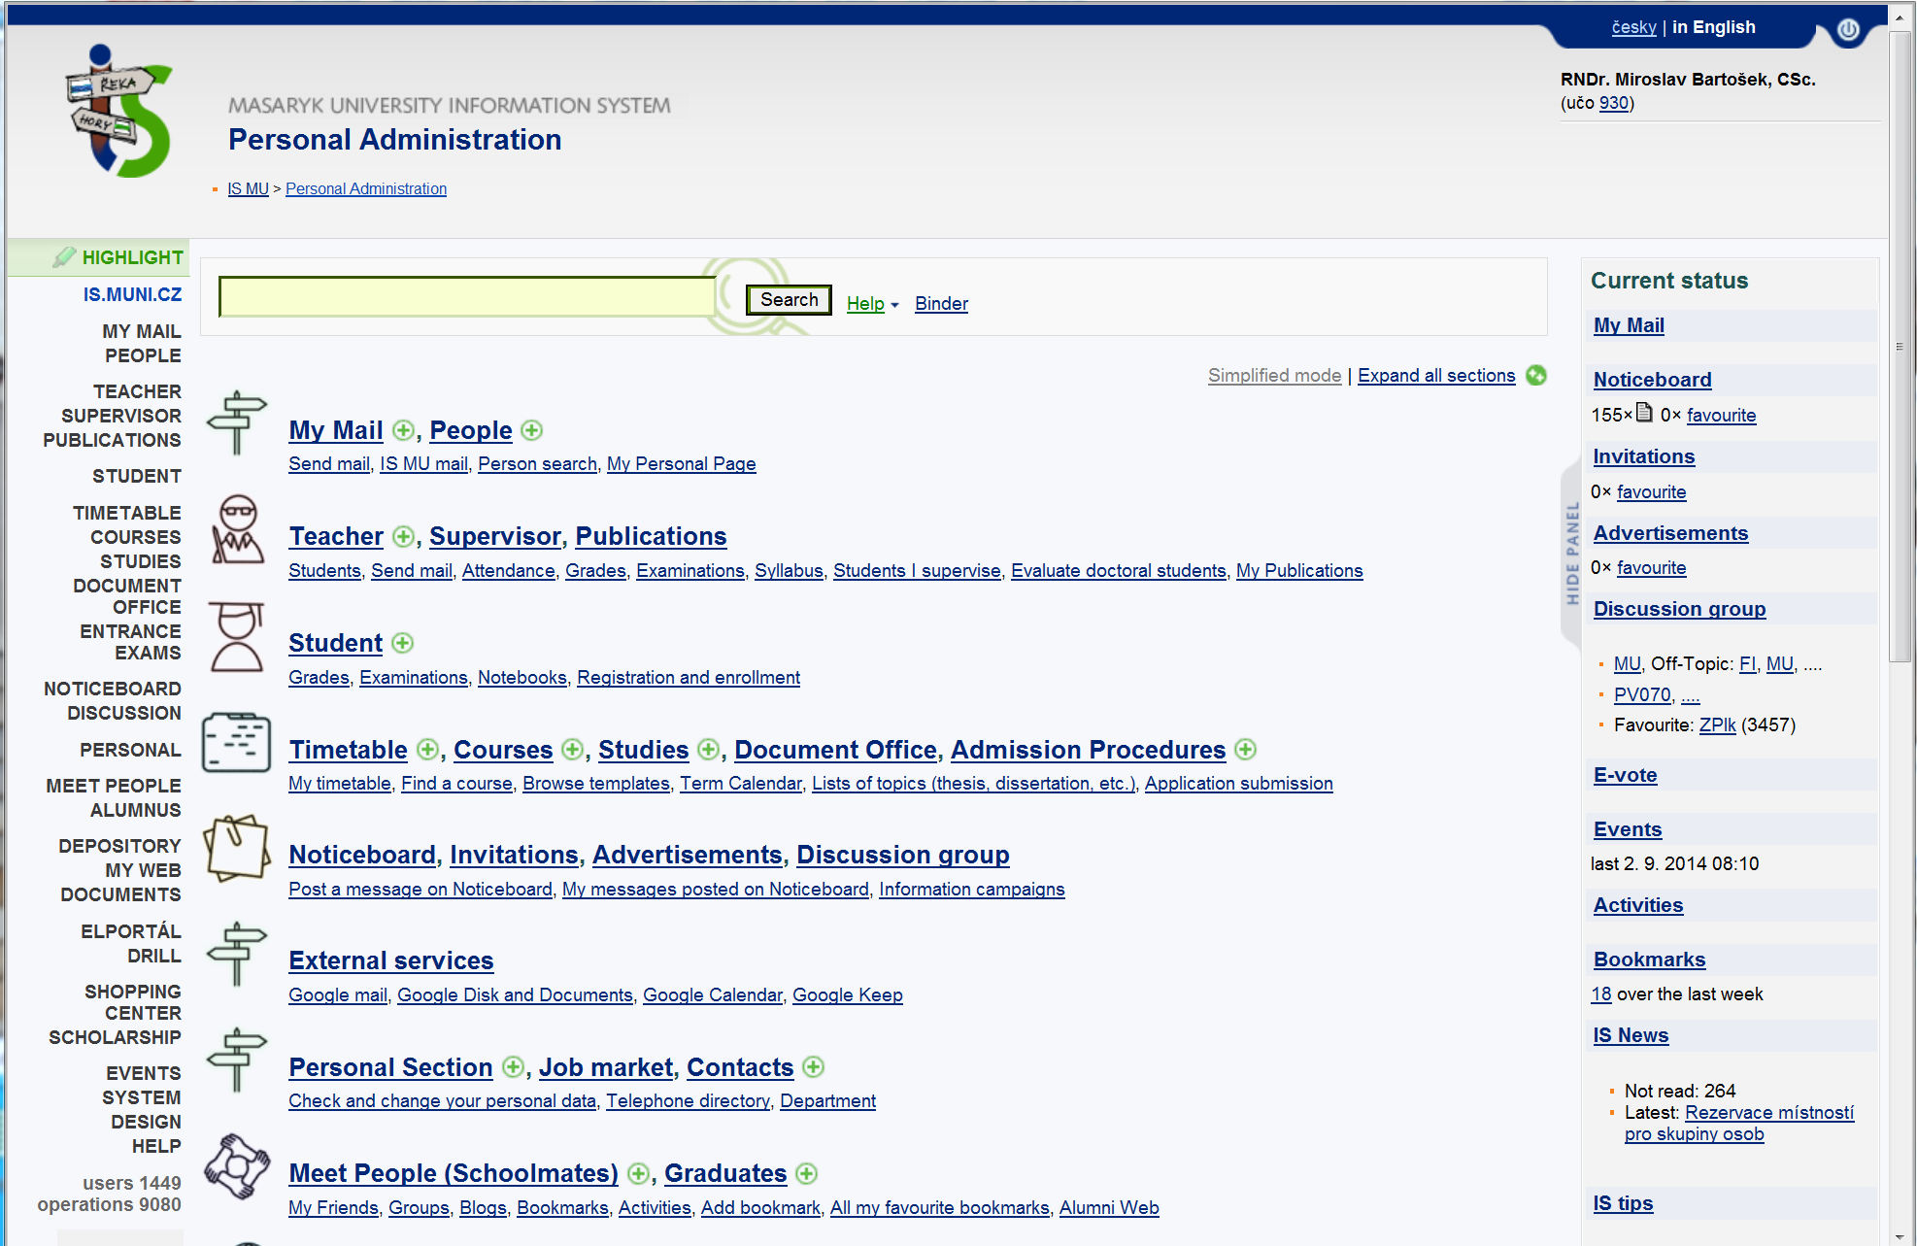
IS MU – Study Supporting System

Slide 21
3. Aleph MU

Slide 22

Library Management System
Aleph-MU
      ExLibris, Israel
      centrally operated service for all MU libraries
      HW/SW, system administration, system librarian, rules, tools
      faculty catalogues + university union catalogue
      750.000 bibliographical records
      cooperation with Czech union catalogue
      Czech authorities (National Library)
      linkage to E-theses archive
      12.000 digitized study books (e-loan)
      Ebrary Academic Complete (80.000 e-books)

Slide 23
Library Management System II
Aleph-MU
      MARC21 (…2015 RDA)
      Modules:
          Patrons
          Acquisition
          Cataloguing
          Serials
          Circulations
          OPAC
          Reservations
          ILL
          e-loans, …
      unified pan-university settings (MU Library Regulations)
      x specialised faculty settings (faculty library regulations)

Slide 24
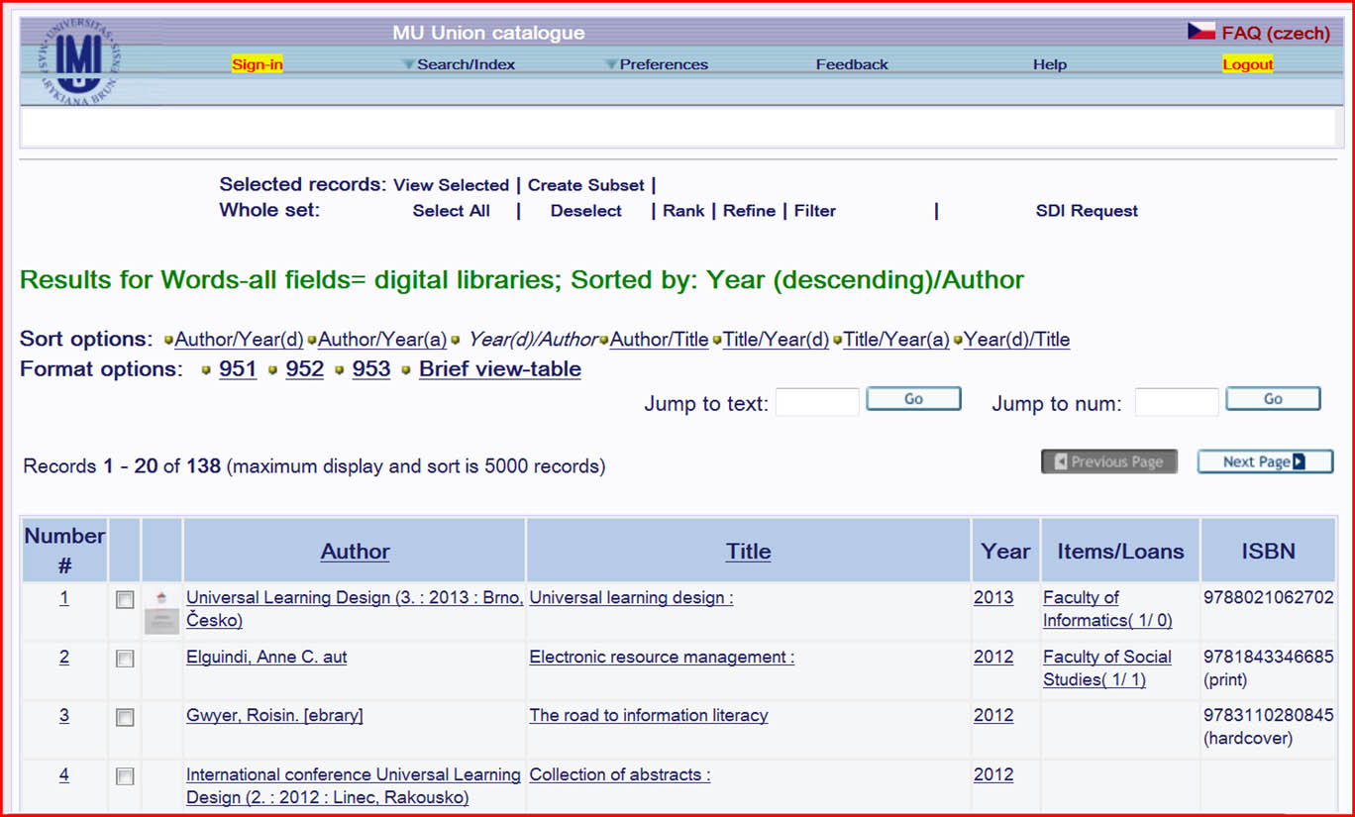
Aleph-MU

Slide 25
4. Electronic Resources

Slide 26
National support/consortia
Ministry of Education ER programmes
      2000-2003 LI
      2004-2008 INFOZ
      2009-2011 1N
      2012-2017 OP VaVpI (EC)
      2013-2017 LR – Information infrastructure for research
National ER consortia
      STM (Elsevier, Springer, Wiley)
      Web of Knowledge
      discipline (chemistry, medicine, …)

Slide 27
ER Acquisition
Coordination
National projects
Internal funding
    Over 100 licensed ERs
LIC-MU@ICS-MU

Slide 28
ER technology
ER Portal http://ezdroje.muni.cz
      all ERs licensed for MU
      free-trials
      tools, ER-technology
discovery.muni
      EBSCO Discovery service
      A-to-Z e-journals/e-books
Linking services
      EBSCO Link Source (SFX)
Remote user access
      OpenVPN, EZ-proxy, Shibboleth

Slide 29
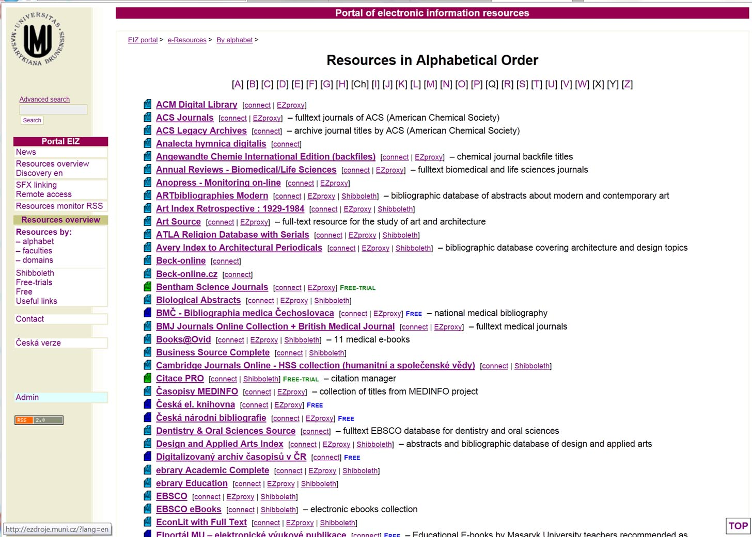

Slide 30
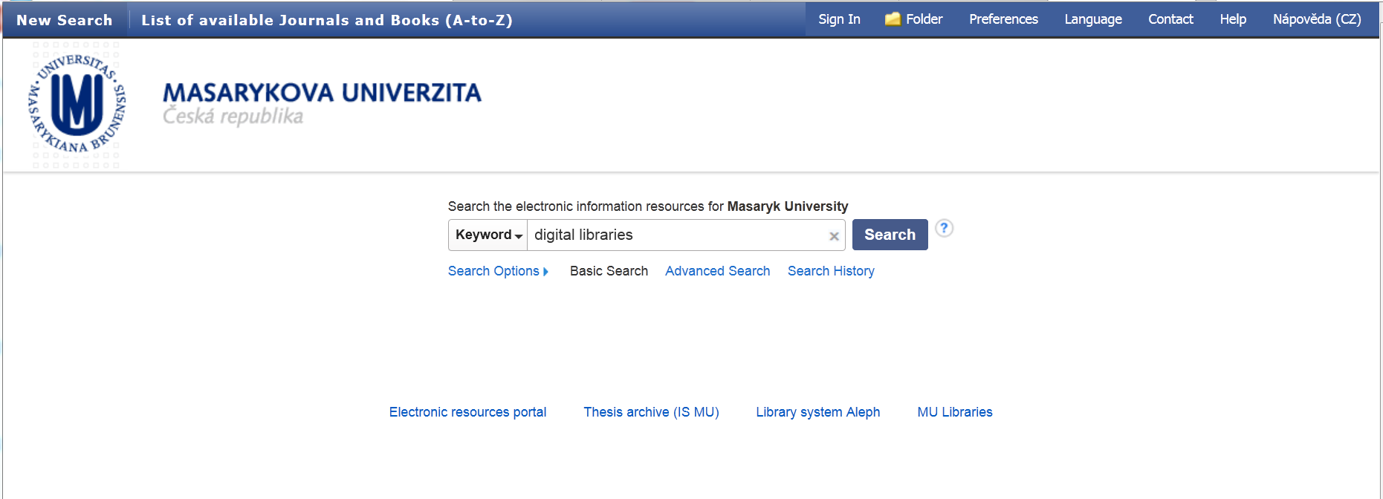
discovery.muni

Slide 31
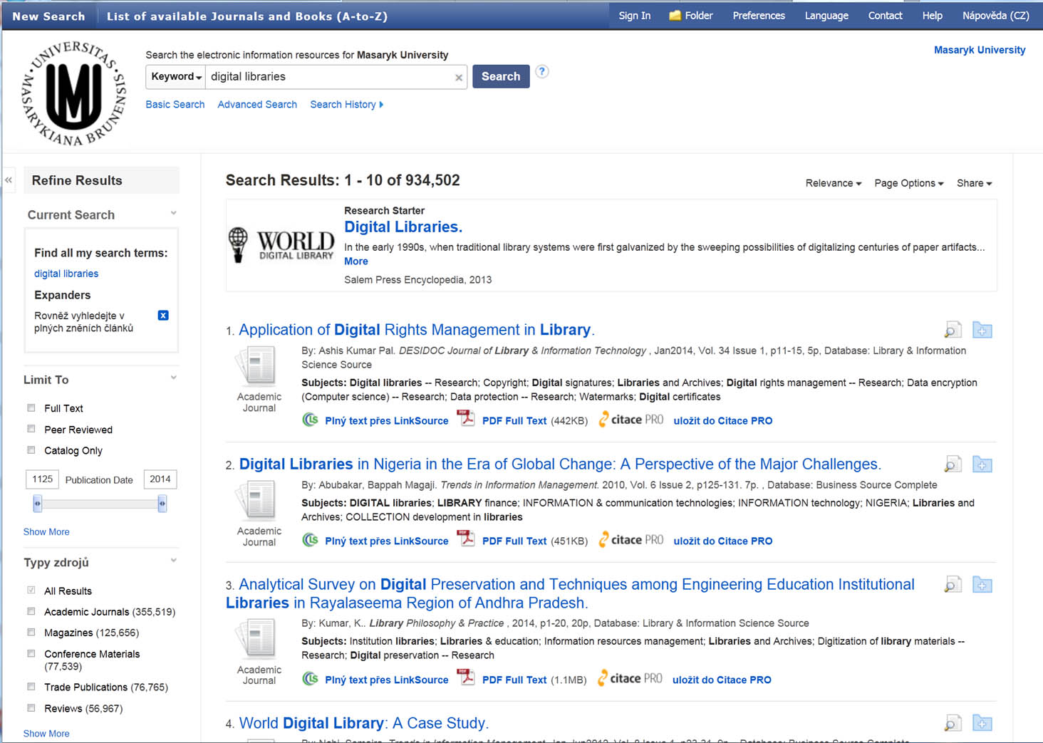

Slide 32
5. Digital Libraries

Slide 33
MU Digital Libraries
DKF-MU
    Digital library of photographs
DML-CZ
    Czech Digital Mathematics Library
DigiLib
    Faculty of Arts Digital Library
    … other in preparation

Slide 34
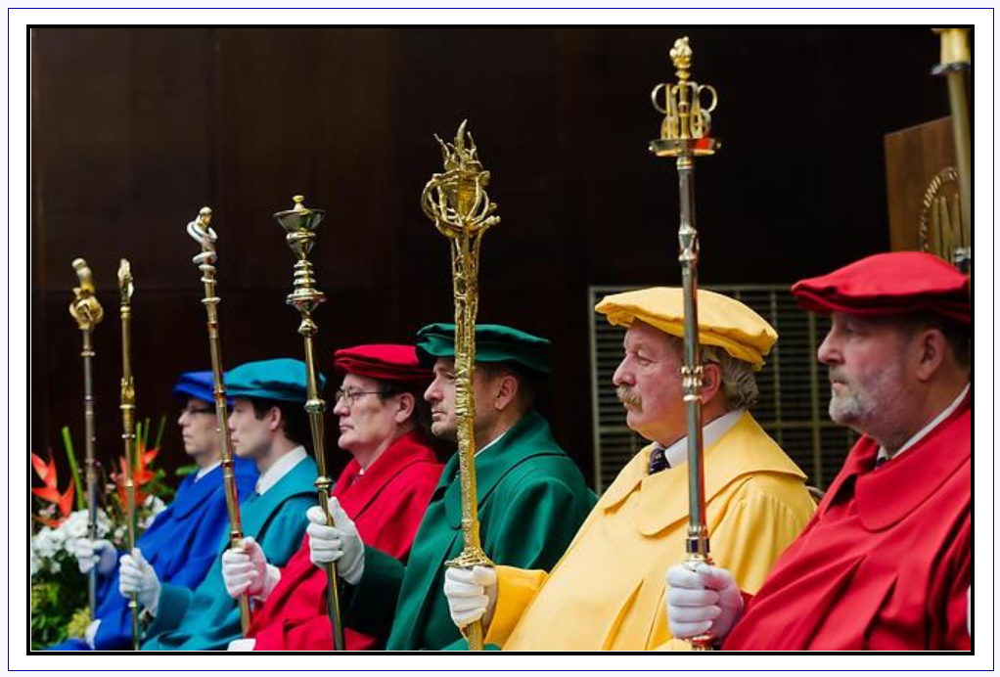
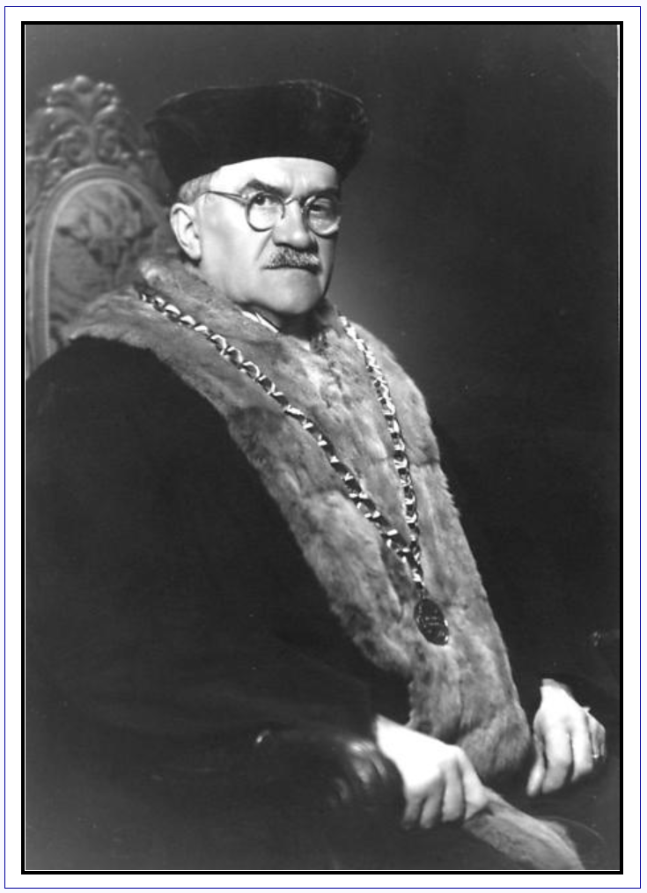
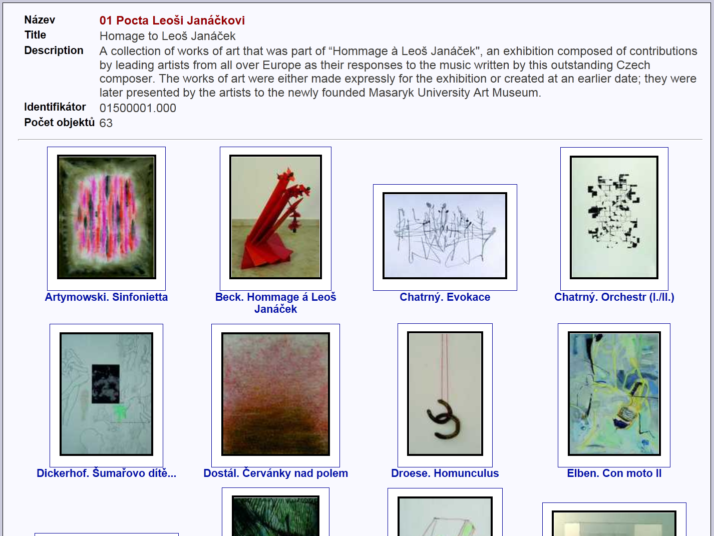
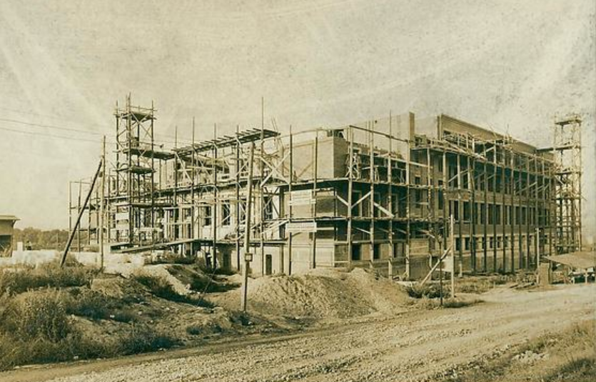
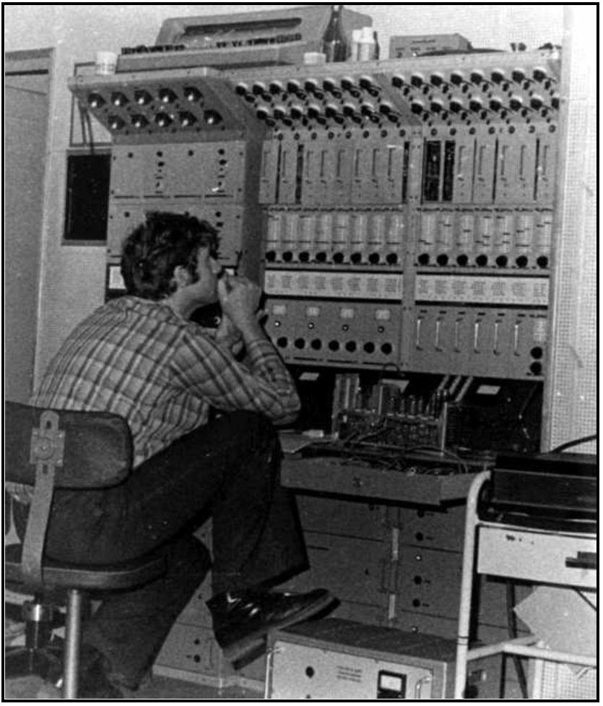
DKF-MU

Slide 35

DML-CZ
    Mathematical literature which has been published throughout history in the Czech lands (19 century – present)
      Project
          Czech Academy of Sciences
          Charles University in Prague
          Masaryk University
      Technology
          Metadata Editor
          DSpace
      Content
          journals, books, proceedings, mathematicians
          33.709 documents, 361.200 pages
          Open Access (98 %)

Slide 36
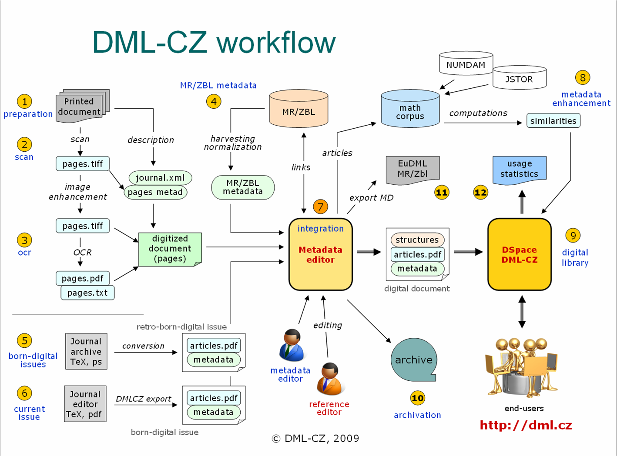
DML-CZ

Slide 37
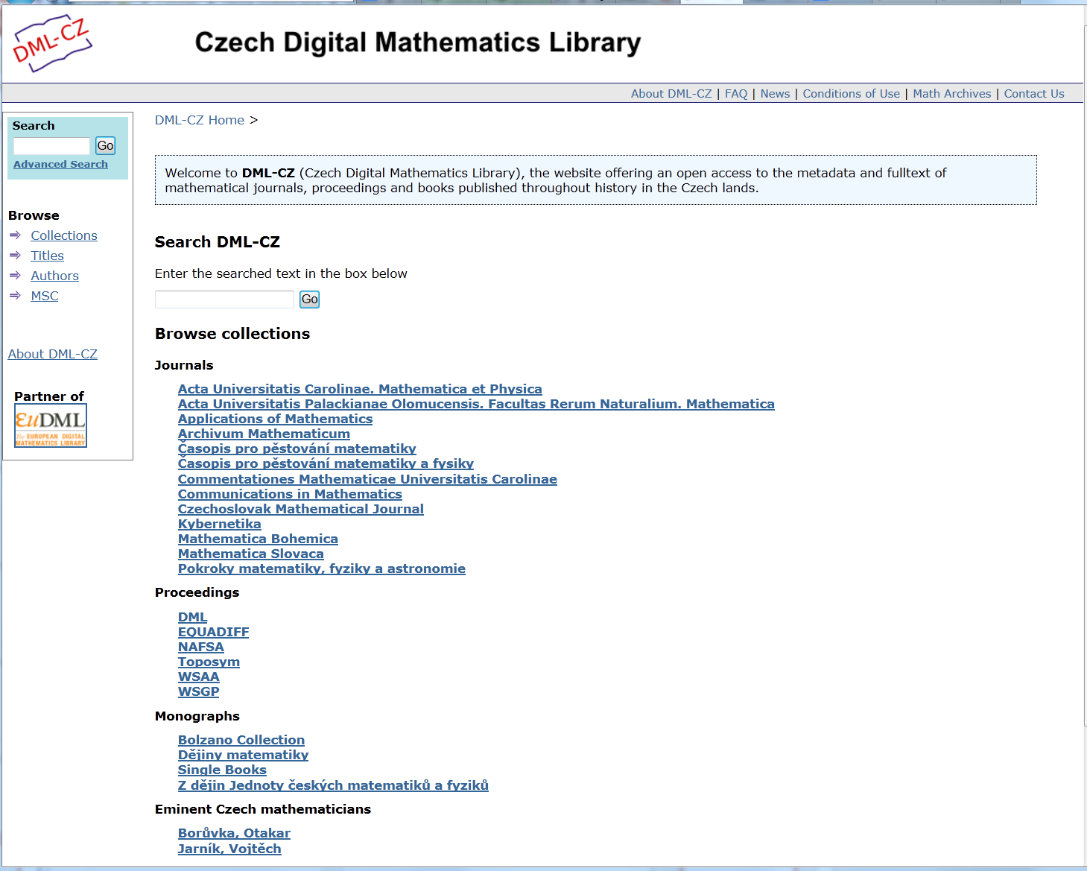
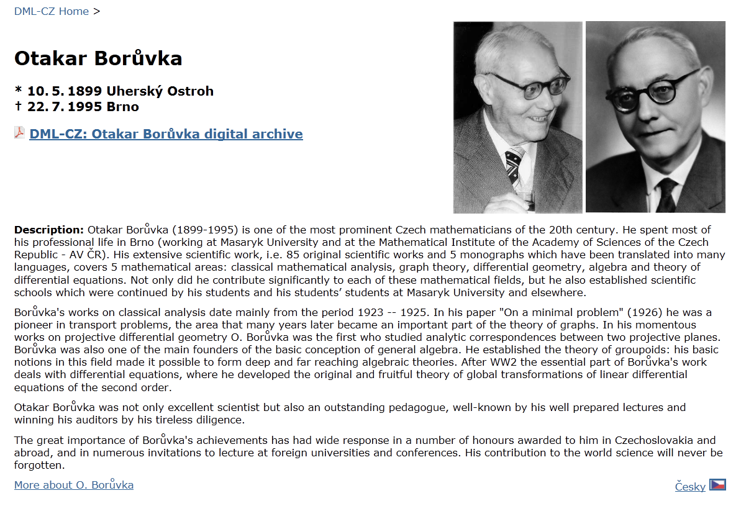
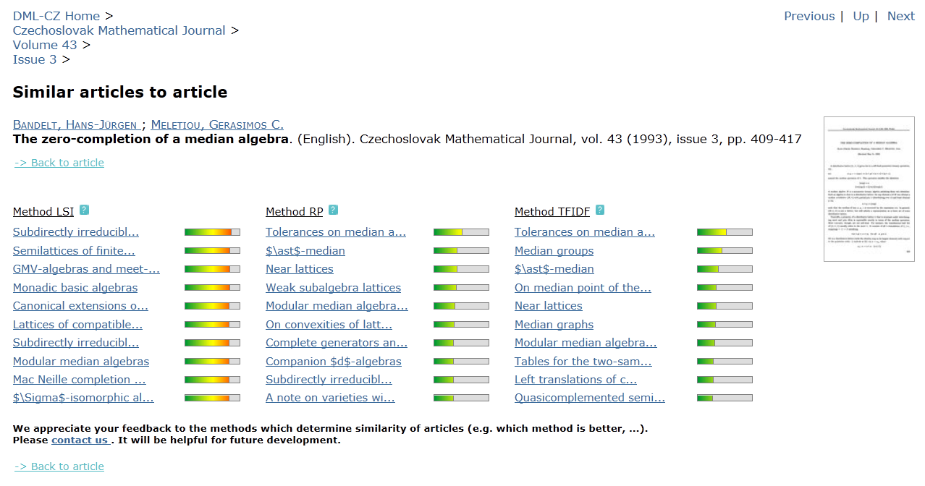

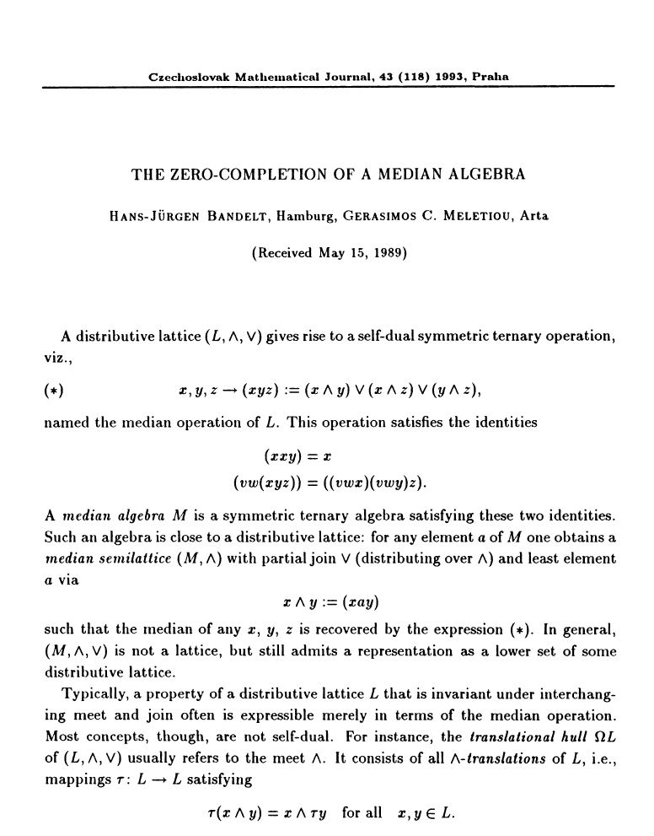
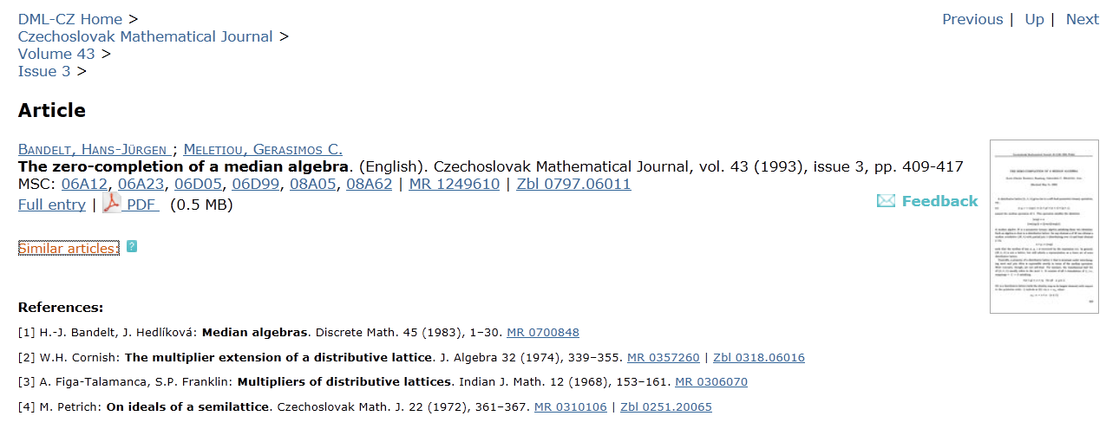

Slide 38

DigiLib
    Public access to all professional production of the Faculty of Arts MU since its foundation in 1919 up to present time.
      Project
          Faculty of Arts MU
          Institute of Computer Science MU
      Technology
        Tools, technologies and processes developed within DML-CZ
          Metadata Editor
          DSpace
      Content
          Journals, books, proceedings
          28.000 documents, 420.000 pages
          Open Access (97 %)

Slide 39
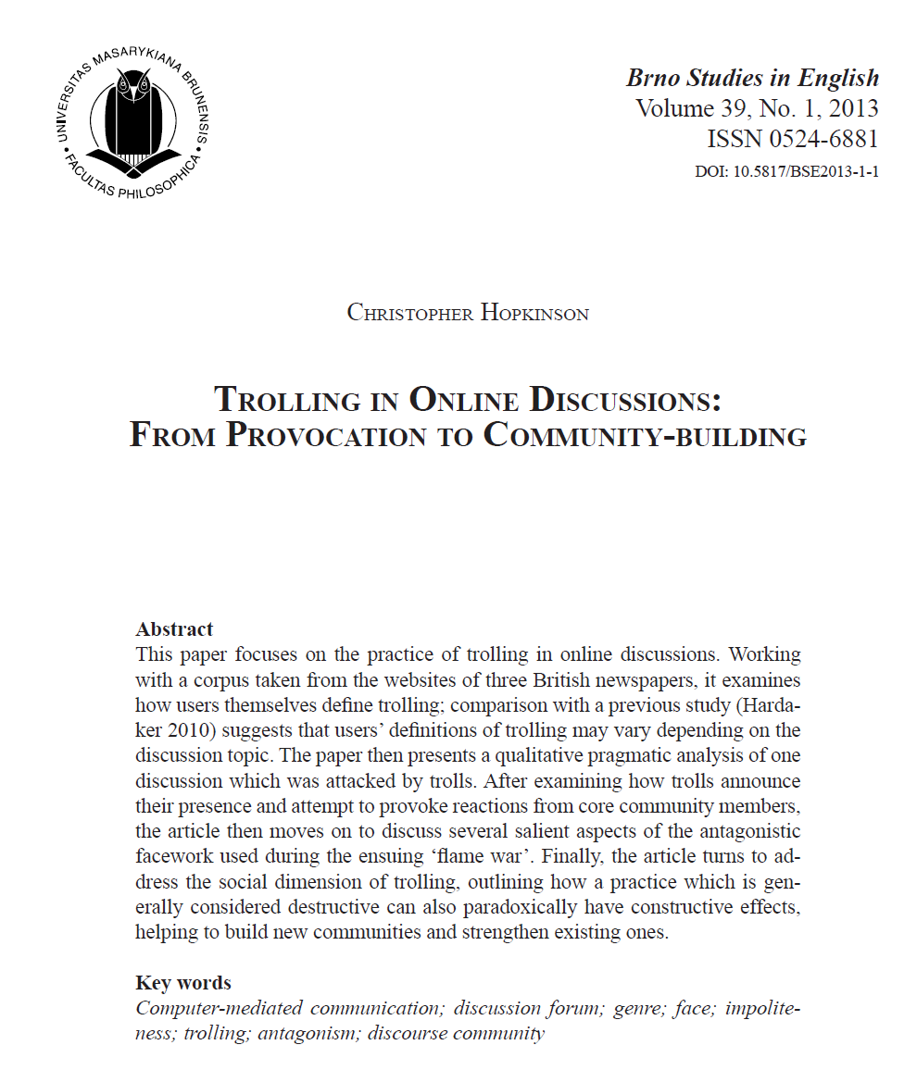
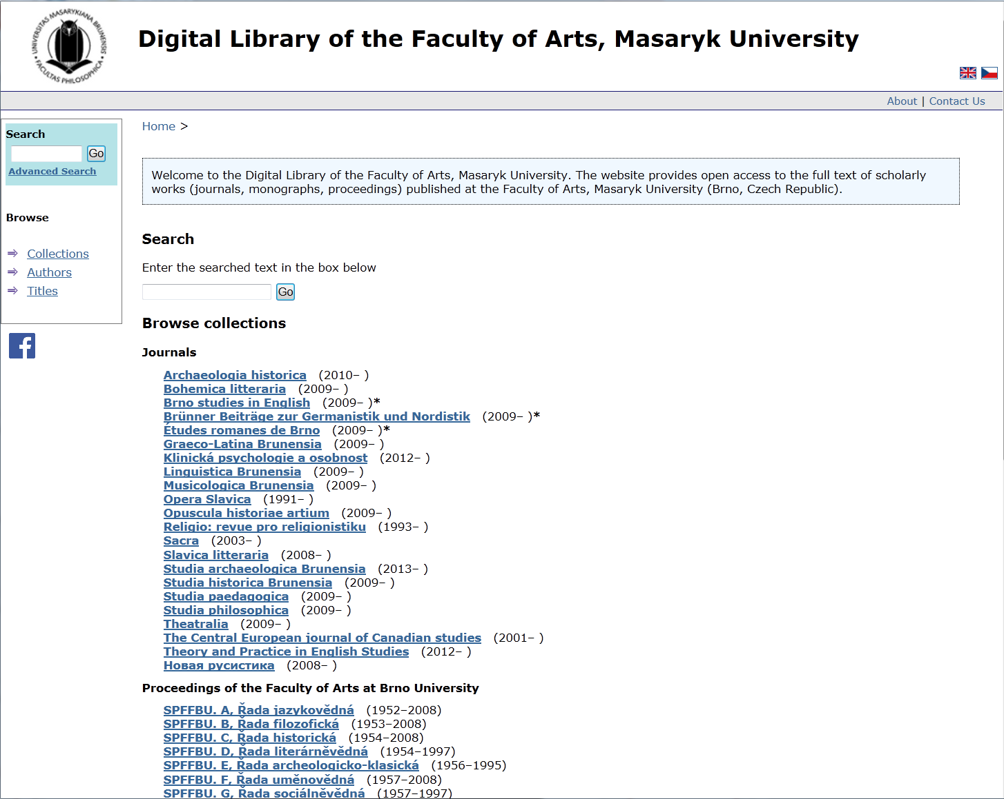
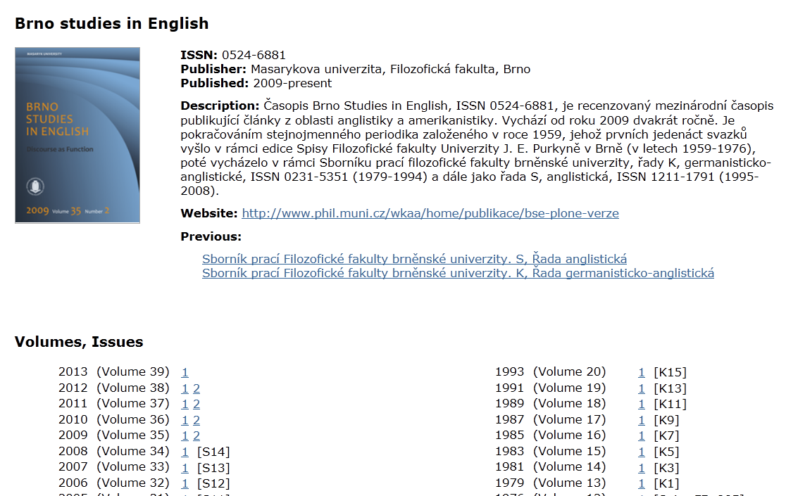
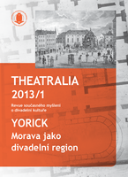




Slide 40
6. Open Access at MU

Slide 41
OA at MU
2006 MU e-theses & dissertations in OA
2010 MU signed Berlin Declaration
2011 MU green OA mandate adopted
2012 MU Institutional repository fully operational
2013 great OA-dispute –> green OA mandate relaxed,
voluntary deposit policy instead…
          …OA progress suspended at MU
          national OA strategy badly missing!
          Digital Preservation – new challenge

Slide 42
  Thank you for your attention!
Miroslav Bartošek
bartosek@ics.muni.cz

