Slide 1
Complutense University Library of Madrid
Erasmus Staff Mobility Week 2014 in the Library and Information Service of the University of Masaryk
Rommy Arce Legua

Slide 2
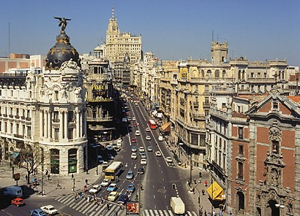
Madrid (Spain)
Madrid is the capital of Spain. Located in the geographical center of the country, 650 m. above the sea level, framed by the central system and the valley of the river Tajo. As of 2013, there are over 6,000,000 people.
The city has one of the most important art collections in Europe: the Prado, Reina Sofia and Thyssen Bornemiza museums.
It is close to important cultural cities: Aranjuez, Alcalá de Henares, Segovia and Toledo.
Is a welcoming city, active and cheerful, highlighted by its cultural offer.
“Tapas” and the nightlife are some of its main attractions.

Slide 3
Complutense University of Madrid
The Complutense University is heir of the Studium Generale founded in 1293 in the city of Alcalá de Henares. Later the Archbishop of Toledo Francisco Jiménez de Cisneros established the “Complutensis Universitas” in 1499. The first faculties were: Arts and Philosophy, Theology, Canon law and Medicine. Its time of splendor lasts until the 17th century when the Counter Reformation ends with the humanist University.
In the middle of 19th century the University moved definitively to the city of Madrid, thereafter known as Central University. From 1929 it starts the construction of the current University City of Madrid.
The civil war (1936-1939) and subsequent dictatorship wounded her death. First as a front of war and after with the exile and debugging of its teaching staff. The centralist structure of Spanish University and lack of autonomy will be maintained until the end of the dictatorship. In 1970 it acquired its current name. University autonomy will be finally approved in 1983.

Slide 4
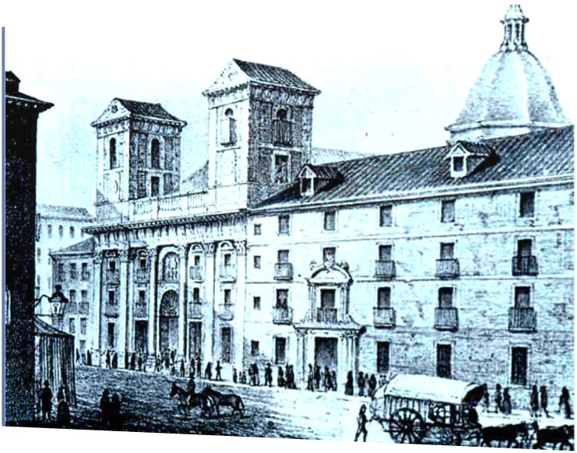
History: XV - XVII
Imperial College (Madrid) – S. XVII
Biblia Políglota Complutense (1514)

Slide 5
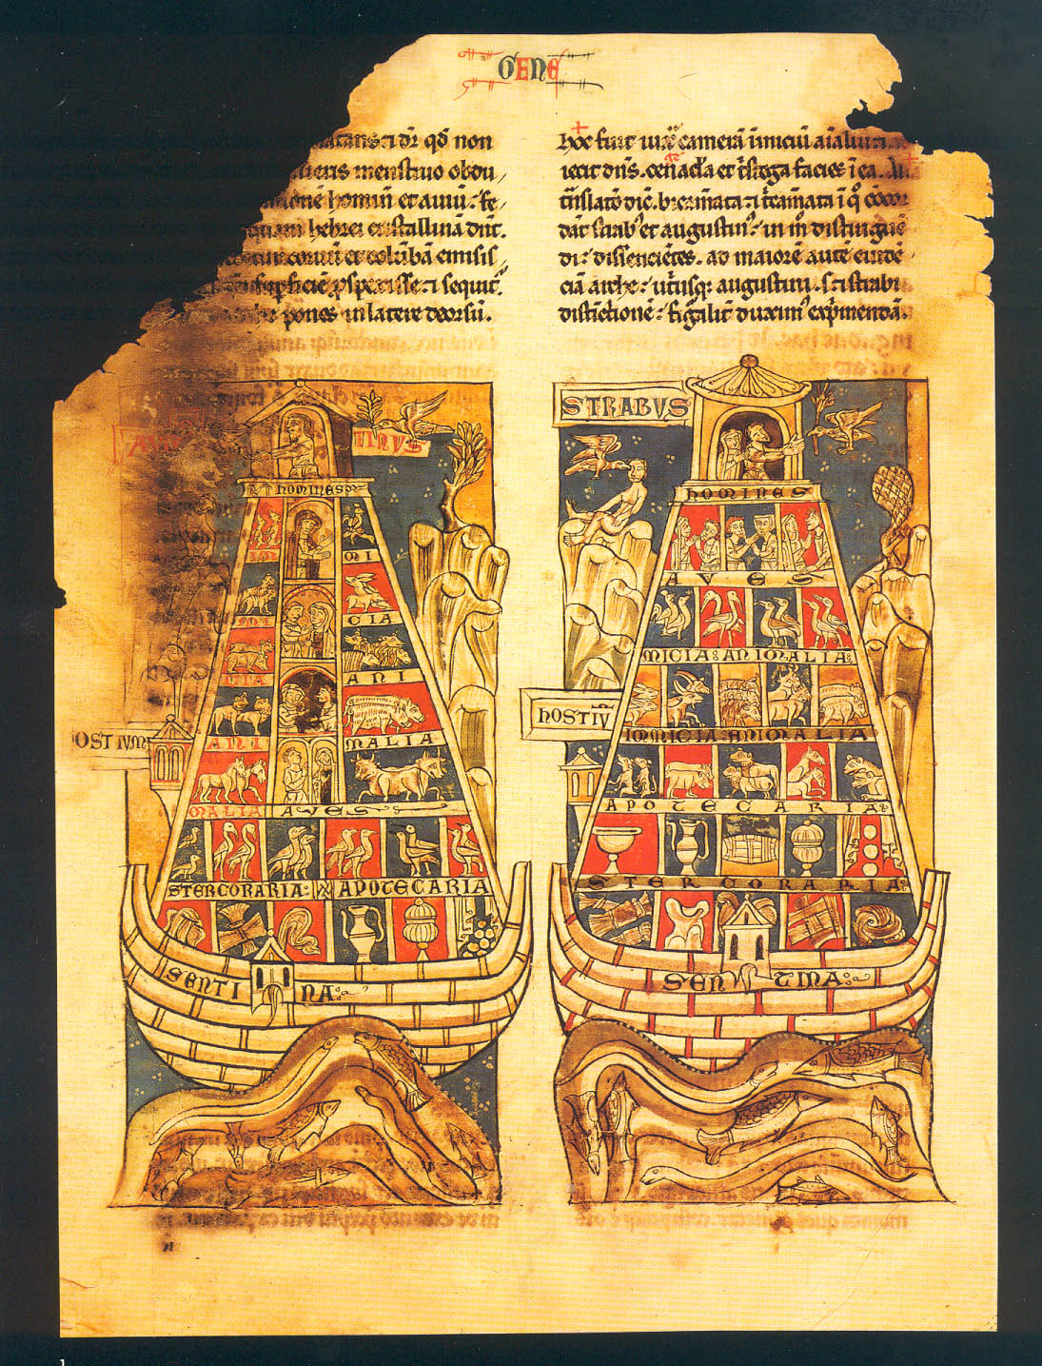
Civil war (1936-1939)
Breviarium Historiae Catholicae, s. XIII

Slide 6
Some figures about UCM
85.000 Students
6.289 Teachers
745 Researchers
4.189 Staff
76 Degrees
133 Postgraduate studies
83 Doctorate studies
21 Faculties
5 Schools
40 Institutes

Slide 7
Complutense University of Madrid Library
The library of the Complutense University (BUC) is heir of the, Renaissance and humanist University of Alcalá, founded by Cardinal Cisneros in 1499. It is currently considered one of the first libraries of the country.
The Complutense library has a large collection of book and document holdings. The bibliographic heritage consists mainly on the collection of the Marques of Valdecilla historical library (16.732 manuscripts of all ages, 184.521 printed books from the 16th to 19th centuries and 734 incunabula), to which we have to add the bibliographic heritage housed in faculty libraries. The most important works: Libros del Saber de Astronomía (s.XIII), Gramática Castellana (1492) or La Biblia Políglota Complutense (1514).
The modern holdings, housed in the faculty libraries, collects documents specialized in the fields of knowledge taught in each of them.

Slide 8
Some figures about library
34 Libraries
411 Librarians
106.289 Users
1.040.851 Loans per year
5.535.347 Website access
11.300 Seats for reading
1.596 Computers for students
2.856.500 Books
100.000 E-books
63.000 Journals
196.733 Ancient books
24.000 DVD
40.000 Maps
8.700 Digitalized dissertations
Gramática castellana of Antonio de Nebrija (1492)

Slide 9
Organization
The BUC is structured in only system, decentralized in branch libraries and coordinated through the technical management. Headquarters have the responsibility of unifying criteria, coordination and standardization of processes and services of branch libraries. The library is comprised of 34 libraries.
Branch libraries
The University has two campuses: The main campus City University is located in Moncloa (Madrid). There is also a small campus, Somosaguas (Pozuelo de Alarcón - Madrid).
Branch libraries are responsible for the direct impact of services in the University community. They are distributed between the two campuses.
In 2012 it was signed an agreement of collaboration with the library of the AECID (Spanish Agency for international cooperation for development) which has come to be associated with the library.

Slide 10
Library services
Using the library
Subjects resources and research support
Borrowing, renewing and reserving (self-issue and return of library materials was introduced in several branch libraries).
Access to online resources
Laptop and ebook borrowing.
Interlibrary loans
Inter-site loans
Library account (on-line services)
Assistance and support for disabled users (extendend loans, photocopying and scanning service…)
Reprographic and digital services
Group study rooms
Exhibitions
Reference services
Subjetcs guides
Reading lists
Dissertation editing
Didactical and training activities
On line tutorials, users guides
Digital and information literacy
Managing information (training on Bibliographic software)
Workshops are suitable for undergraduate, postgraduate…

Slide 11
Library Cooperation
The library belongs to many national and international associations aimed to promote library cooperation and the optimization of its resources.
Rebiun (Spanish University Libraries Consortium)
Madroño (Consortium of the Public Universities of Madrid and UNED)
GEUIN (Spain Innopac Users Group).
Liber (Ligue des Bibliothèques Européene de Recherche).

Slide 12
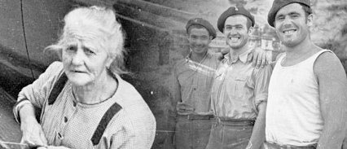
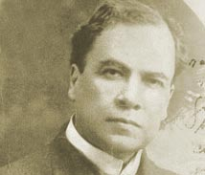
Digital Library
Historical Archive of the Spanish Communist Party (PCE): 799
Rubén Darío Archive: 2.363
Collection of old drawings of the Faculty of Fine Arts: 284 (1752-1914)
Dioscórides: 53.132 (heritage collection)
E-prints: 13.209
Books UCM-Google: 114.765
Journals UCM: 32.008 (articles)

Slide 13
Digital Library: Complutense- Google
The agreement with Google signed in 2006. The purpose was mass digitalization of library collections free of copyright. Since the project began 120,000 books (19th century) have already been digitized.
Google scans documents and is responsible for the costs: books are scanned twice to avoid errors.
Gives to the Complutense a copy of the scanned books.
Digitized books are freely searchable and downloaded from Google, Google Books, Google Play, Hathi Trust Digital Library, Internet Archive, Europeana, Biblioteca Virtual Miguel de Cervantes and the BUCM Library Catalogue.
Complutense joined Hathi Trust in 2010 and it is the only non‐American partner. Is a library consortium to ensure that the cultural record is preserved and accessible long into the future.
Also, Complutense participe in Europeana Libraries.

Slide 14
Digital Library: Eprints…
Eprints Complutense
It’s an open access repository of the research literature of the Complutense University of Madrid. We offer help to researchers who need or want to publish their research by OA(theses,papers, working papers, patents, conference…)
The University has recently signed a commitment with green route to open acces on “Institutional Policy of Open Access” (2014)
Digitalization
In collaboration with Ramón Menédez Pidal Foundation (2014)of its holdings.
Ancient “Romancero”
Letters from Ramón Menéndez Pidal with spanish intellectuals and politicians.

Slide 15
Education Library
It is located on the campus at Moncloa. Its heritage collection is composed mainly books from s. XIX, from the old Schools of Education "Pablo Montesino" and "Maria Diaz Jimenez" in addition to holdings from the Education Section of the Faculty of Philosophy and Letters.
It has a reading room, reference room, current periodicals reading room and workroom. In total 294 seats provides reading.
There is also a self-service check out that has greatly facilitated the work because it is reducing queues and reducing pressure on staff. Customers can return and check out their own books.

Slide 16
Some figures of Education Library
Total items: 108.571
Reading room holdings: 25.858
Restricted collection: 82.713
Heritage collection: 8000
Journals: 1.625
Psychological tests collection: 490(avalaible for loan)

Slide 17
One of my tasks: Chat Reference
This service is held by all libraries. To organize the attention shifts, monthly schedules are made. In each turn we are online two or three libraries, always from different areas of knowledge to transfer the inquiry to another partner if we have any doubts.
The user can access the chat from the homepage of the website or from the help page. The service is provided Monday through Friday from 10:00 to 14:00 and from 16:00 to 20:00. Libraries make two-hour shifts.
We attend questions on services, the collections and the use of the catalogue but not renewals or bookings through this service since we advise users not to enter personal information.
The Library developed a policy which is available to all users and a guide of good practices for staff serving the chat.

Slide 18
Chat Reference
The service is implemented through two tools: LibraryH3lp, and the program client Pidgin.
LibraryH3lp is a set of Instant Messeging (IM) integrated and chat via the web designed specifically for the needs of libraries and virtual reference services.
The reference service works with the creation of waiting rows ("queue") and accounts of librarians assigned to them. Each UCM library provides a "queue" with their corresponding email (Yahoo) accounts.

Slide 19
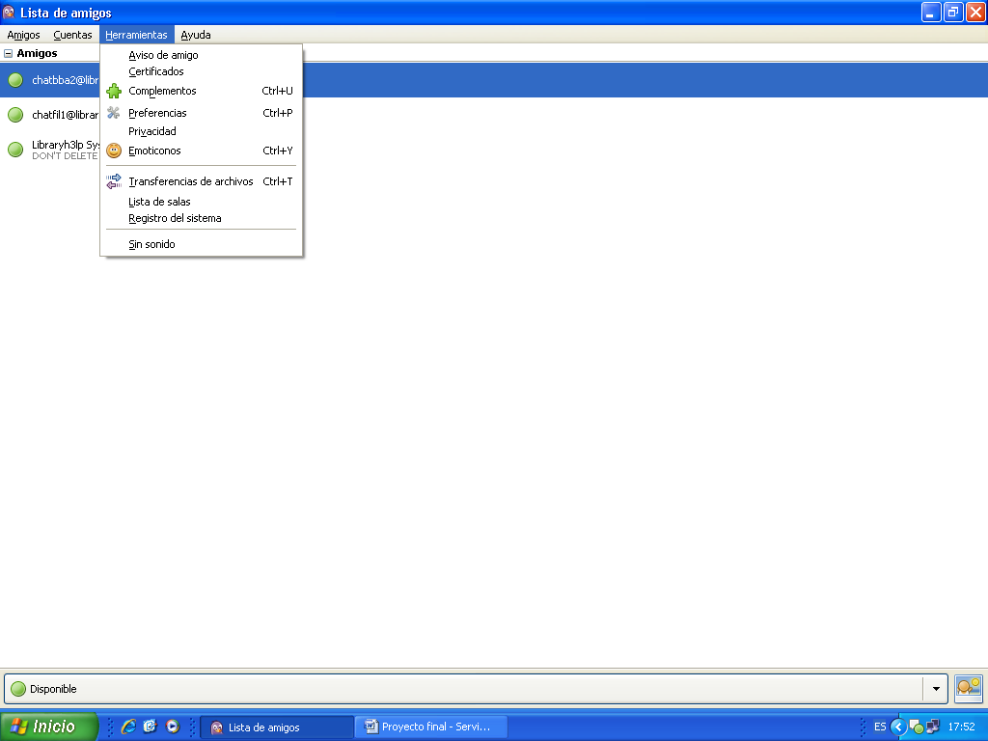
Chat Reference

Slide 20
More information: videos (Youtube chanel)
Brief history of Complutense University
http://www.youtube.com/watch?v=NJqMHdBImak&list=FLFljXfsQ5Nnmsgf23nWeRYQ
Brief history of Library
http://www.youtube.com/watch?v=710R4qxbug8&list=FLFljXfsQ5Nnmsgf23nWeRYQ
http://www.youtube.com/watch?v=CyOtcwDuEK0&list=FLFljXfsQ5Nnmsgf23nWeRYQ
Heritage collection: Biblia Políglota
http://www.youtube.com/watch?v=ABsgljCcBUA&list=UUjQQ05hXkKokuGULJRvxiUA
Cronology of Cisneros: V aniversary of Biblia Políglota
http://www.youtube.com/watch?v=ttuydbNWhpY
Exhibition of astronomy books: “From knowledge of stars”
http://www.youtube.com/watch?v=aEMghUcI1IM&list=FLFljXfsQ5Nnmsgf23nWeRYQ
Discovery tool: Bucea
http://www.youtube.com/watch?v=qVqXdiaVzpQ
Archive E-prints
http://www.youtube.com/watch?v=FajOoABihvs&list=PL1548EADE3F13CB11

Slide 21
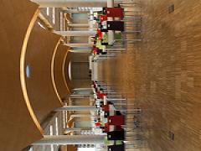
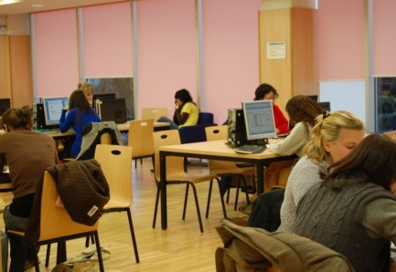
Thank you for your atention Děkuji
Rommy Arce Legua
rarceleg@ucm.es
Complutense University of Madrid Library

