Slide 2
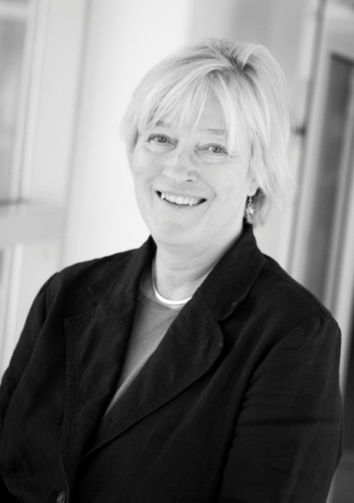
University West
Kerstin Norén
Founded in 1990
Vice Chancellor: Professor Kerstin Norén
Pro-Vice Chancellor: Jan Theliander
Chairman of the board: Eva Eriksson, former Member of Parlament
Notes:
We got a new campus 2008 so it´s a real new
We have a female vice chancellor

Slide 3
A dynamic university
The identity of the university is based on a clear focus on education, work integrated learning and research of high international quality which is both applicable and close to the labour market.
Notes:
.

Slide 4
Our profile - Work Integrated Learning
Since 2002, the university has been commissioned by the Swedish government to develop educational methods for work integrated learning within higher education, coordinated through the Forum for Work Integrated Learning and Educational Development.

Slide 5
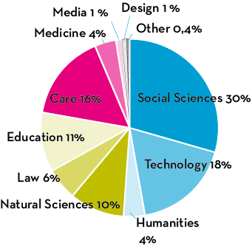
University West has more than 11 500 students and more than 5 000 full-time equivalents.
Our students
Notes:
Subjects

Slide 6
Our education
University West offers undergraduate- and post graduate studies within the following areas of interest:
Computing and IT
Economy and Leadership
Health and Care
Education and Language
Media
Individual and Society
Technology
Notes:
100 new nurses student every semester

Slide 7
Research
Authorized to issue doctorates in two areas – WIL and production technology
Research is conducted in cooperation with the surrounding community and is dominated by technology and social science.
Robotics
Welding
Notes:
WIL and PT
Welding and robotics

Slide 8
Cooperation with universities in:
Approximately
250
International students per year
Europe, North and South America, Australia, Africa and Asia.

Slide 9
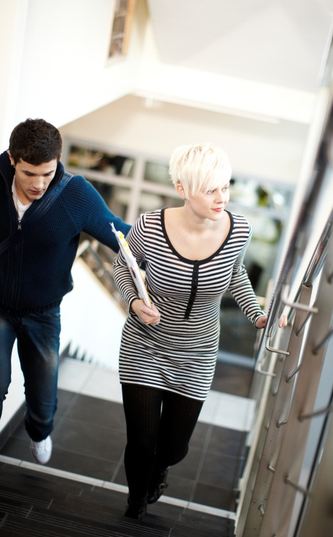
A Campus Built for students
Campus building located in the heart of Trollhättan, close to shops, cafés or a stroll along the riverside.
Library with very good computer facilities.
Two restaurants/cafeterias seating in total 300 people
More than 50 group rooms for studying
5 student kitchenettes with dining areas
Auditorium seating 500 people
Excellent access to computer work stations

Slide 10
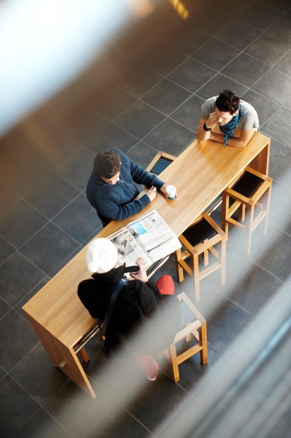
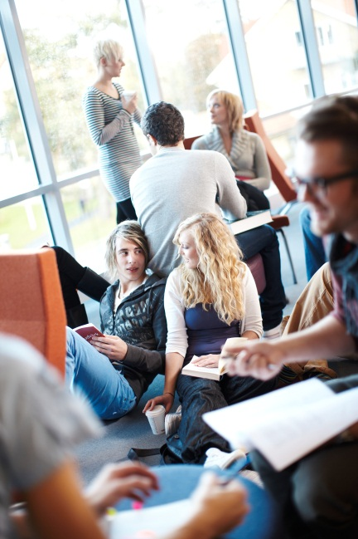

Slide 11
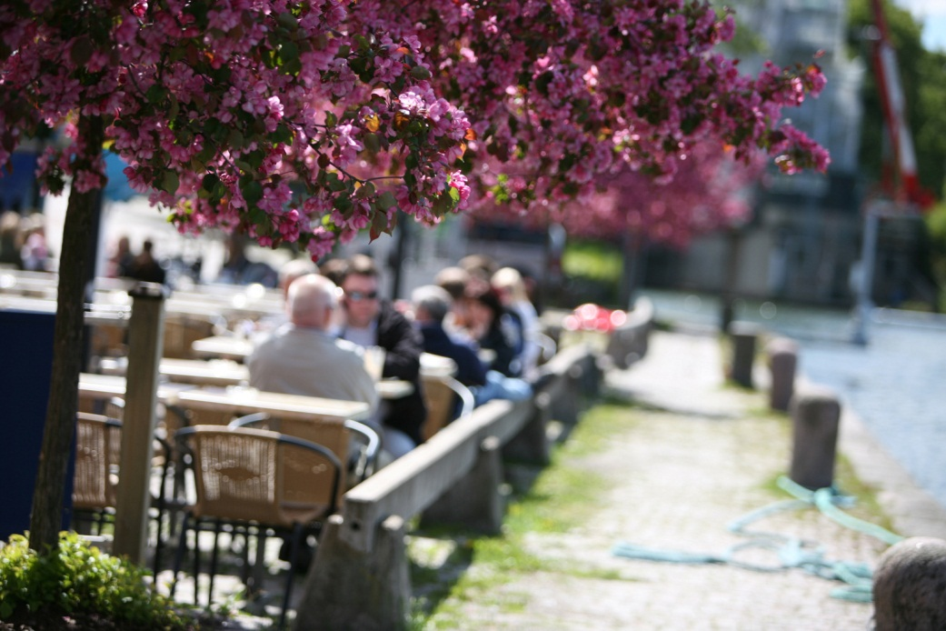
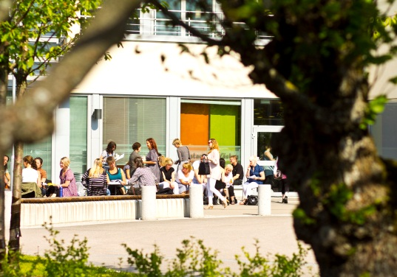
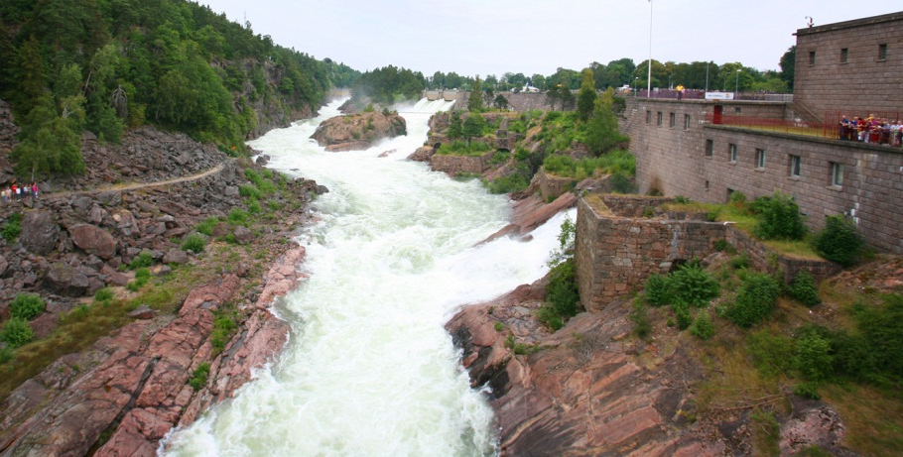
Trollhättan
A small town in the south central of Sweden, approximately 60.000 inhabitants

Slide 12
Our library - in short
Two floors in the middle of the building.
11 librarians and 4 library assistants
Aleph and Primo
Dewey our classification system – also on shelf
About 50 000 titles in physical items
We invest in electronic media, E-journals and E-books
We subscribe to 50-60 databases in different subjects
We teach information literacy about 300 hours per year
BB twitter fb chat ezproxy

Slide 13
A visit to our library
https://www.youtube.com/watch?v=2-0xqC77Xk4

Slide 14
Use your mobile device academically! New project
The University library regularly arranges seminars on usage of tablets and smartphones in the academic life.
We demonstrate ways to read articles and books on mobile devices, and give off tips on useful apps to use for example note-taking. We also discuss the usage of cloud-services and the problematic usage rights around e-books.
such as

Slide 16
http://hv.se.libguides.com/engineering

