Slide 1
ABOUT ME!
I graduated from the department of Information
Management, Hacettepe University in 2001. In the
same year I started to work at Erol Ucer Music Library
of the Centre for Advanced Studies in Music, Istanbul
Technical University (ITU). There I cataloged almost
17.000 books, music scores and audiovisiual material
besides other library duties. I have been working as a
reference librarian for 4 months at the main library of
ITU.

Slide 2
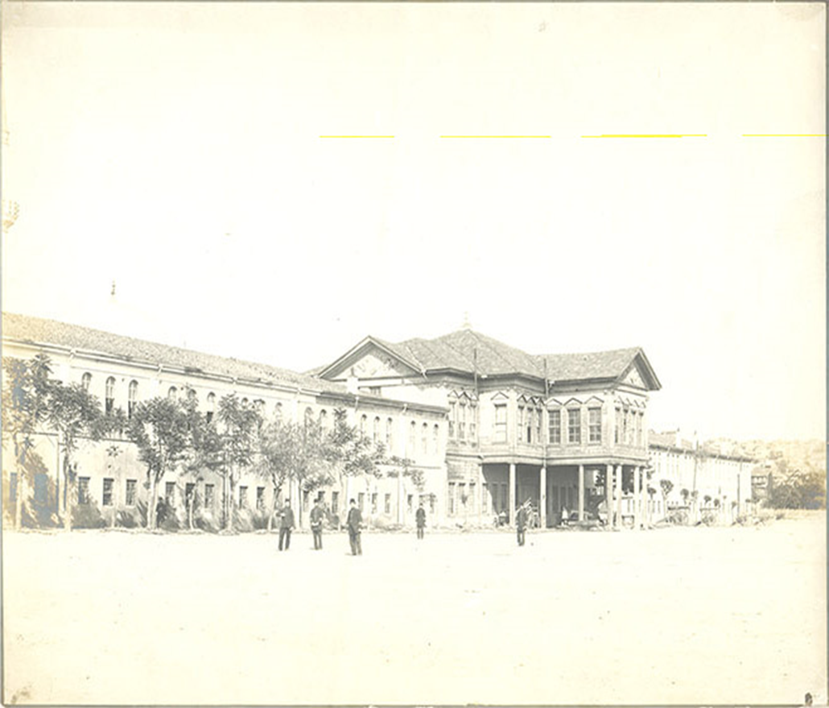
İSTANBUL TECHNICAL UNIVERSITY
HISTORY
ITU was founded in 1773 with the name “Mühendishane-i Bahr-i Hümayun” (Imperial School of Naval Engineering) during the Ottoman Empire and served for training map and ship engineers in western techniques and technologies . The university’s first place was at Haliç Tersanesi
ITU was founded in 1773

Slide 3
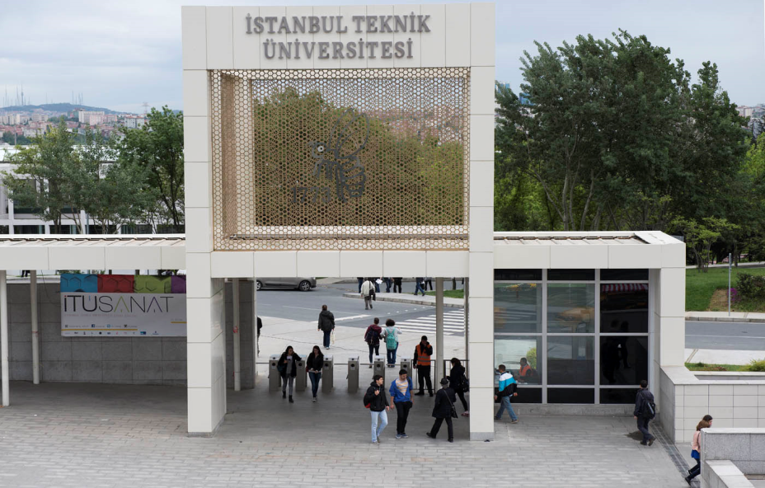
NOW
Istanbul Technical University has 5 campus, 13 faculties, 6 institutes,more than 450 professors, 2.500 academics, over 30.000 students.
Education is delivered in many languages (English being one of the main ones) in the university.
The university also provides students many opportunities for socializing like; olympic size swimming pool, gym, football field and cultural clubs etc.
Also, İTU Stadium hosts many famous music groups and artists . For example: Metallica, Justen Timberlake, Rihanna and Lady Gaga is coming next September..

Slide 4
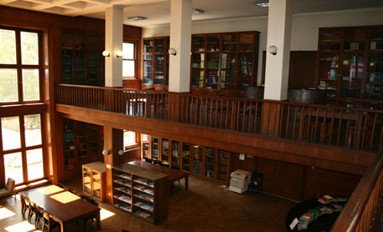
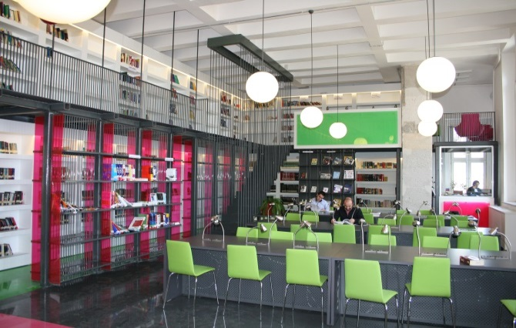
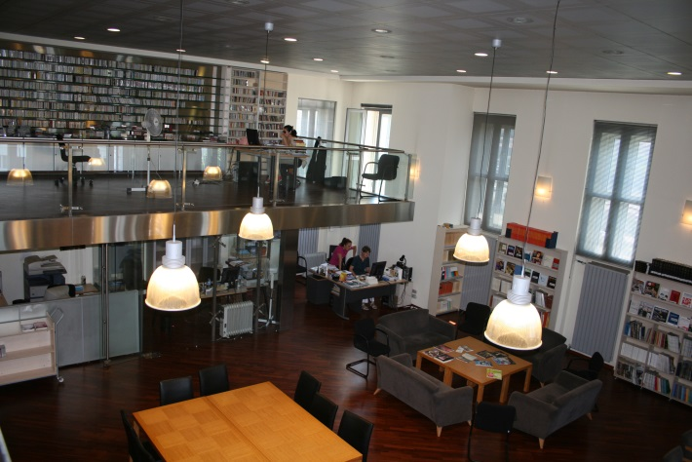
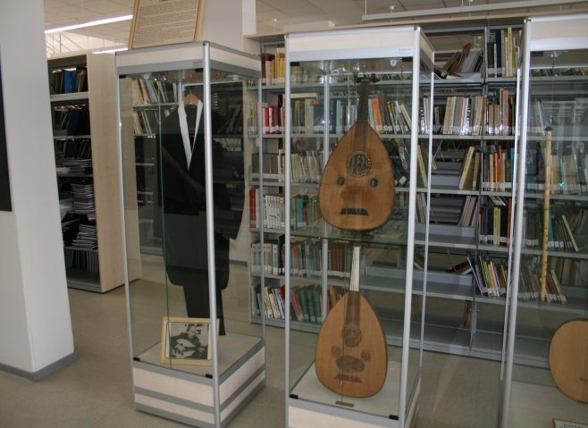
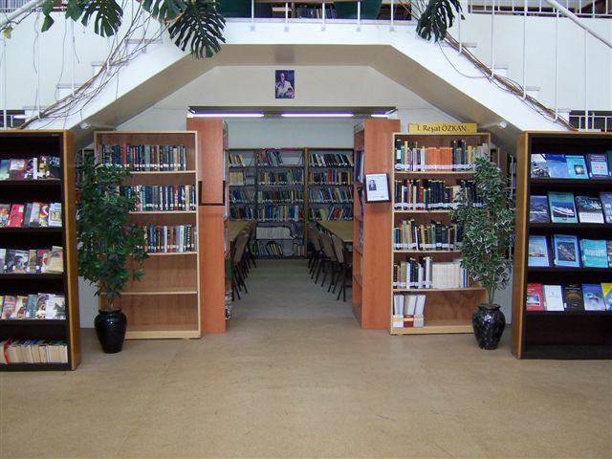
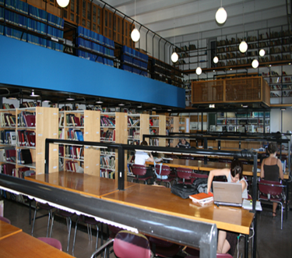
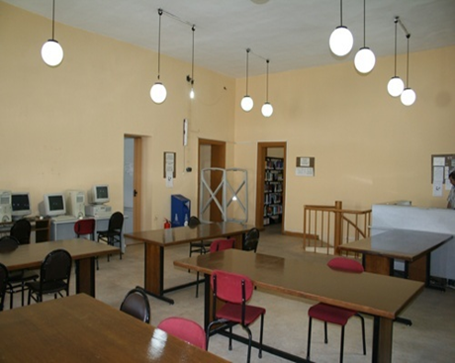
İTU LIBRARIES
Main Library (Maslak)
Mechanical Faculty Library (Gümüşsuyu)
School of Foreign Languages Library(Maçka)
Conservatory Library(Maçka)
Advanced Music Studies Library(Maçka)
Maritime Faculty Library(Tuzla)
Management Faculty Library(Maçka)
Architecture Faculty Library(Taşkışla)

Slide 5
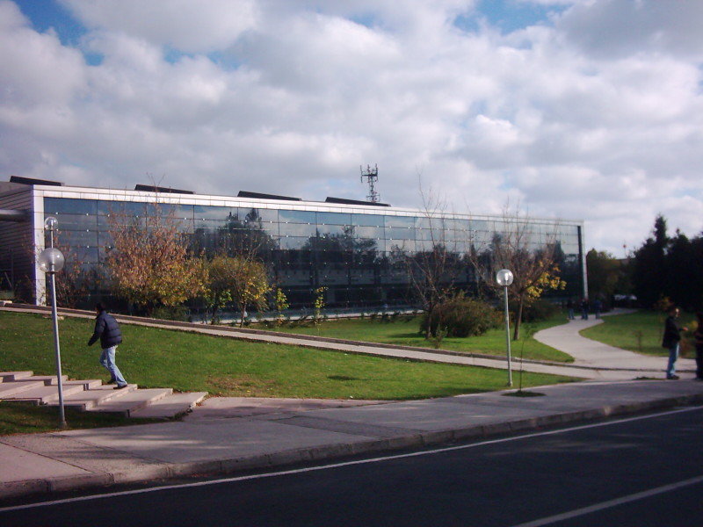
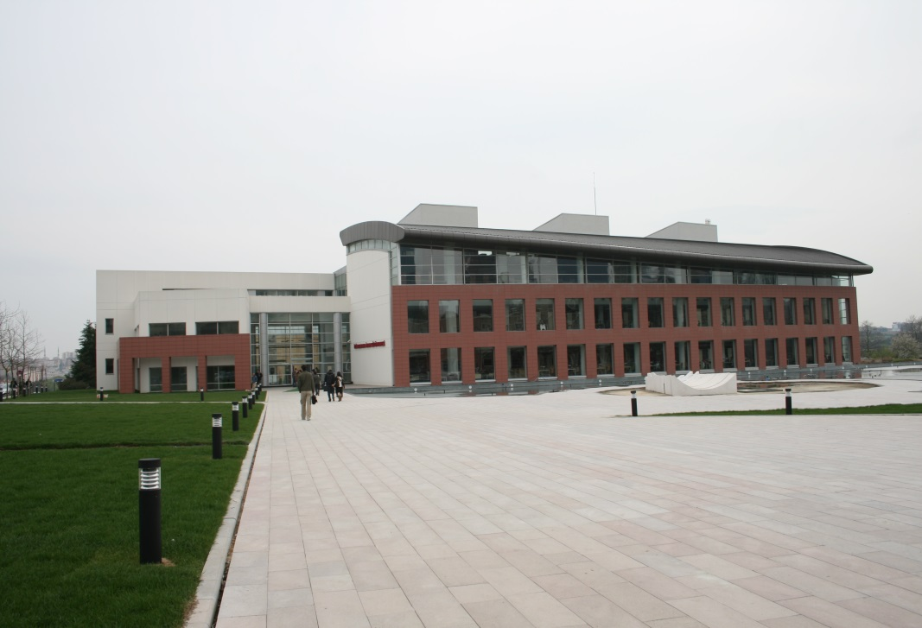
İTU LIBRARIES
HISTORY
The history of Istanbul Technical University library dates back to the Mühendishane-i Berri-i Hümayun which was established in 1795. The first library regulations were prepared in 1797. Mühendishane printing house which was founded in those years were the source that has sustained the library.
Today knowledge services at ITU are sustained on 5 campuses with 8 libraries. Library services are given at Mustafa İnan Library in Ayazağa Campus and at 7 branch libraries in Maçka, Taşkışla, Gümüşsuyu and Tuzla campuses
Mustafa İnan Library which serves as the central library in Ayazağa Campus has moved to its new premises in 2007
Old Library Building
Today’s Library Building

Slide 6
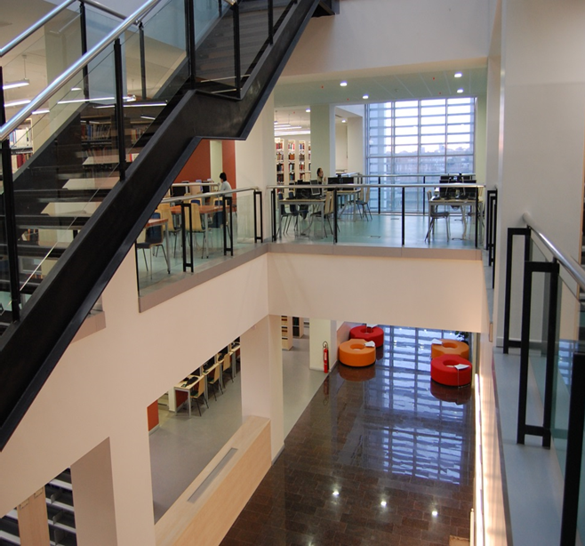
İTU MAIN LIBRARY BUILDING INFORMATION
5 floors (10,000 square meters area )
1 meeting room and 1 conference hall
1,250 seating capacity
82 user computers
Wireless network at every floor
Security control with 62 cameras
Fire extinguishing system with gas and water, and earthquake gas cut-off sensor
Air condition

Slide 7
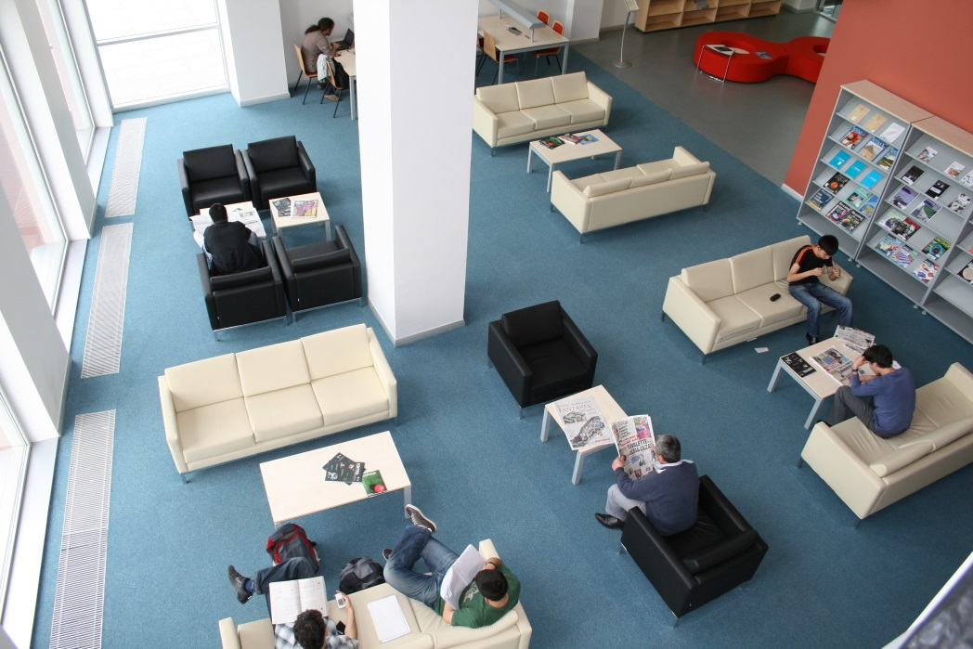
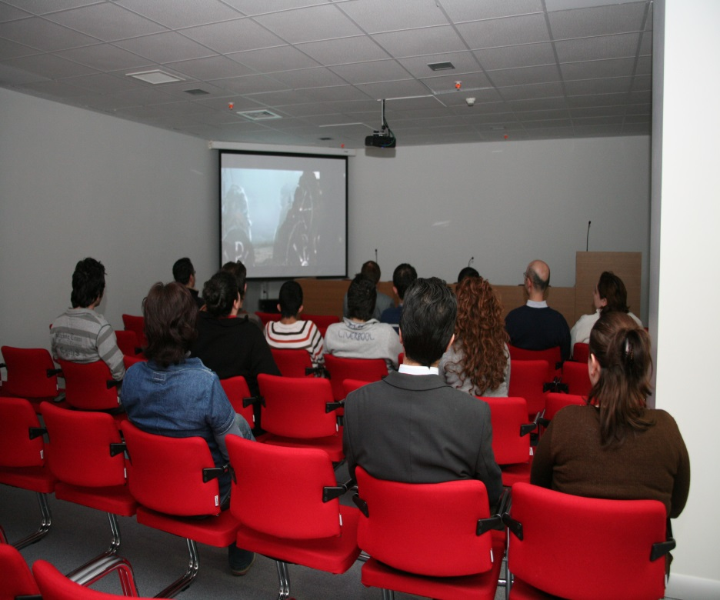
Materials are located to three floor. The library follows the system of open shelves but users can have access to rare collections with the help of the librarian
.
The Library members can read daily
newspaper or monthly magazines on the first floor (picture.1)
Picture:1
If members want to watch Library visual materials with a group in the library, they must reserve the conference saloon which has a capacity of 80 people (picture.2)
Picture:2

Slide 8
THE MAIN LIBRARY DEPARTMENTS AND PERSONNEL
Administration : 1 Library Director, 2 Branch Manager and 1 Secretary
Collection Development : 8 Persons
Cataloging Services : 10 Persons
E-Resources and Periodicals: 9 Persons
Circulation and ILL: 12 Persons
IT: 4 Persons
Publicity Organizations and Academic Relations: 1 Person
Shelving : 11 Persons
Technical Services : 2 Persons
Support Services : 10 Persons

Slide 9
THE LIBRARIES COLLECTION
İTU Library collection includes ;
537.000 printed books,
167 databases which includes 198000 e-books, 87163 e-journals and standards
18512 theses,
15.000 audiovisual materials,
5000 rare collections,
5000 maps.

Slide 10
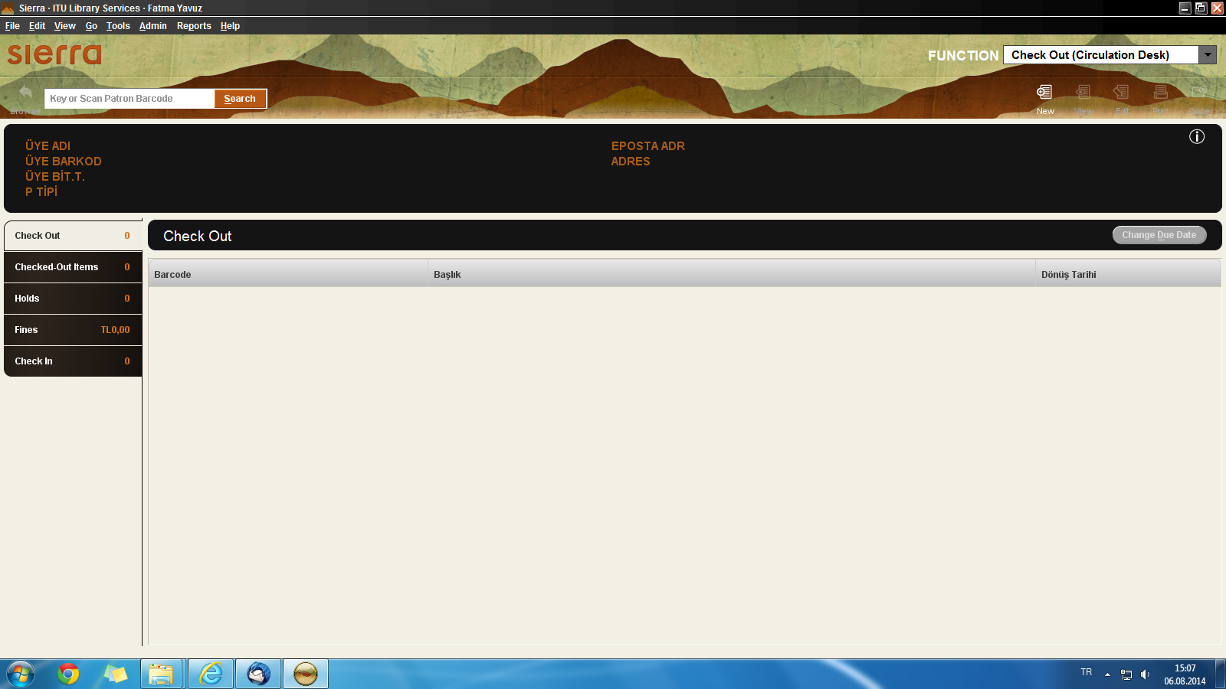
THE LIBRARY AUTOMATION SYSTEM
In 1997, work on an automation system that covered all ITU libraries begun and as a result ‘’Innopac Library Automation System’’ which is widely used in universities all around the world were begun to be used. From January 1998, all library resources were automated.
ITU libraries are based on an open access shelf system; there exists an efficient system of inter library loans and supply of periodicals. Books that are bought and periodicals subscribed to are announced through the library web page.
ITU Library Automation System is Sierra. The Library collection is classified according to Library of Congress Classification System.

Slide 11
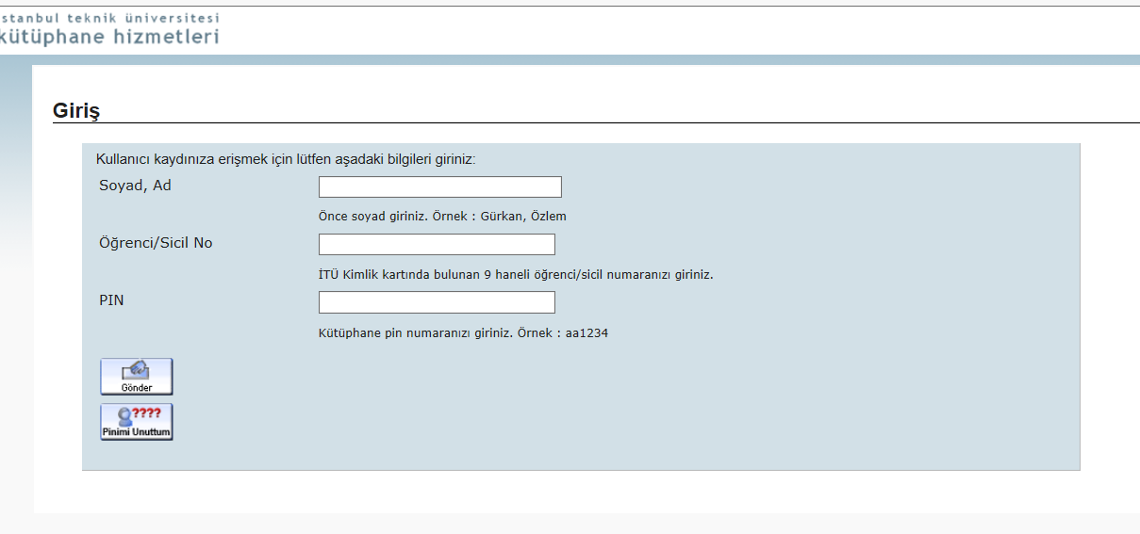
The Library system can be reached through http://www.library.itu.edu.tr/ web address. If members want to connect out of campus they must use their University ID Numbers and PIN. Below picture shows out of campus connection:

Slide 12
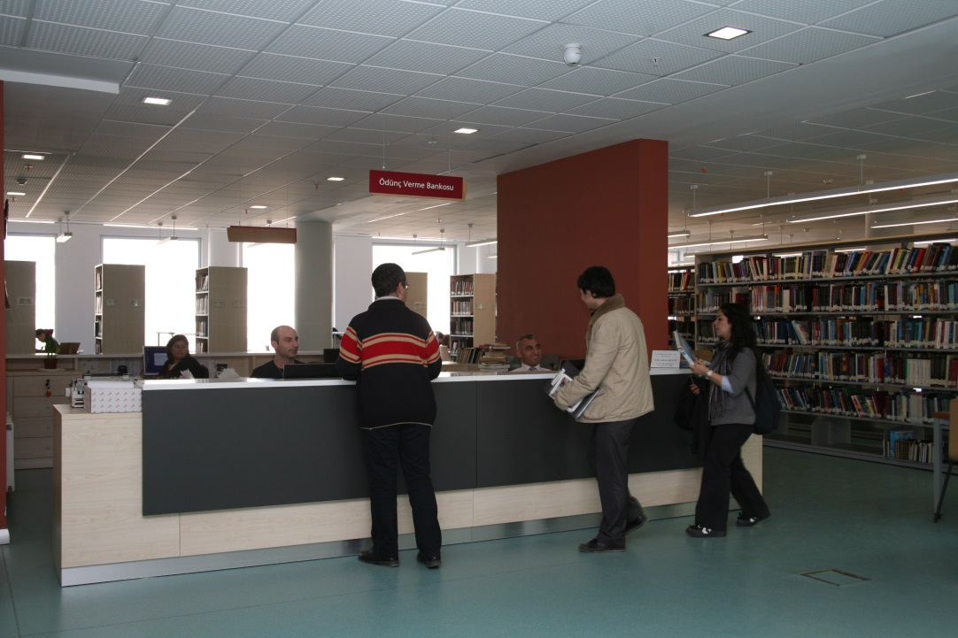
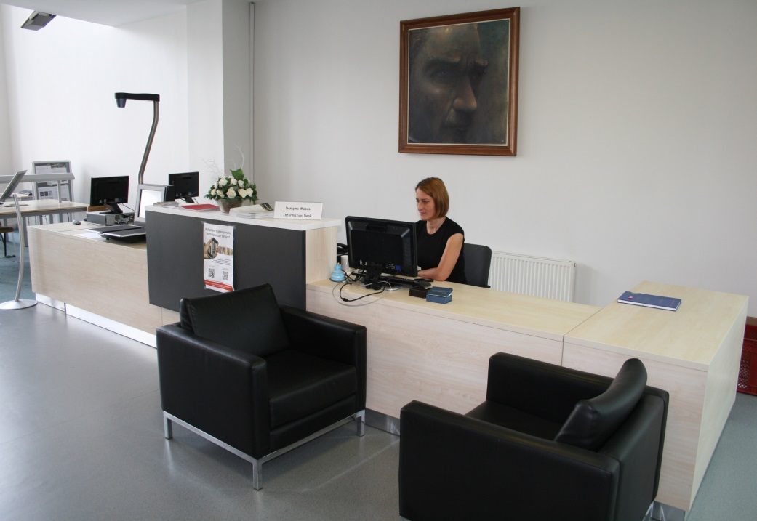
İBRAiiiiiİİİRE LIBRARY HOURS ANDRULES
LIBRARY WORK HOURS AND RULES
Circulation desk
Information desk
Main Library is open 24 hours/7 days. Other Branch Libraries working hours are between 8:30 –
17:30 and they are close at the weekend.
The Library Members;
Professors and other academicians can check out 30 books for a month with 4 renewals
Doctorate and Master Degree student can check out 15 books for 15 days with 3 renewals
Undergraduate students can check out 10 books for 15 days with 3 renewals
Officers can check out 10 books for a month with 3 renewals
Retired İTU Members can check out 5 books for a month with 3 renewals
If a member is a researcher from another university they can use material only in the library
There is no photocopy service in the library but if users need, they can scan % 20 of material to
theirs USB.

Slide 13
If you need more information about us please visit our university and library web pages:
http://www.itu.edu.tr
http://www.library.itu.edu.tr
THANK YOU!!
FATMA YAVUZ
yavuzf@itu.edu.tr
Librarian
İstanbul Technical University
Mustafa Inan Main Library
İstanbul, Turkey
Photos by Faik Keskin

