Slide 1
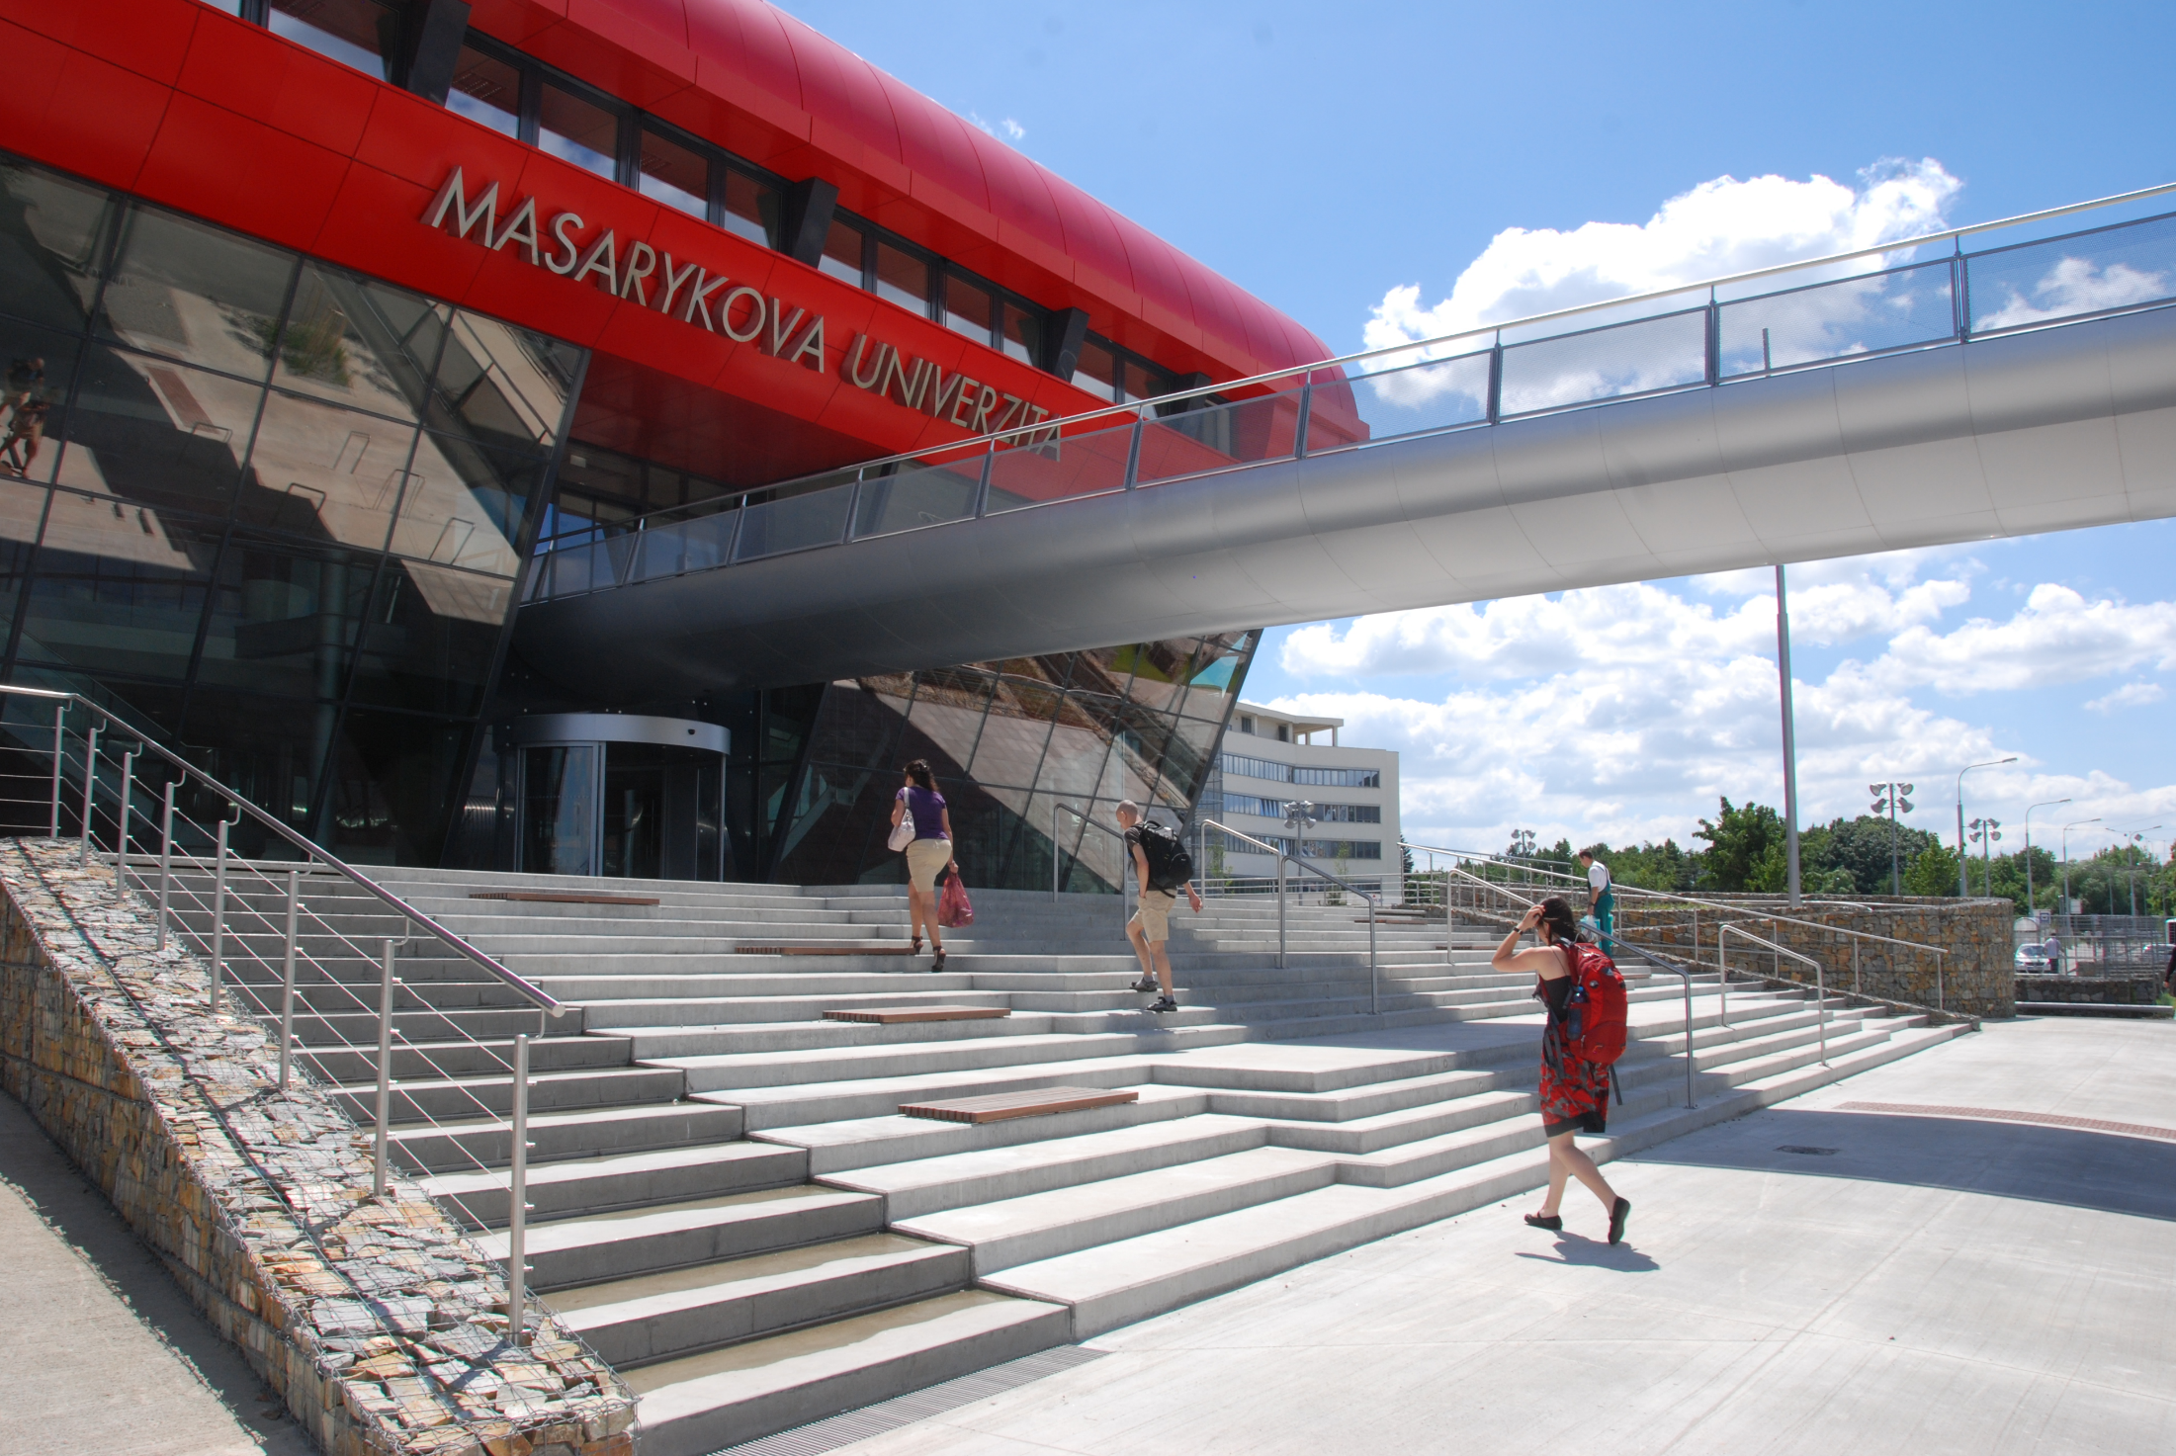
E-learning course
vsiv021 Information literacy:
best practices
Jiří Kratochvíl
kratec@ukb.muni.cz
549 49 3710

Slide 2
Conditions at the MU
The MU Information System (www.is.muni.cz) includes e-learning modules based on the Moodle system
The MU Information System is directly connected to all teacher and student administrative applications
Masaryk University offers full free support of preparing
e-learning courses – creation of study materials, help
with using all applications etc.

Slide 3
Why the course exists?
The need of developing medical students‘ information literacy skills:
Searching scientific informations
Evaluatin of information sources
Scientific writing
Citing
Spring 2008 – face-to-face
From autumn 2008 – e-learning

Slide 4
Why e-learning?
To increase a number of course graduates
F2F

Slide 5
Why e-learning?
Time and Space Flexibility
The number of opening study materials
during a week in a specific term

Slide 6
Why e-learning?
Saving a time spent by teaching
Classic lessons at the Fac. of Science and Fac. of Medicine
 | Number of students | Number of hours
Autumn 2005 | 18 | 11
Autumn 2006 | 46 | 34,5
Spring 2007 | 30 | 25
Autumn 2007 | 24 | 36,5
Spring 2008 | 58 | 78
CELKEM | 176 | 185
E-learning LF
 | Number of students | Number of hours
Spring 2011 | 52 | 27
Autumn 2011 | 128 | 67
CELKEM | 180 | 94

Slide 7
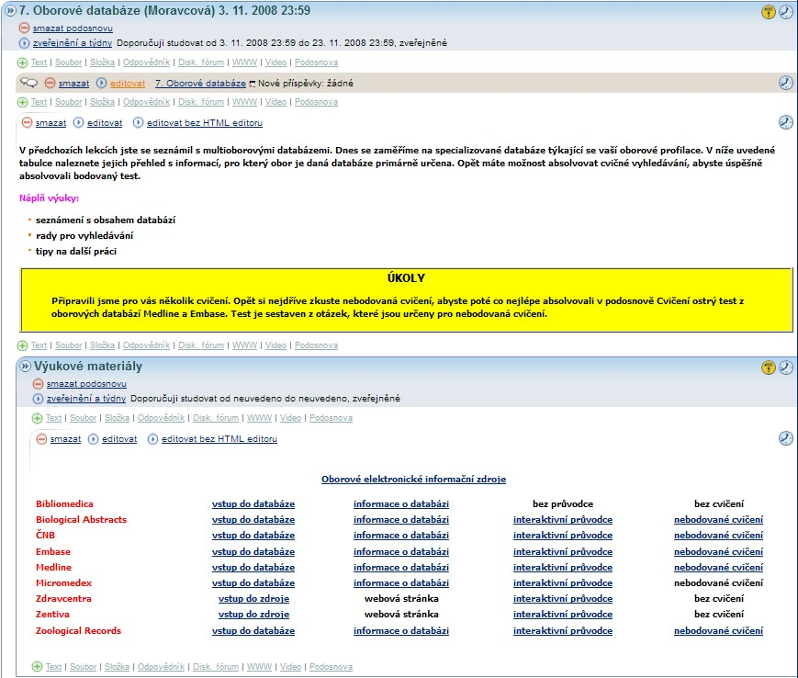
Best practice: syllabi
autumn 2008: let‘s start!

Slide 8
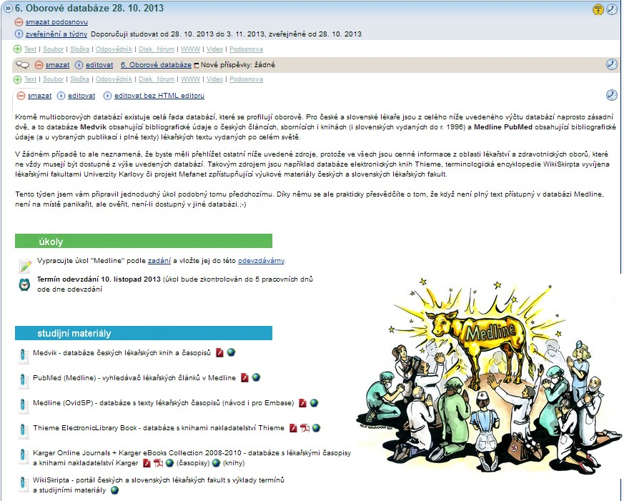
Best practice: syllabi
autumn 2013: finally, I hope…

Slide 9
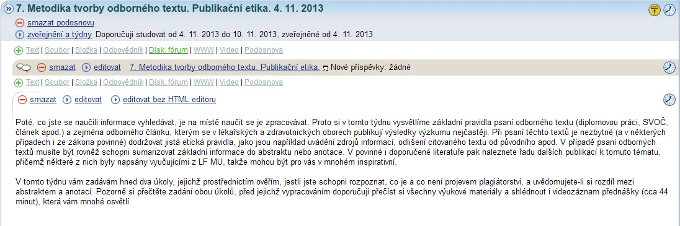
Best practice: syllabi topics
what about a topic is
description of tasks and their necessity

Slide 10
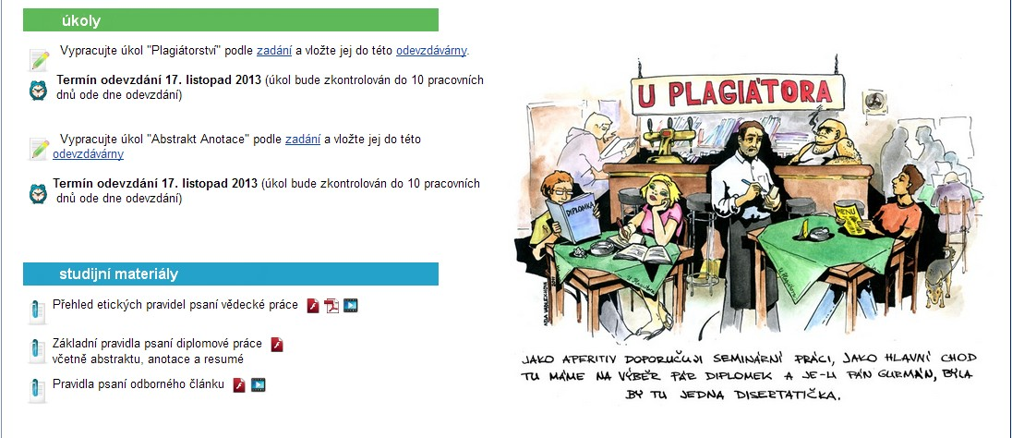
Best practice: syllabi topics
links on tasks assignment and homework vaults

Slide 11
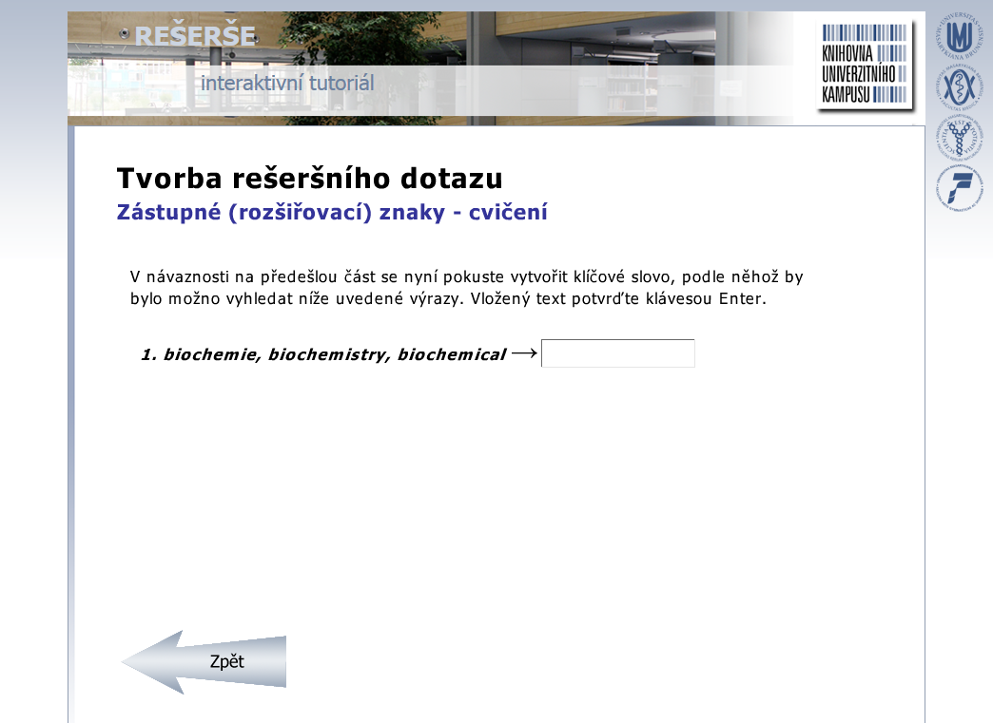
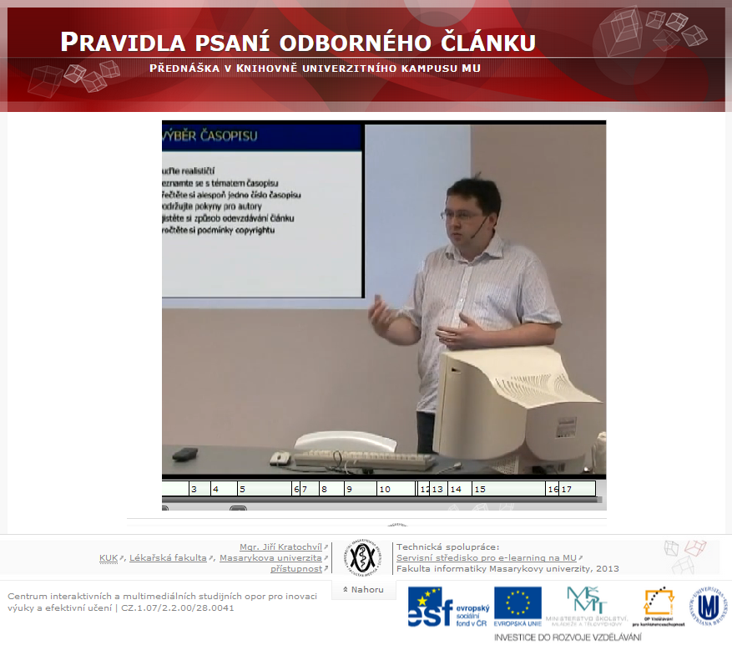
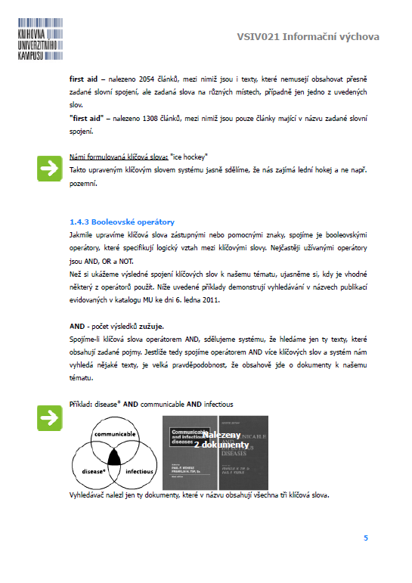
Best practice: study materials
various types of study materials

Slide 12
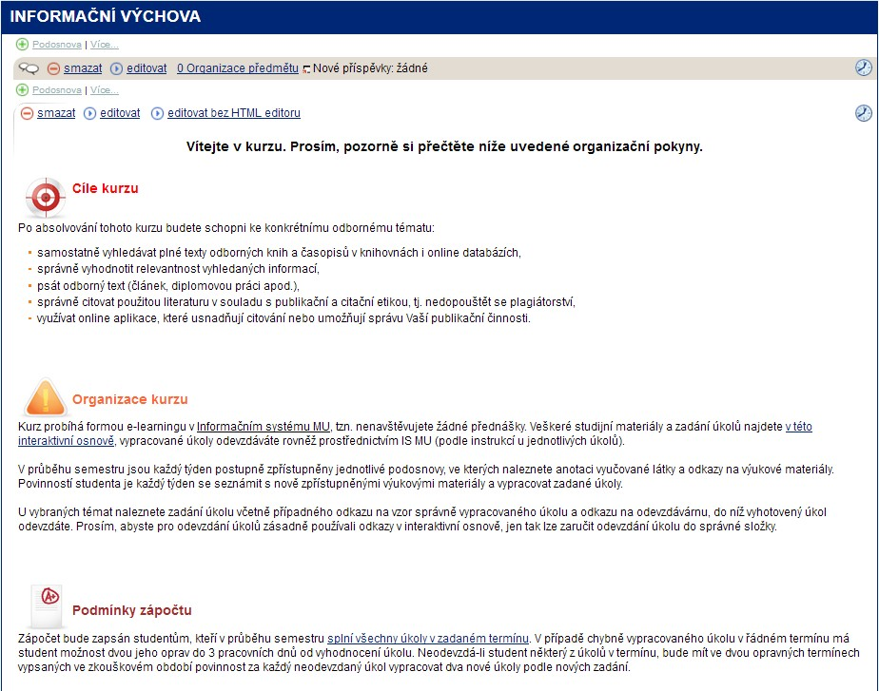
Best practice: course rules

Slide 13
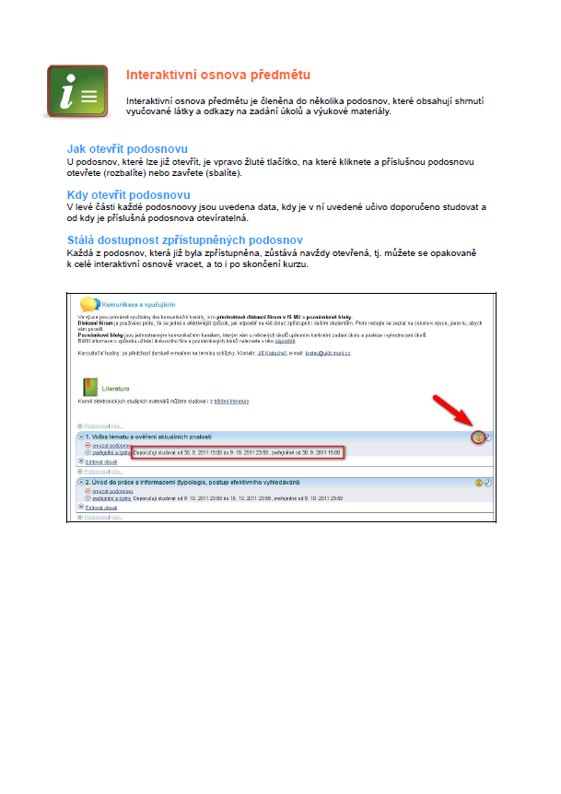
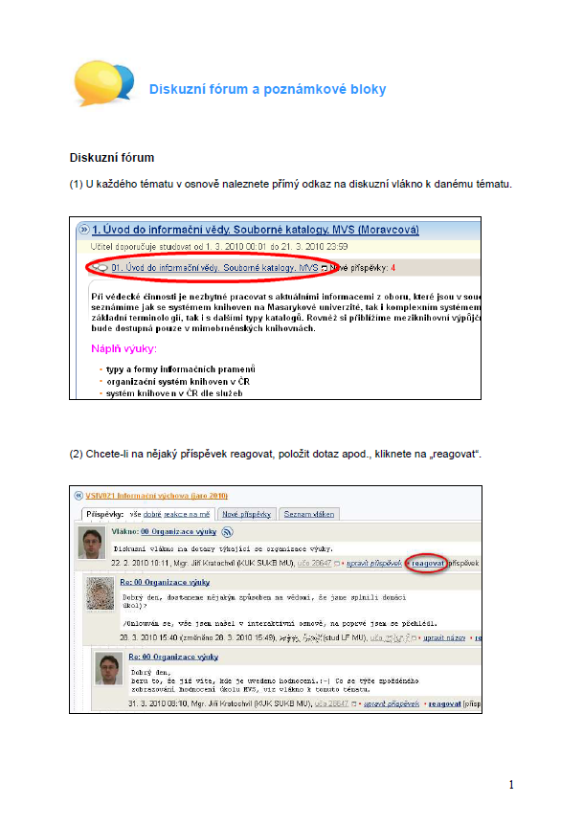
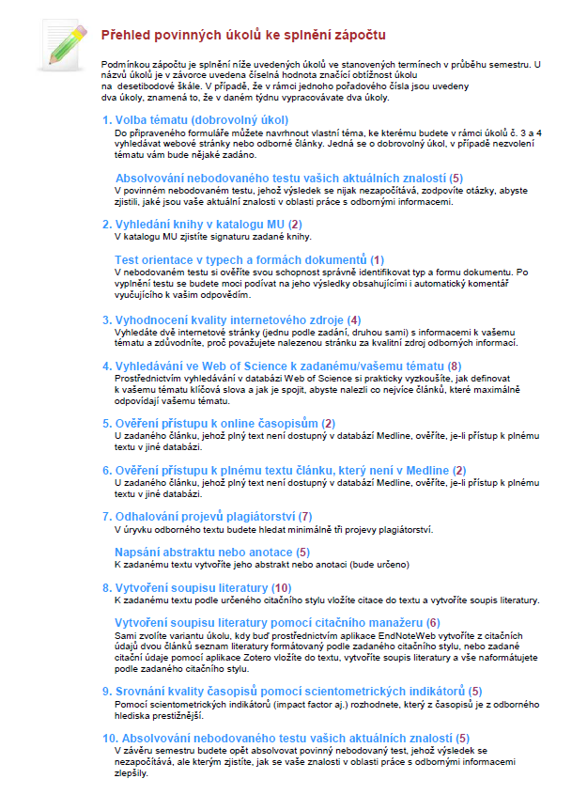
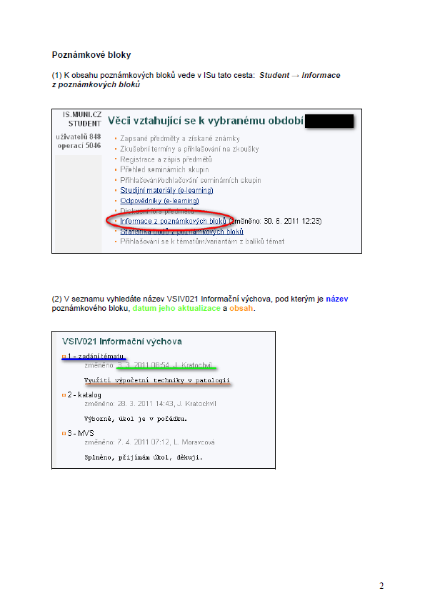
Best practice: course rules
working with the interactive syllabi
using discussion forum
how to show notepads
a list of tasks and their difficulty

Slide 14
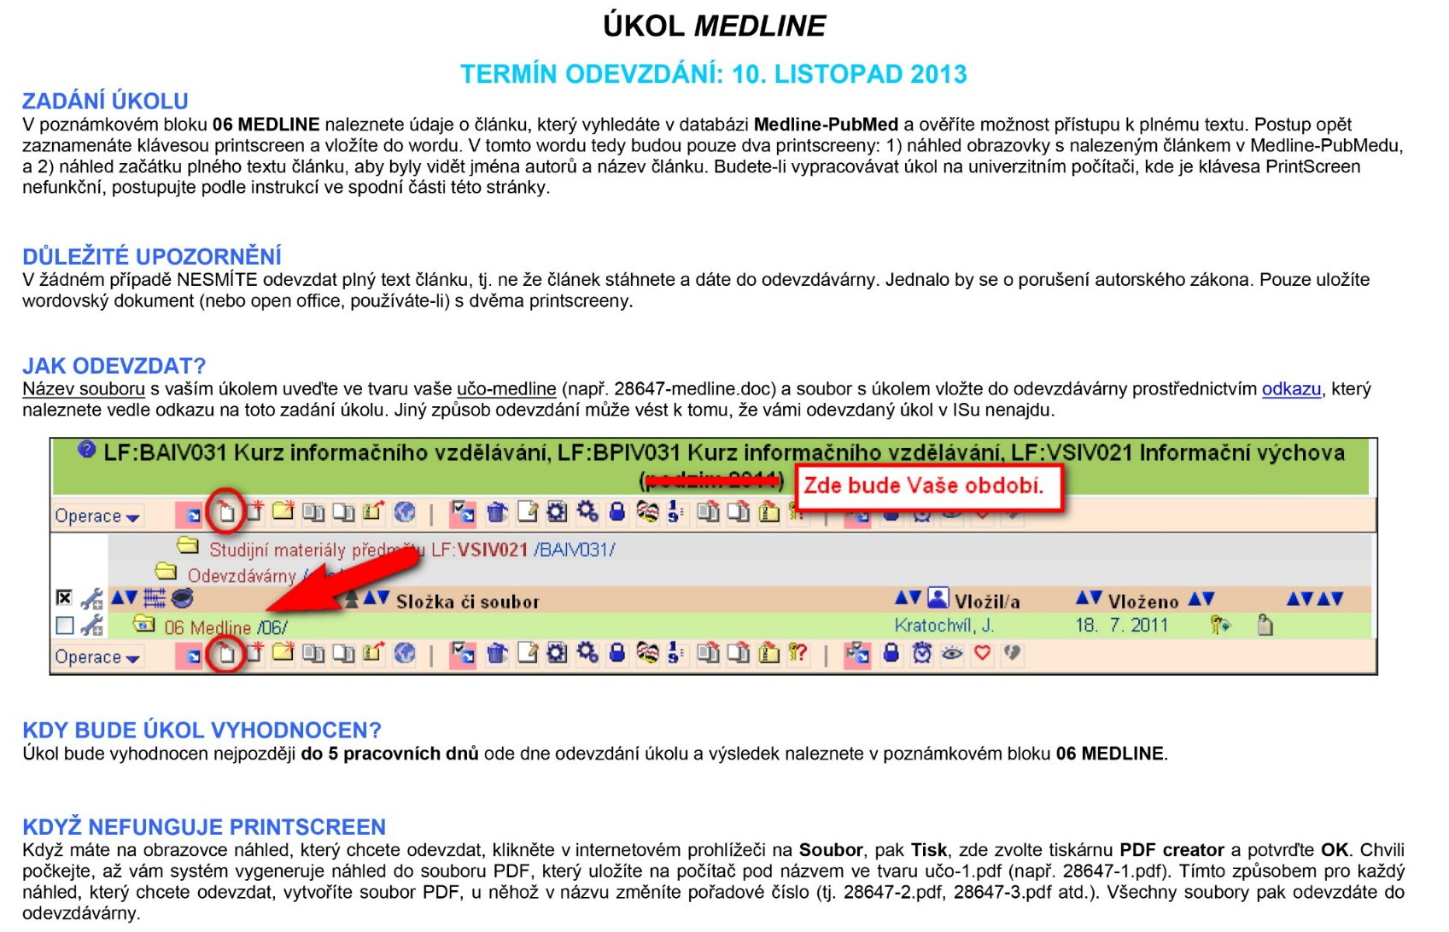
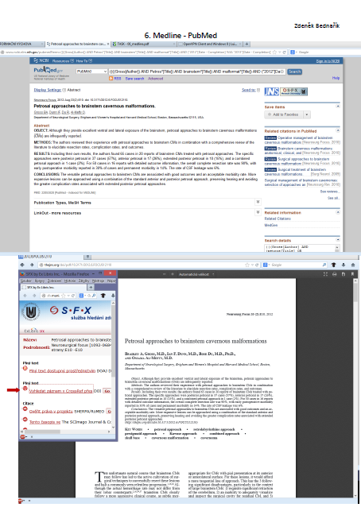
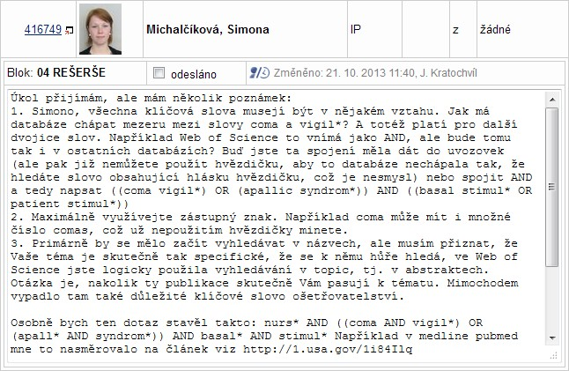
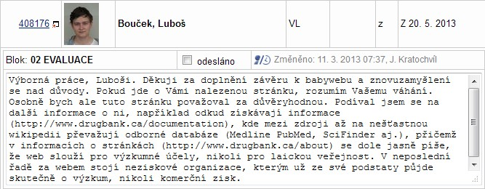
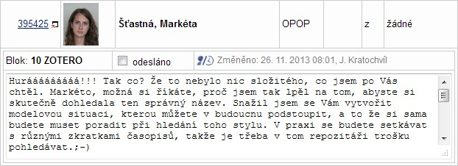
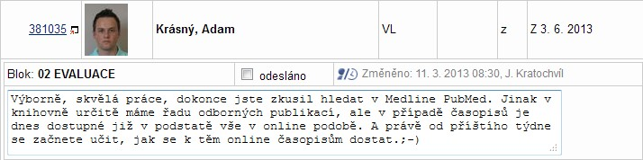
Best practice: tasks
minor tasks (e.g. linking service)
quickly evaluation of tasks
individual approach to a student
specifications of task submission (e.g. PrtScr)
motivating by weekly tasks
Note.: Screens are used with students‘ written agreement.

Slide 15
Evaluation: did they learn anything?

Slide 16
Evaluation: satisfaction with e-learning?

Slide 17
EXPERIENCES
DISADVANTAGES |  | ADVANTAGES
Difficult preparing |  | More time for course innovation
More students fail the course |  | More students can study the course
Lower motivation of students for selfstudying |  | Time flexibility for teachers and students
Necessity of being familiar with applications of the MU IS |  | Ideas to enhance e-learning applications
Time-consuming and methodically difficult preparing of the study materials |  | Unlimited availability of study materials for students
Loss of the F2F contact with students |  | Mass communication
 |  | Possibility to effective directing of taught topics

Slide 18
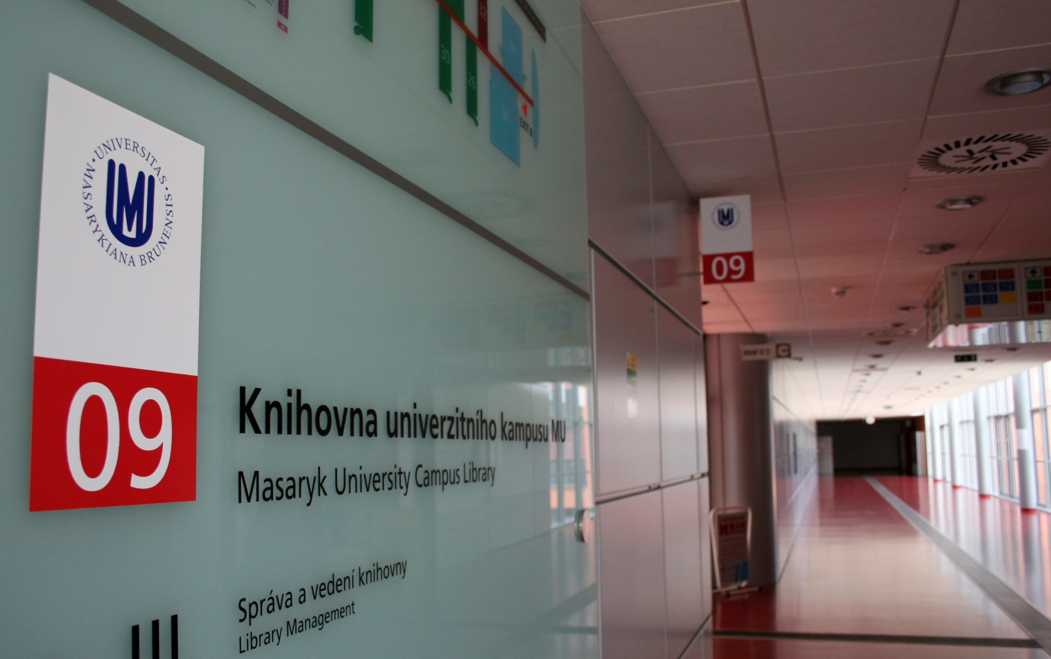
THANK YOU
FOR YOUR ATTENTION

