Slide 1

Evaluation of Information Literacy Education
Mgr. Gabriela šimková (faculty of arts, masaryk university)
Mgr. Jiří Kratochvíl, ph.d. (the MU Campus Library)

Slide 2
Measuring effectiveness: main reasons
„E-learning can be a powerful tool – it is scalable and less expensive than traditional training (...). But after spending a lot of money on infrastructure and content, how do you know if your e-learning content or program is really effective?“
Learning activities focusing students‘ needs
Knowledge – Skills – Attitudes
Evidence-Based Learning Approach (continual research as a precondition for more effective achievement of educational goals defined within information literacy (IL) education)
Key project activity

Slide 3
Measuring as a continuing process
Educational needs analyse
Measuring methodology design
Measuring before activity
Learning activity
Measuring after activity

Slide 4
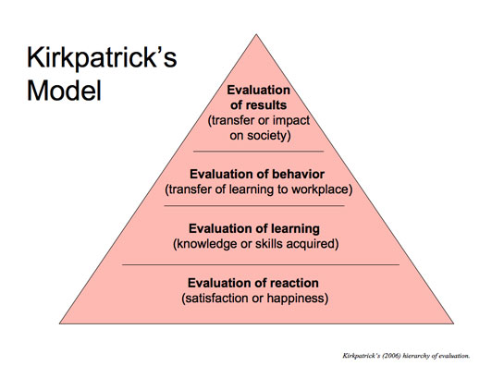
Kirkpatrick’s Four-Level Model
Our aim: to strength students’ satisfaction and learning results
The first level tries to evaluate immediate students’ reactions to an educational activity (environment, content and the lecturer) - short paper questionnaires (smile-sheets)
The second level explores the change in knowledge and skills - a pre- and a post-test
The third level tries to identify the long-term change in participants’ behaviour - qualitative methodology, specifically a focus group series and 360-degree feedback
The fourth level is focused on the return on investment in education

Slide 5
About Model
introduced already in 1959: a reaction to the increasing pressure on proving the effectiveness, value and benefit of education for business.
one of the most widespread models for education evaluation
well reflects the current constructivist conception of instruction
comprised of four hierarchically ordered levels revealing, one by one, the levels of effectiveness of the educational process

Slide 6
Level 1: Immediate Reaction to Education
Key question: To what extent were the participants satisfied with the educational activity?
to evaluate immediate students’ reactions to an educational activity (a seminar, a workshop, an e-learning module, etc.)
how participants feel about the various aspects of a training program
a clear research goal, understandable questions, and quantifiable answers, ensure anonymity of participants and the possibility of adding a comment
We assessed students’ satisfaction with the study environment, study content and the lecturer

Slide 7
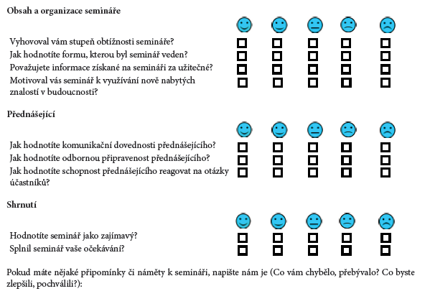
About smile sheets:
type of tool displaying immediate students' response to the educational activity
a target group comprised mainly of students aged between 20 and 25
the design of the questionnaire was based on an adjusted five-point Likert scale
instead of an evaluation reaching from "extremely satisfied" to "not at all satisfied", consisted of five smileys indicating the level of satisfaction with a particular aspect
The three main aspects evaluated by this questionnaire are: content and organization of the seminar, the instructor and overall assessment of the lesson.

Slide 8
Measuring of participants’ satisfaction at the MU Campus Library

Slide 13
Level 2: Gained Knowledge
Key question: To what extent did the participants obtain the expected knowledge and skills as a result of attending the educational activity?
explores the change in one or more areas of participants’ knowledge, skills or attitudes due to education activity
This change is expressed by the quantity of knowledge transferred during a lesson
quantitative methods with statistical evaluation when knowledge is measured both prior to and after the lesson for a comparison (a pre-test, a post-test)

Slide 14
Measuring of gained knowledge: e-learning Course of Information Literacy, pre- and post-test autumn 2013 (n=1184)

Slide 15
Measuring of gained knowledge: e-learning Course of Information Literacy, pre- and post-test autumn 2013 (n=

Slide 17
Level 3: Long-Term Effects
Key question: To what extent do the participants apply the knowledge and skills obtained to their everyday work?
to identify the long-term change in participants’ behaviour with the benefit of hindsight (e.g. three to six months after the lesson)
methods used for third-level measurements usually have a qualitative character:
  an interview, finding out the views of students or teachers who work with the person who attended the course
  focus group - Small number of people (usually between 4 and 15, but typically 8) brought together with a moderator to focus on a specific topic (satisfaction with study materials, communication aspects...). Focus groups aim at a discussion instead of on individual responses to formal questions, and produce qualitative data (preferences and beliefs) that may or may not be representative of the general population.

Slide 18
Level 4: Results
Key question: To what extent have the planned objectives of a development project and subsequent support activities been achieved?
shows the tangible results of a programme and is accepted mainly in the commercial sphere because it is focused on the return on investment in education

Slide 19
References
1. Eldredge, J.: Evidence-Based Librarianship: searching for the needed EBL evidence. Medical Reference Services Quarterly. 3, 1-18 (2000)
2. Davies, P.: What is evidence-based education?. British Journal Of Educational Studies. 2, 108-121 (1999)
3. Smith, A.: Scientifically Based Research and Evidence-Based Education: A Federal Policy Context. Research & Practice for Persons with Severe Disabilities. 3, 126--132 (2003)
4. Kirkpatrick, D.: The Four Levels of Evaluation: Measurement and Evaluation. American Society for Training & Development Press, Alexandria (2007)
5. Kirkpatrick, D. Seven Keys to Unlock the Four Levels of Evaluation. Performance Improvement. 45, 5--8 (2006)
6. Explorable: Pretest-Posttest Designs, https://explorable.com/pretest-posttest-designs
7. Kirkpatrick, J.: The Hidden Power of Kirkpatrick's Four Levels. T+D, 61(8), 34--37 (2007)
8. Naugle, K.A., Naugle, L.B., Naugle, R.J.: Kirkpatrick’s Evaluation Model as a Means of Evaluating Teacher Performance. Education. 1, 135--144 (2000)

