Slide 1
MUST Week
Projects and activities of the Division of Information and Library Studies (KISK)
PhDr. Michal Lorenz, PhD.

Slide 2
Plan
Digital curation
Skills of librarian
Collaboration
Electronic publishing
Readership supporting projects
Community building

Slide 3
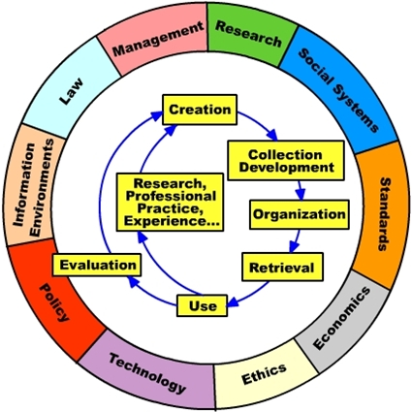
KISK

Slide 4
Digital curation
projects portal - http://www.knihovna.cz/
tools - nastroje.knihovna.cz
opensource.knihovna.cz

Slide 5
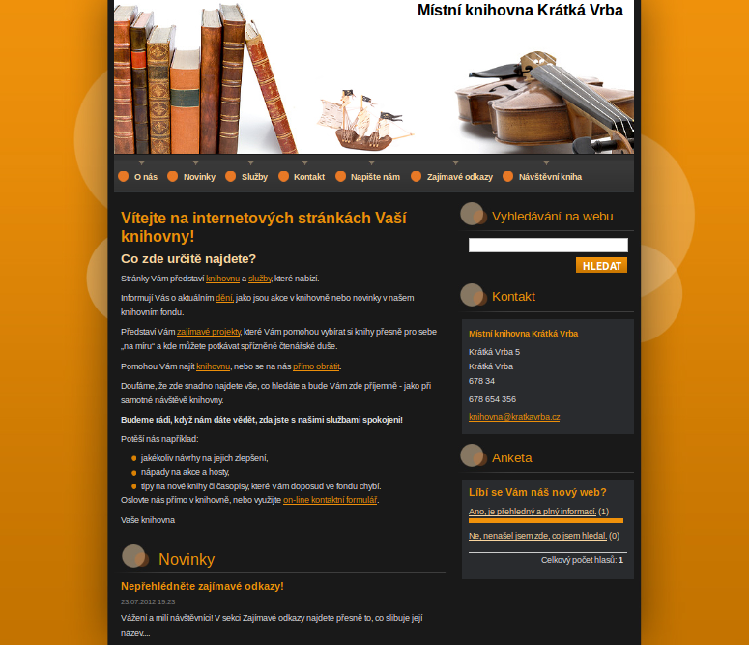
Digital curation
webovky.knihovna.cz

Slide 6
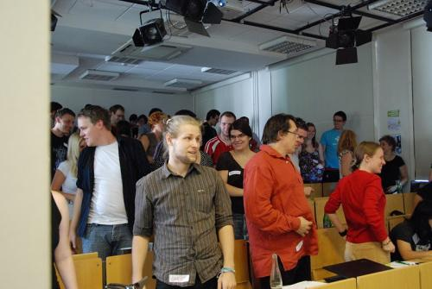
Digital curation
Library Marketing Tuesday - lmt.knihovna.cz

Slide 7
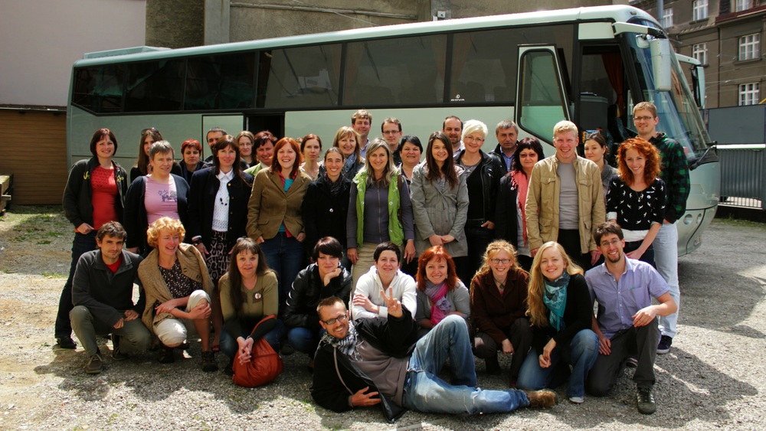
Collaboration
service design - designsluzeb.knihovna.cz
CIDES - http://cides.cz/

Slide 8
Collaboration
Wiki - wiki.knihovna.cz
365.knihovna.cz
SEX: new position of librarianship

Slide 9
Skills of librarian
courses for librarians - kurzy.knihovna.cz
research in libraries - vyzkumy.knihovna.cz
100 methods for libraries - 100metod.knihovna.cz

Slide 10
Electronic publishing
Proinflow - review journal http://pro.inflow.cz/

Slide 11
Community building
Inflow – experimental internet zin
http://www.inflow.cz

Slide 12
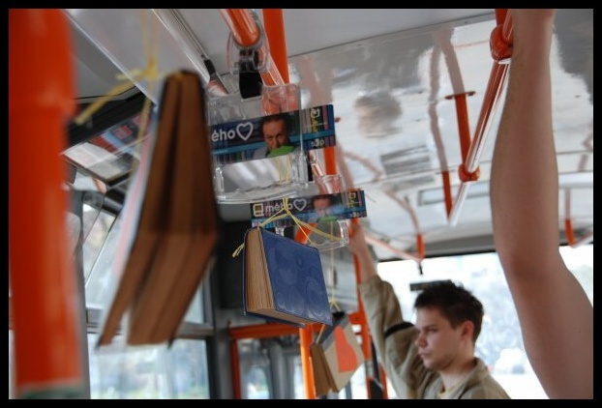
Readership supporting projects
Čtesyrád - http://www.ctesyrad.cz/
Bibliohelp - http://www.bibliohelp.cz/
Guerrilla Readers - http://www.greaders.cz/
librarian's anthem: http://youtu.be/PiIMKSWGKaU

Slide 13
Readership supporting projects
Knihárum – http://www.kniharum.cz/
Inspiromat - http://inspiromat.cz/

Slide 14
Curriculum
Balcheor specialization:
information services
information technology
information and documents organization
information in science and research
information studies

Slide 15
Curriculum
Master specialization:
information service design
educational technology
information and data management

