Slide 1
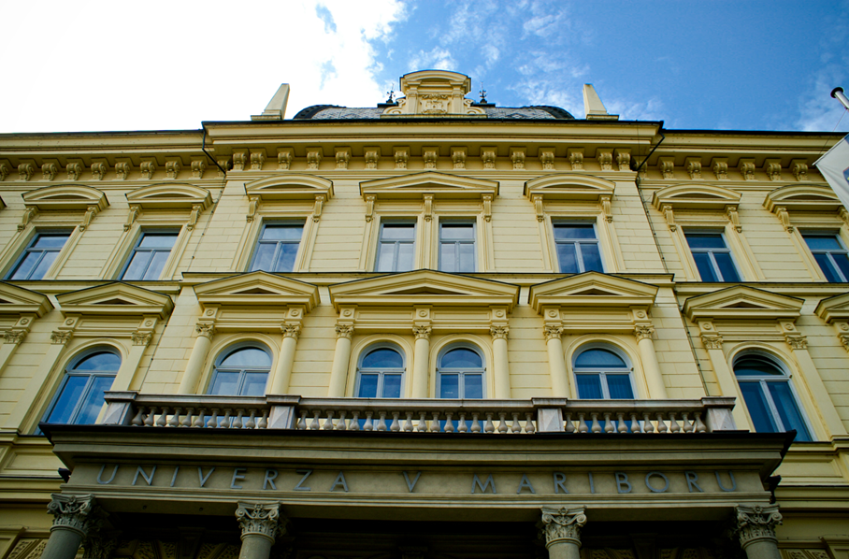
Researchers‘ Bibliography at the University of Maribor
Terezija Balant
September 2018

Slide 2
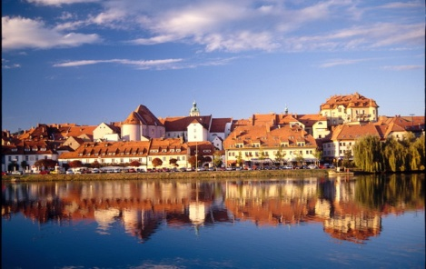
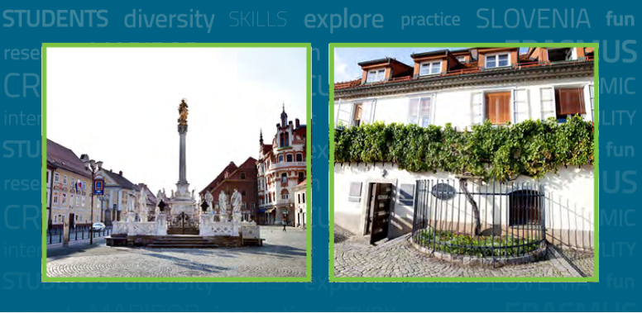
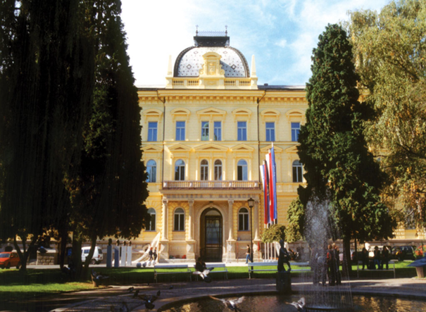
Maribor – the second biggest city in Slovenia

Slide 3
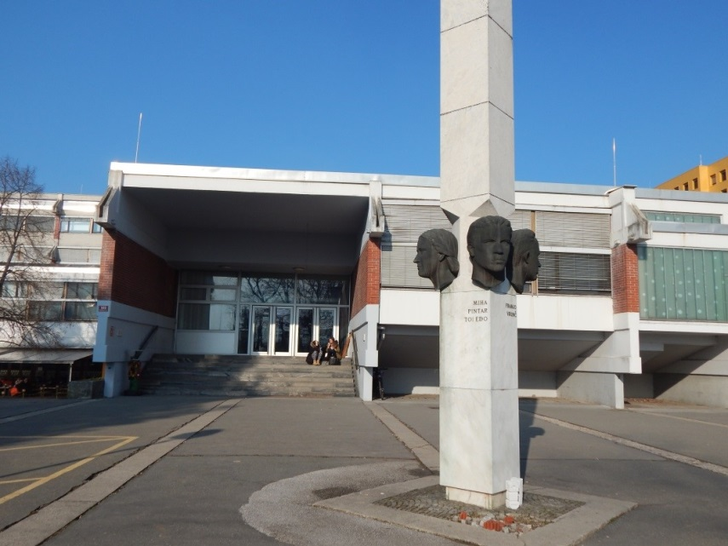
Miklošič Library - FPNM
The biggest faculty library at the UM
It is a library of 3 faculties: Faculty of Arts, Faculty of Education and Faculty of Natural Sciences and Mathematics
Since 2007
KISUM – Library Information System of the University of Maribor
University Library Maribor + 12 faculty libraries
Employs 8 librarians, 3 bibliographers

Slide 4
Bibliography at the University of Maribor
WHO for?
University: researchers and professors (17 faculties)
Miklošič Library – FPNM: researchers and professors of 3 faculties, students, guest professors (including artists lecturers)
WHAT for?
Evaluation of research performance
Habilitations at the University
Within the framework of the Slovenian Research Agency (SRA) – includes all Slovenian researchers
HOW does it work?
As a part of COBISS (Cooperative Online Bibliographic System and Services) – a unified library information system for all types of libraries (since 1988, in today‘s form since 1996), created/developed and maintained by IZUM (Institut of Information Science)

Slide 5
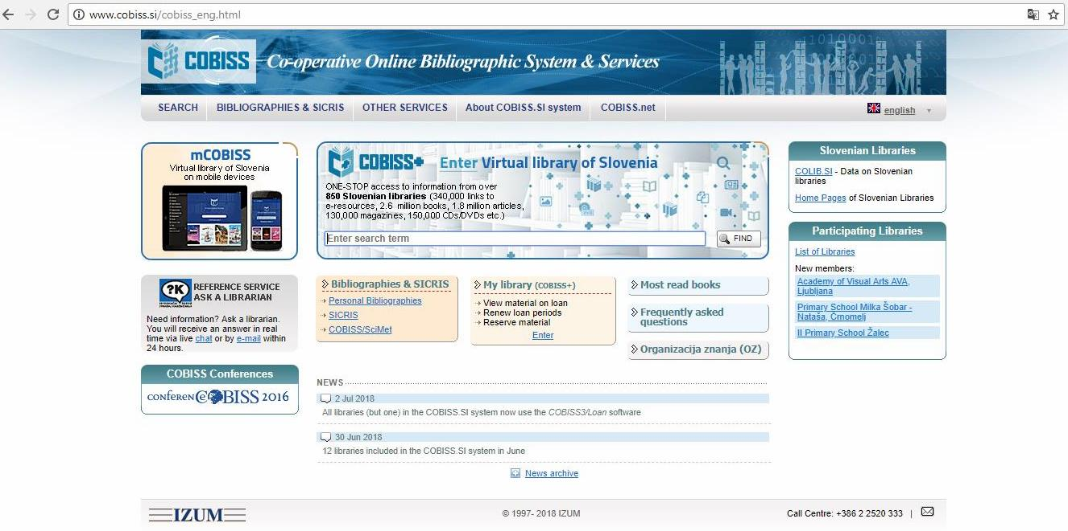
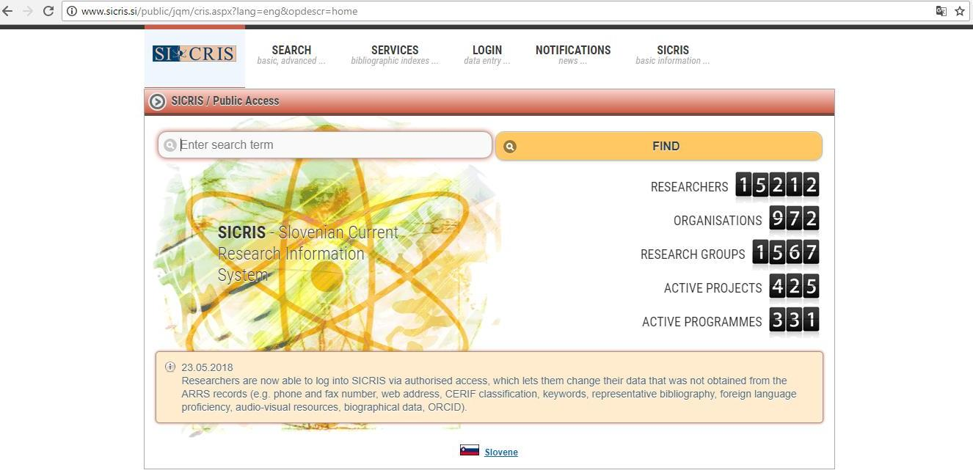
COBISS
Cooperative Online Bibliographic System and Services
Slovenian unified library information system (889 libraries)
Shared cataloging with the COBIB shared bibliographic database
Local databases of participating libraries
Other special databases and functions
Slovenian Current Research Information System
A tool for managing Slovenian research activities
Covers researchers, research organisations, research groups, projects and programmes
Developed and maintained by IZUM and SRA
Linked to COBISS and its shared bibliographic database – direct insight into researchers‘ bibliographies
SICRIS

Slide 6
Bibliographic records – national level
Are created by qualified licenced librarians in the libraries using COBISS system
Catalogued by the standard rules
COMARC format for data exchange
Can be created on the basis of genuine original documents (no photocopies), provided by the authors
The classification of bibliographic units is based on the uniform Typology of Documents/Works for Bibliographies in COBISS System
Monographs
Articles
Performances
Secondary authorships
Six Central Information Centres (for 6 scientific disciplines each) monitor and supervise that the bibliographic units‘ classification complies with the valid typology

Slide 7
What does a librarian need to create a bibliographic unit?
Personal data (author + co-authors) – to make the entry to the authority database CONOR
Full name, date of birth, formal education, contact information
Genuine materials (originals) provided by the author
If monograph – whole book, CD, patent, computer programme …
If article - whole journal or full text article with details on publication
If contribution/component part in books or proceedings – the whole book
If performed act (exhibition, concert, lecture) – certificate (invitation, catalogue, programme …) with full data
If internet source – link
Filled in form with suggested type of document

Slide 8
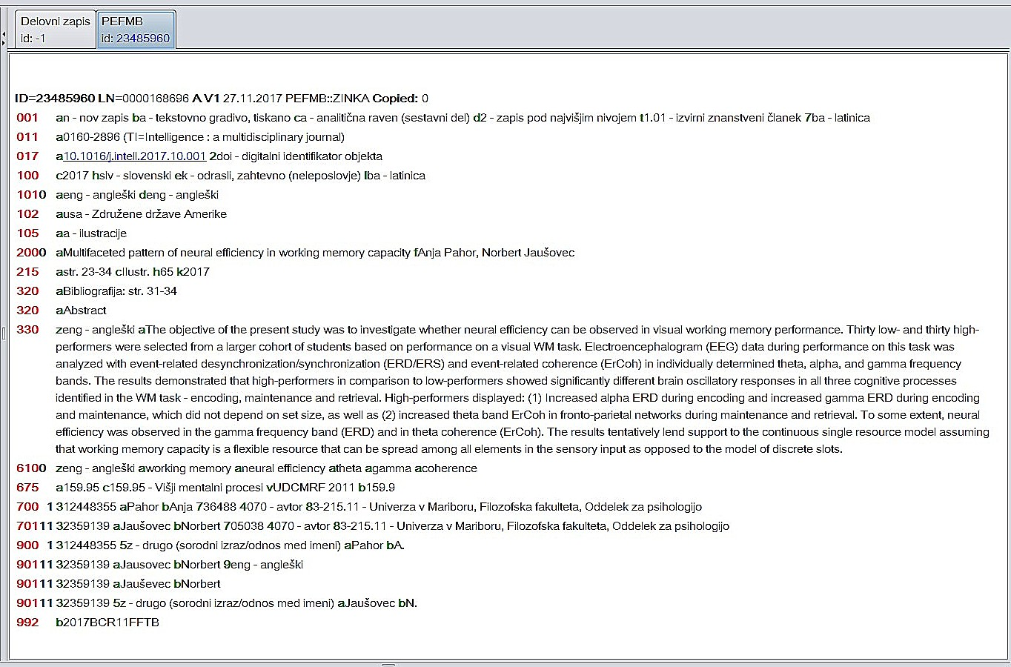
Bibliographic entry in COMARC format (article)

Slide 9
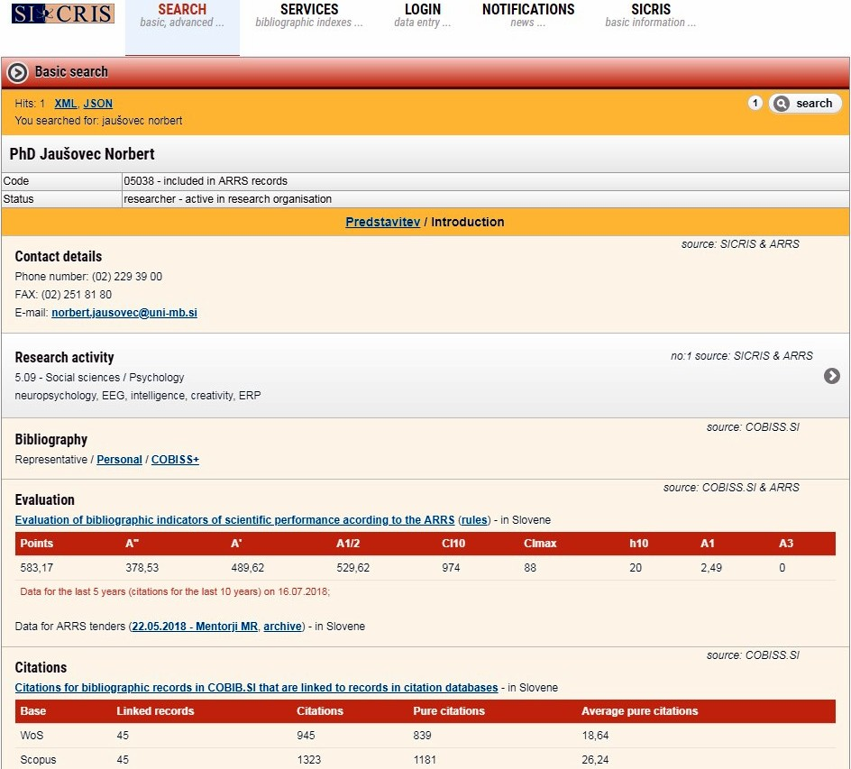
Researchers‘ bibliographies online
COBISS web application used to evaluate the bibliographic indicators for research performance in the SICRIS system
Can be prepared for the researchers registered at SRA (researchers‘ code), personal for everybody
Can be prepared in Slovene and personal also in English
Are based on classification by typology
Algorithms permit various categorizations (links to JCR/SNIP, WoS/Scopus …)
Results are expressed in „points“
It is up to the users – ministry, universities - how to interpret and use them for their purposes (performance evaluation, habilitation process evaluation, selected bibliography …)

Slide 10
Personal bibliography

Slide 11
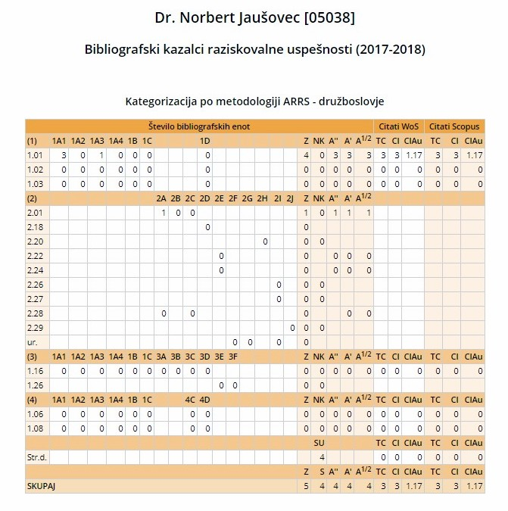
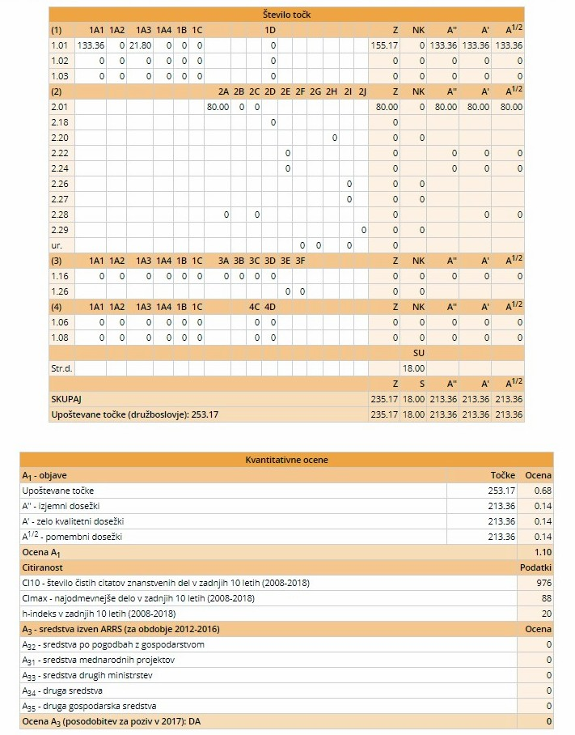
Evaluated researcher‘ bibliography

Slide 12
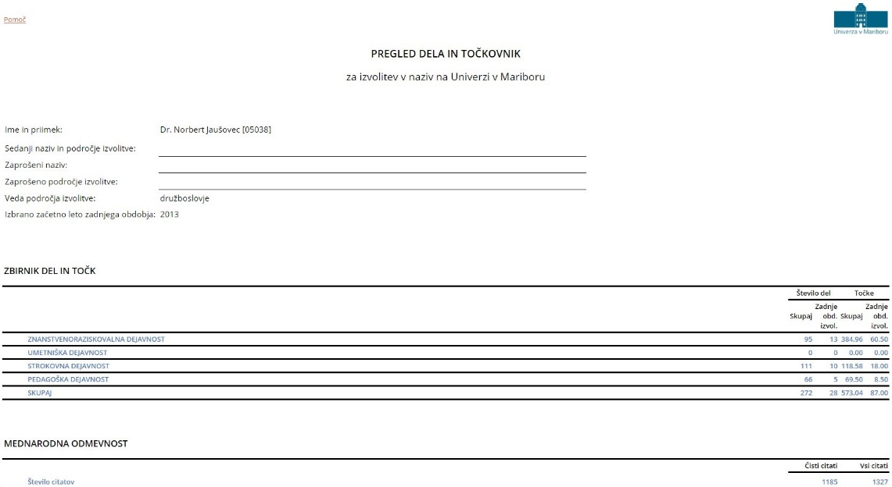
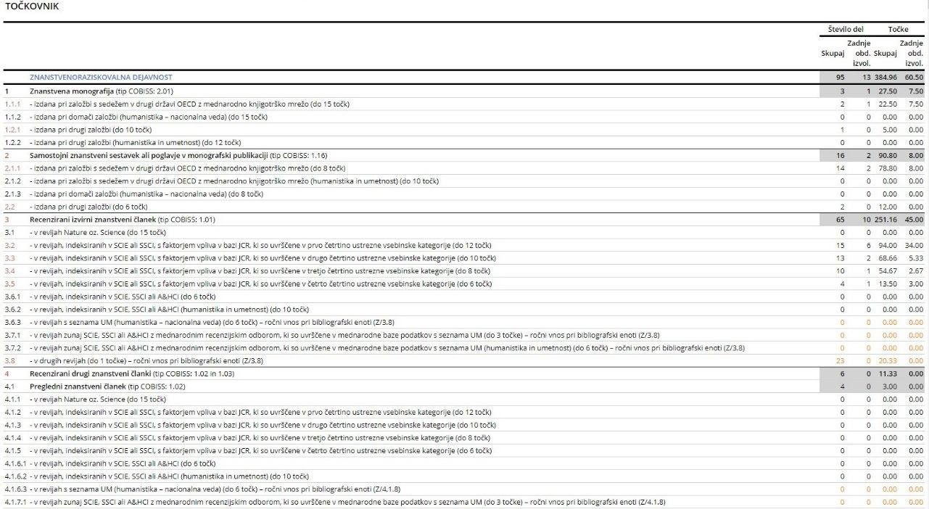
Appointment of faculty ranks at the UM

Slide 13
Personal bibliography

Slide 14
Present
Bibliographies
Searching of citations and maintaining a base of citations
Advisory work on publishing
Advisory work on evaluation of the research performance
Future
+ Support to open science
+ Advisory work concerning authorship legislation
+ Support to research data management
+ …

Slide 15
References:
Institut of Information Science (2018), COBISS. Retrieved from http://www.cobiss.si/cobiss_eng.html
Institut of Information Science (2018), Personal bibliographies. Retrieved from http://splet02.izum.si/cobiss/BibPersonal.jsp?lang=eng&init=t&code=&type=conor
Institut of Information Science (2018), SICRIS. Retrieved from http://www.sicris.si/public/jqm/cris.aspx?lang=eng&opdescr=home
Institut of Information Science & Research Agency of Slovenia (2016), Typology of documents/works for bibliography management in COBISS. Retrieved from http://home.izum.si/COBISS/bibliografije/Tipologija_eng.pdf
University of Maribor (2018), University of Maribor. Retrieved from https://www.um.si/en/Pages/default.aspx

Slide 16
HVALA. DĔKUJI. THANK YOU.
 | Terezija Balant Univerza v Mariboru | University of Maribor Filozofska fakulteta | Faculty of Arts Miklošičeva knjižnica - FPNM Koroška cesta 160, 2000 Maribor, Slovenija T: +386 2 229 3784 E: terezija.balant@um.si, www.ff.um.si http://www.ff.um.si/o-fakulteti/miklosiceva-knjiznica/

