Slide 1
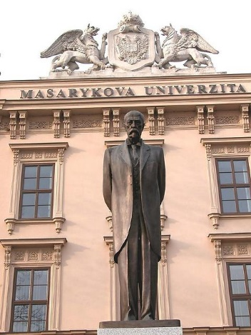
Masaryk
University
Libraries
Miroslav Bartošek
MU Library and Information Centre

Slide 2
Agenda – general overview of MU libraries
System of MU Libraries
IT Support for Libraries
Electronic Resources
Digital Libraries
OA@MU

Slide 3

MU at a glance
MU
rector’s office
9 faculties
2 institutes
12 specialized units
Arts
Institute of Computer Science
Hostels/Canteens
Science
CEITEC*
MuniPress
Medicine
Telč Centre
Law
other units
Education
MU-Archives
Economics
Disabled Students Support
Informatics
Language Centre
Social Studies
Technology Transfer
Sports Studies
Mendel Museum
* Central European Institute of Technology

Slide 4
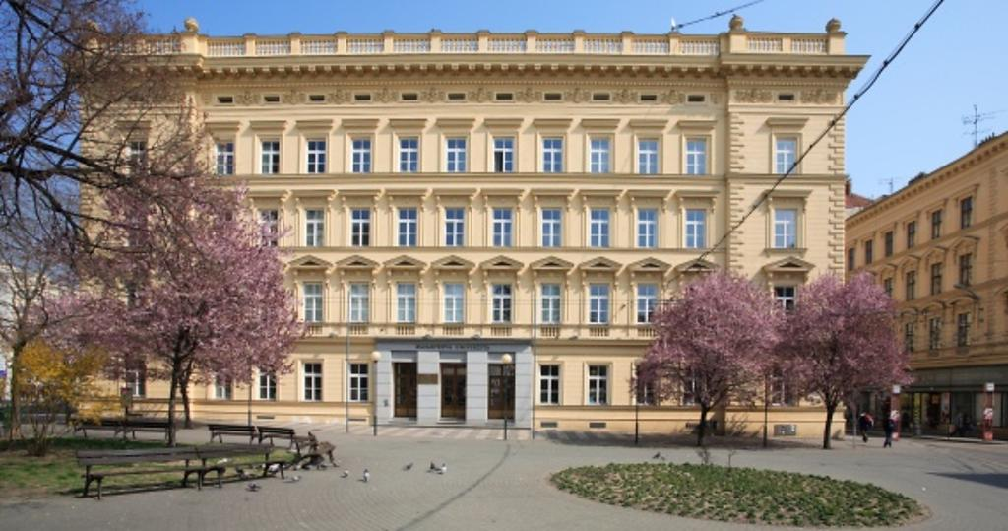
MU at a glance
Locations
  MU scattered all over the city
  (each faculty in different location/s) ~ 60 sites
  University campus Bohunice
    Medicine, Sports, Science faculties (chemistry, biology)
Numbers (Annual Report 2017)
  30 457 students
  5 356 employees
  280 degree programmes / 600 filelds of study
  2nd biggest university in Czech Rep

Slide 5
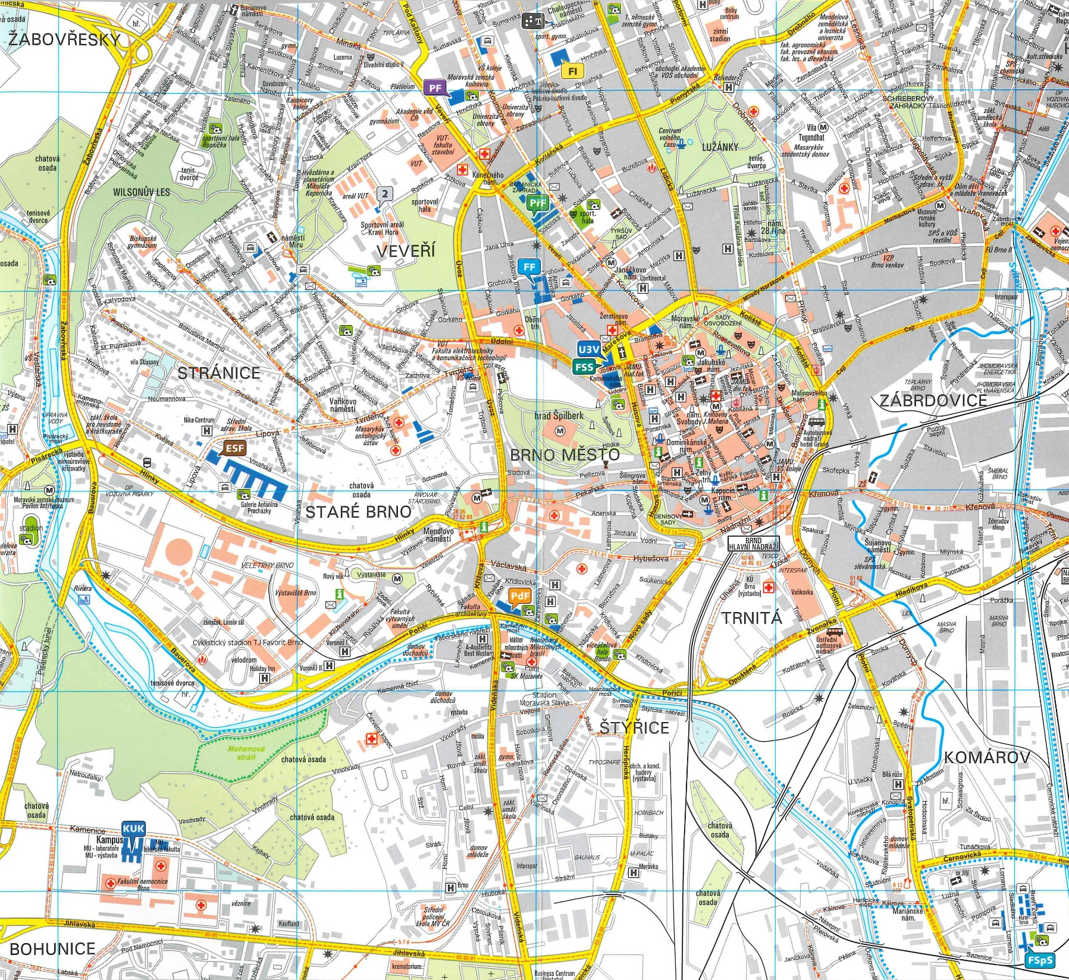

Slide 6
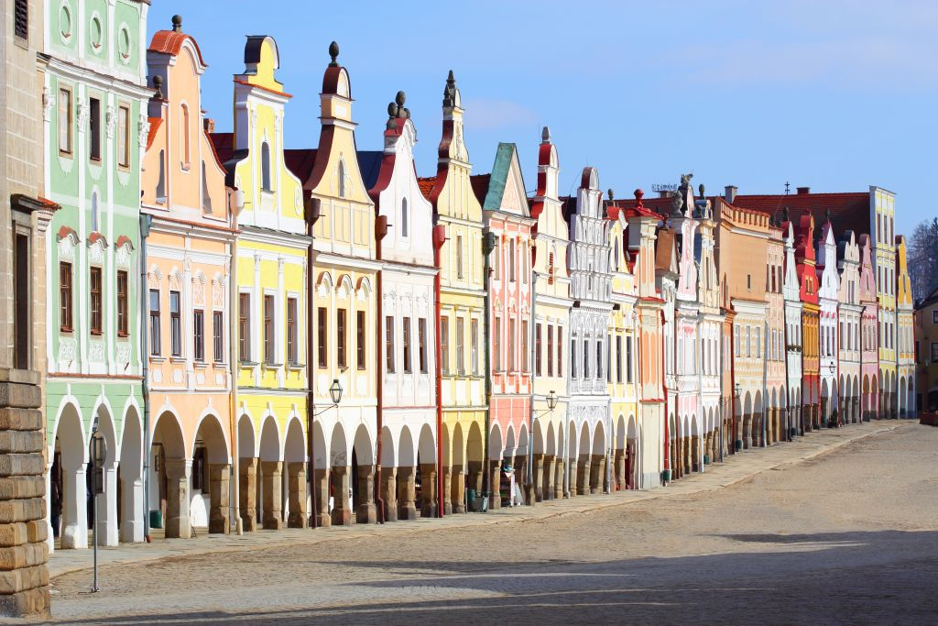
Telč University Center

Slide 7

1. MU Libraries
None main university library
  MU Library and Information Centre (coordination)
  9 faculty libraries
  Library for students with special needs
  ~ 100 branch/subject/department libraries
Autonomously managed yet integrated into a university system
MU Library and Information Centre
  Coordination of library services
  Common IT infrastructure + technologies
  ER acquisition
LIC-MU@ICS-MU

Slide 8

1. MU at a glance
MU
rector’s office
faculties
institutes
specialized units
Arts
Institute of Computer Science
Hostels/Canteens
Science
CEITEC*
MuniPress
Medicine
Telč Centre
Law
other units
Education
MU-Archives
Economics
Disabled Students
Informatics
Language Centre
Social Studies
Technology Transfer
Sports Studies
Mendel Museum
* Central European Institute of Technology

Slide 9
1. MU Libraries in Numbers
9 faculty libraries (core) + 100 branch/subject libraries
Disabled Students Library
108 librarians
2.500 seats in study rooms
1,7 mil of books (0,60 arts, 0,33 campus, 0,28 science)
  39.083 new (printed) books in 2017
23.500 e-journals, 209.893 e-books
36.378 registered users
629.165 loans

Slide 10
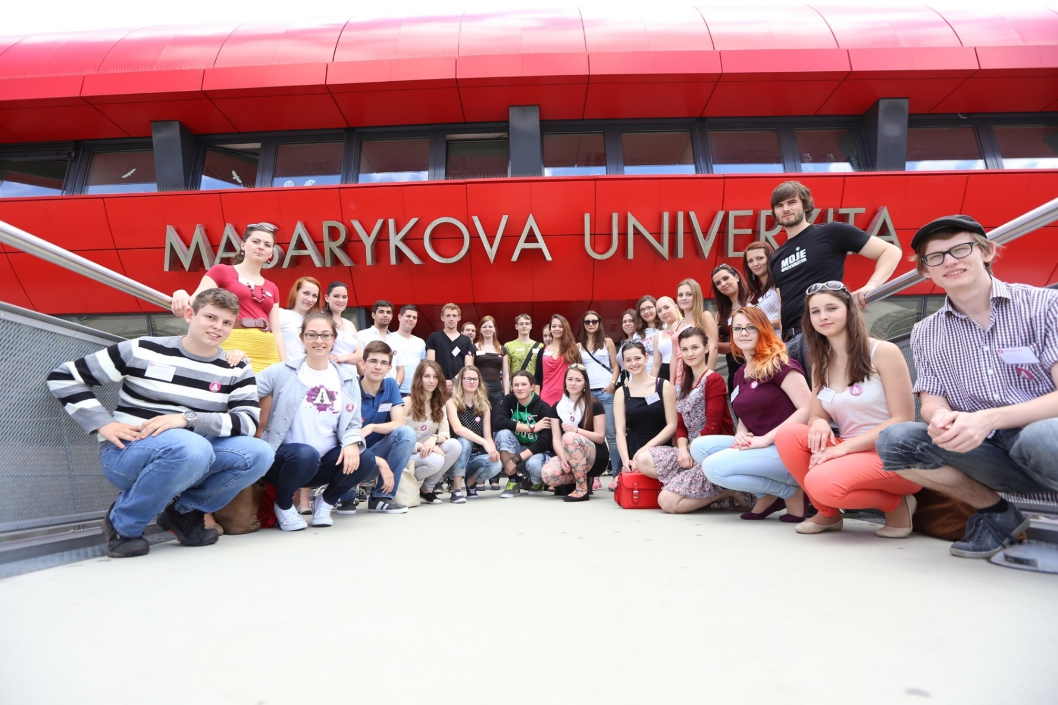
1. Virtual MU libraries Tour
All libraries new or reconstructed after 2000

Slide 11
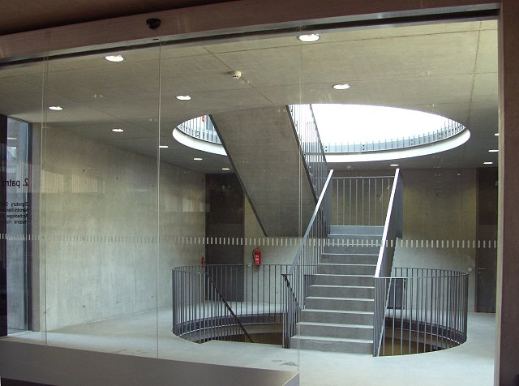
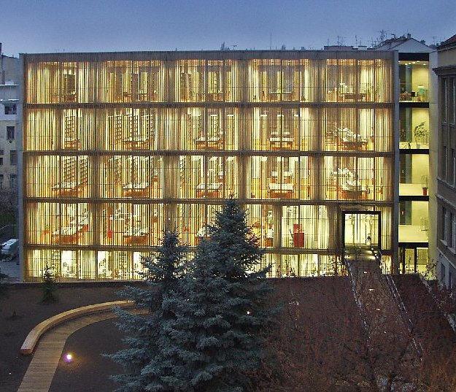
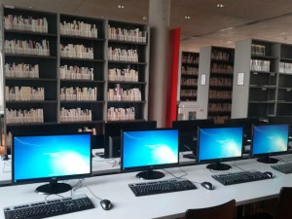
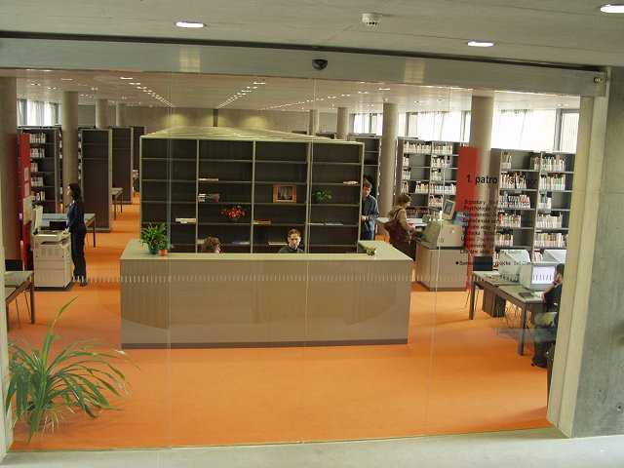
1.1 Humanities Library

Slide 12

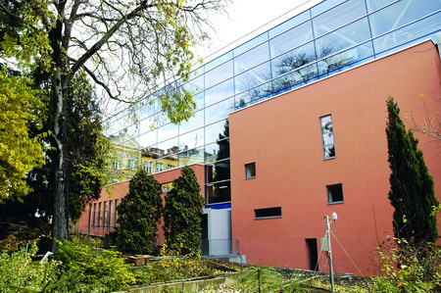
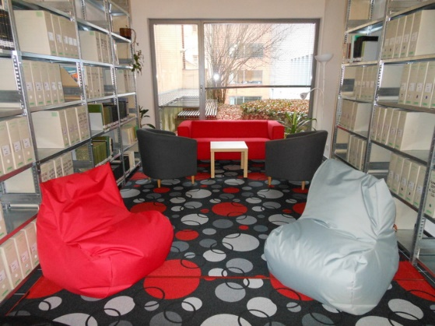
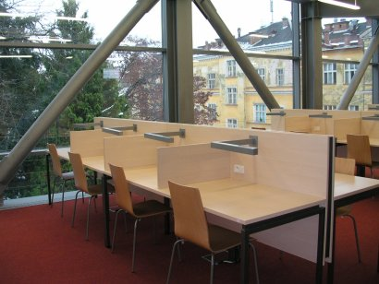
1.2 Science Library

Slide 13
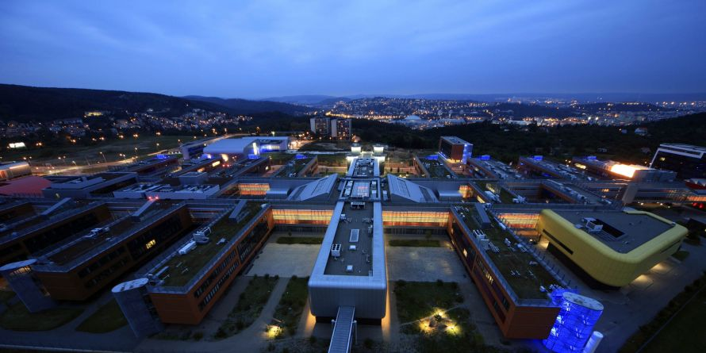
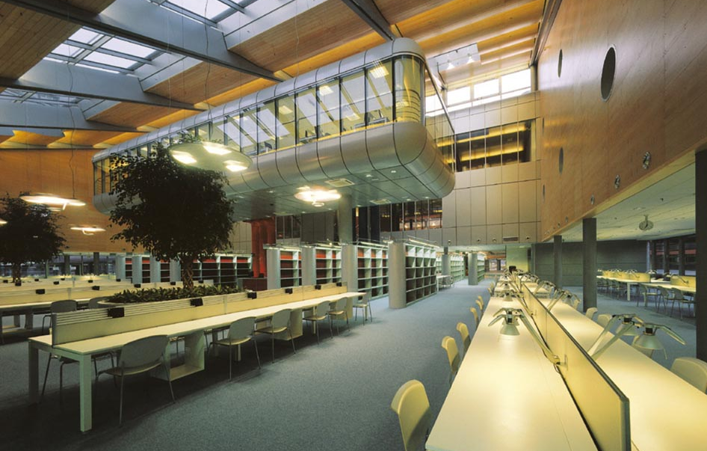
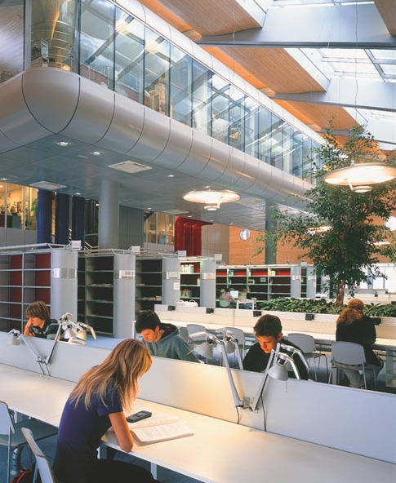
1.3 Campus Library

Slide 14
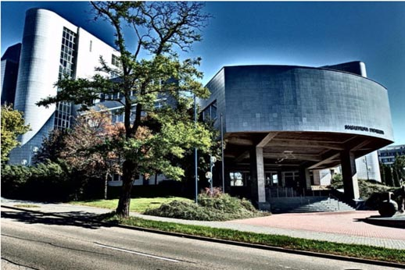
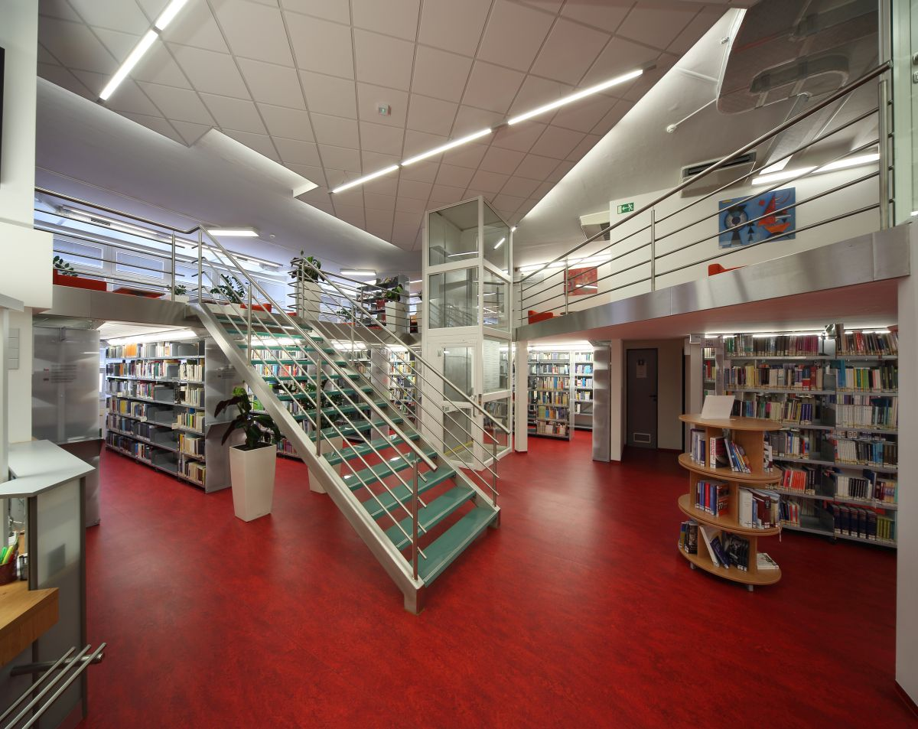
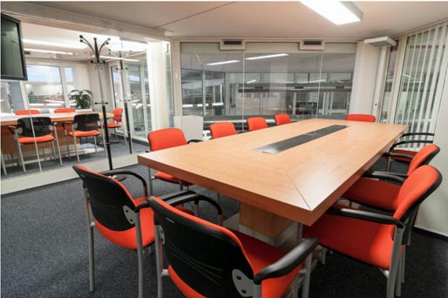
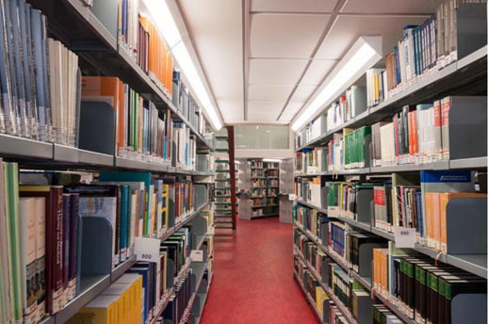
1.4 Economics Library

Slide 15
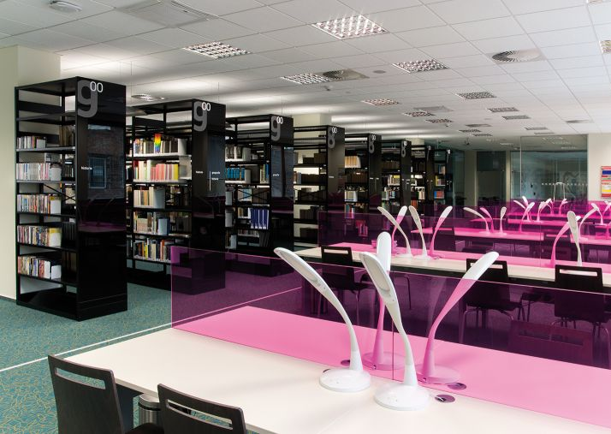
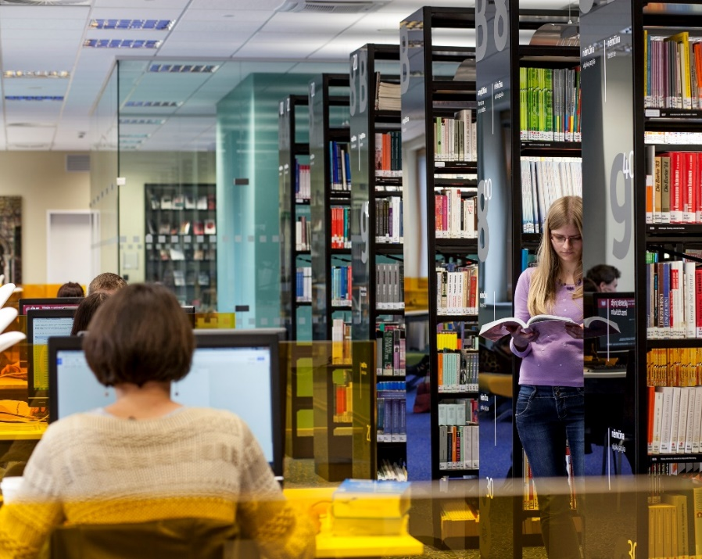
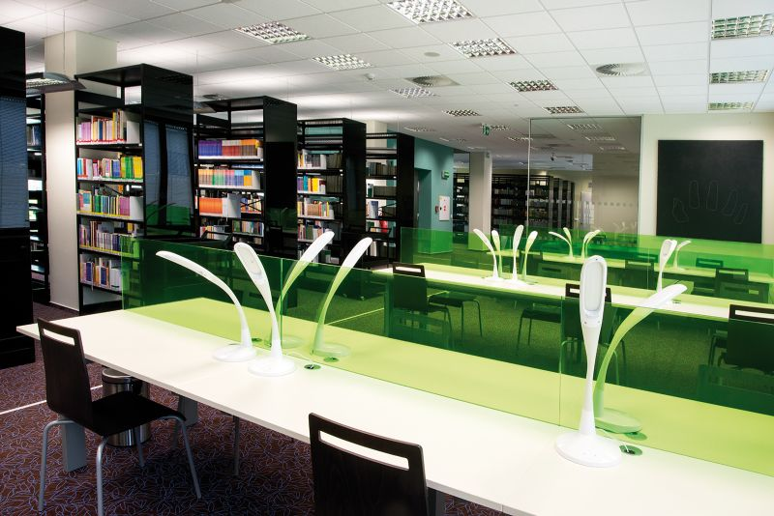
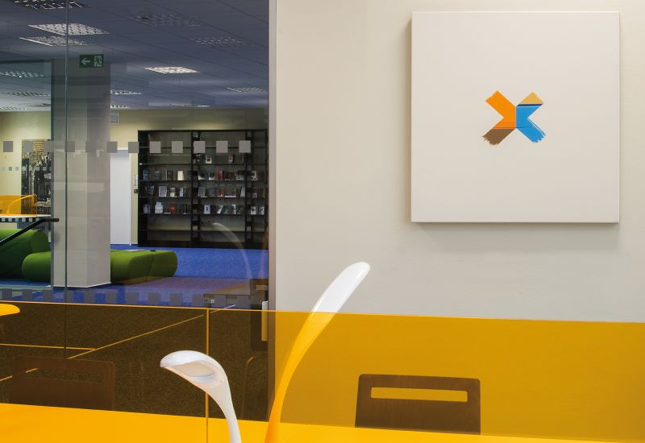
1.5 Education Library

Slide 16
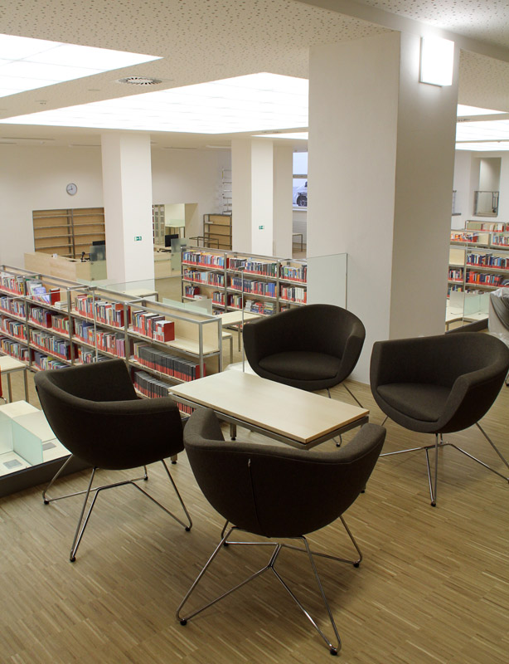
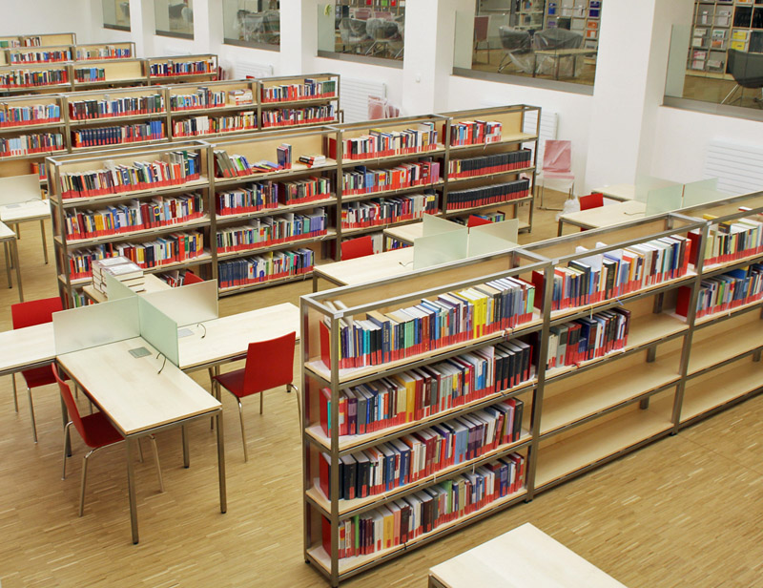
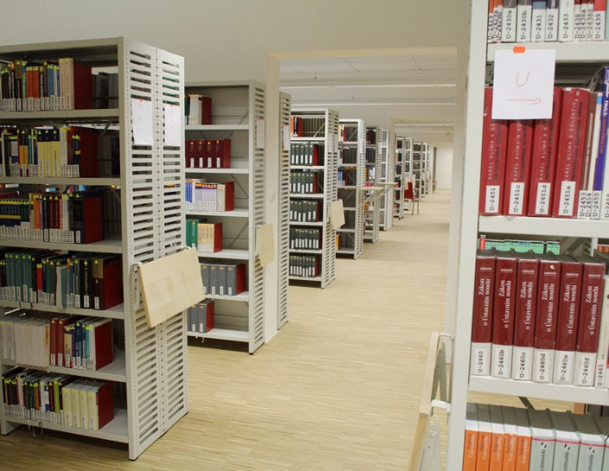
1.6 Law Library

Slide 17
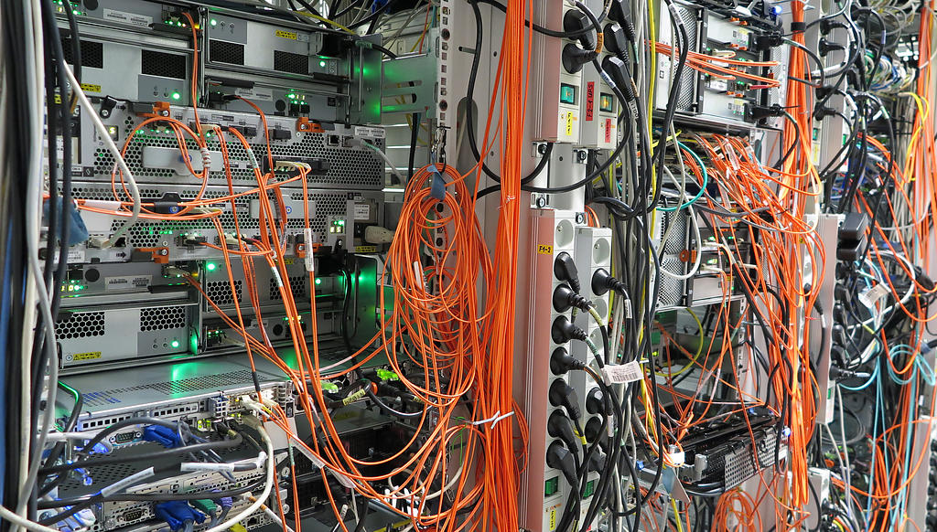
2. IT support for libraries@MU
Institute of Computer Science
(Library and Info Centre)
  Aleph-MU – Library management system
  ER technologies
  Digital Libraries
  Computer study rooms
  Network infrastructure, library standards, id-cards, …
Faculty of Informatics (Study supporting system)
  E-thesis archive
  University repository
Local IT in libraries

Slide 18

3. Electronic Resources
Over 100 ER-packages
  Web of Science, Scopus, Elsevier-ScienceDirect, SpringerLink, Wiley, Nature, EBSCO, ProQuest, Sage, T&F, ACS, RSC, Oxford journals, IEEExplore,… and many more
CzechELib
National Centre for Electronic Information Resources (since 2017)
ER technology@MU
  ER Portal
  Discovery.muni
  Linking services
  Remote Access (OpenVPN, EZproxy, Shibboleth)

Slide 19
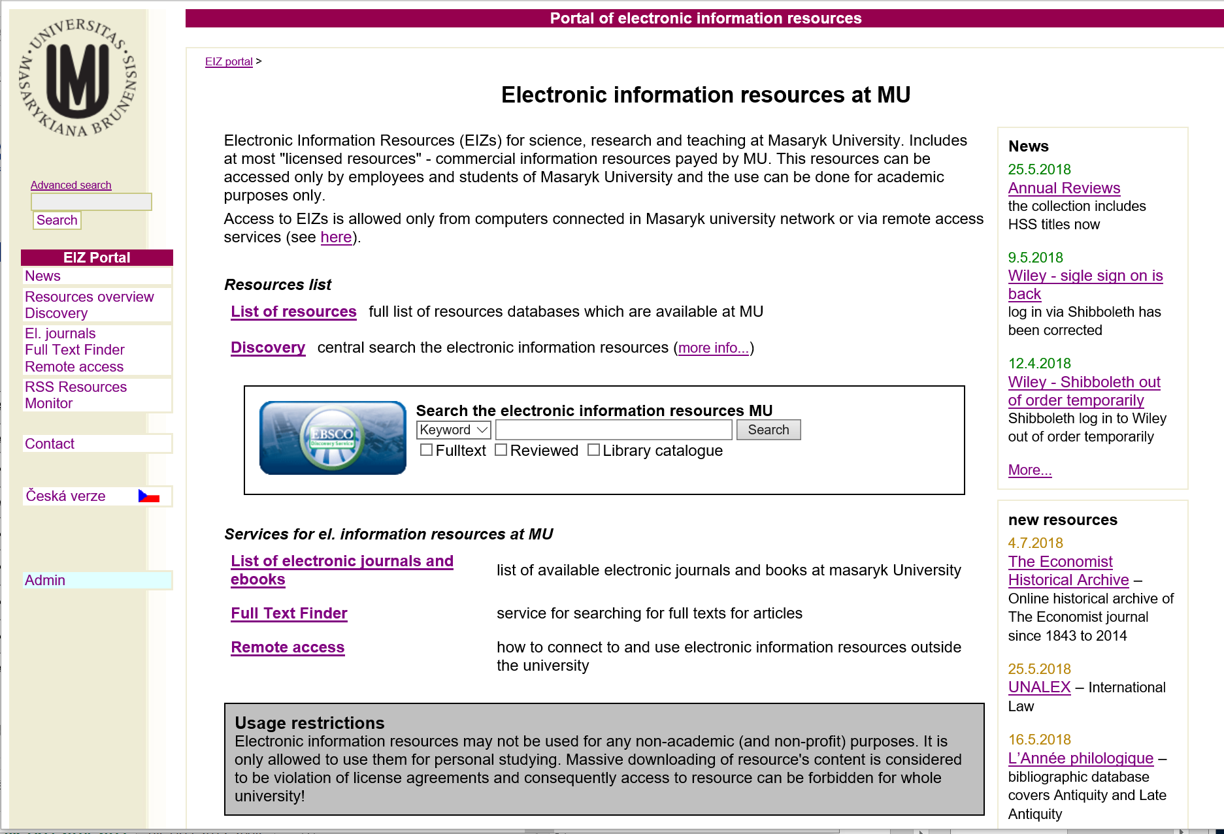

Slide 20
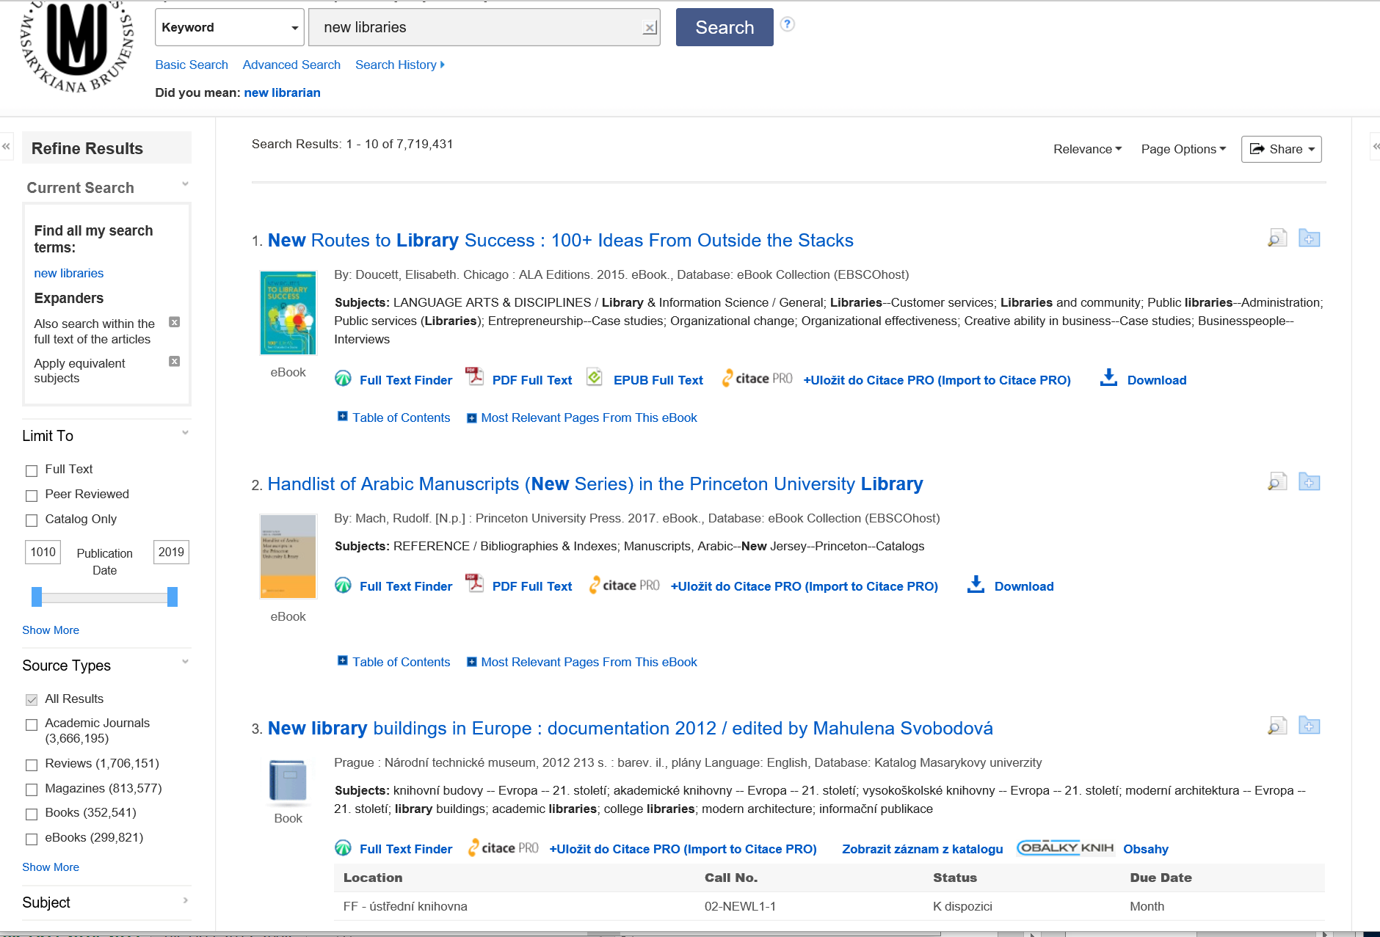

Slide 21
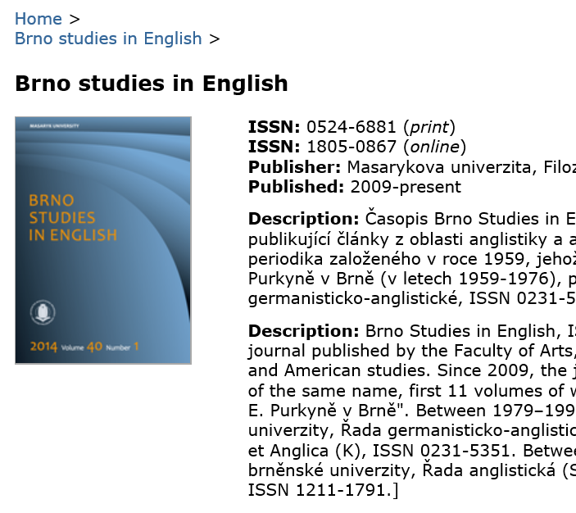
4. Digital Libraries
DSpace + Metadata editor
Low-cost digitization
Specialised digital libraries
  MU Digital Library of Photograps
  Czech Digital Mathematics Library
  Faculty of Arts DL
  Law-DL
  … other in preparations

Slide 22
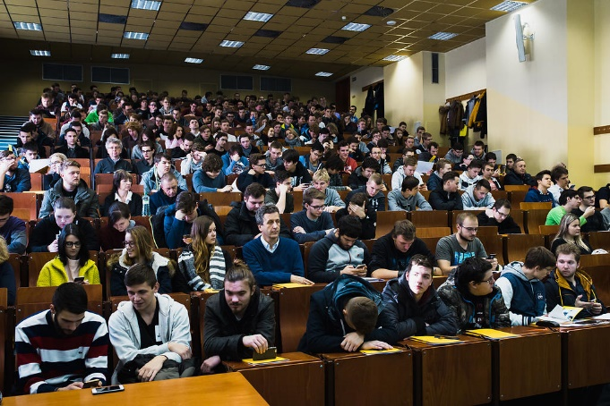
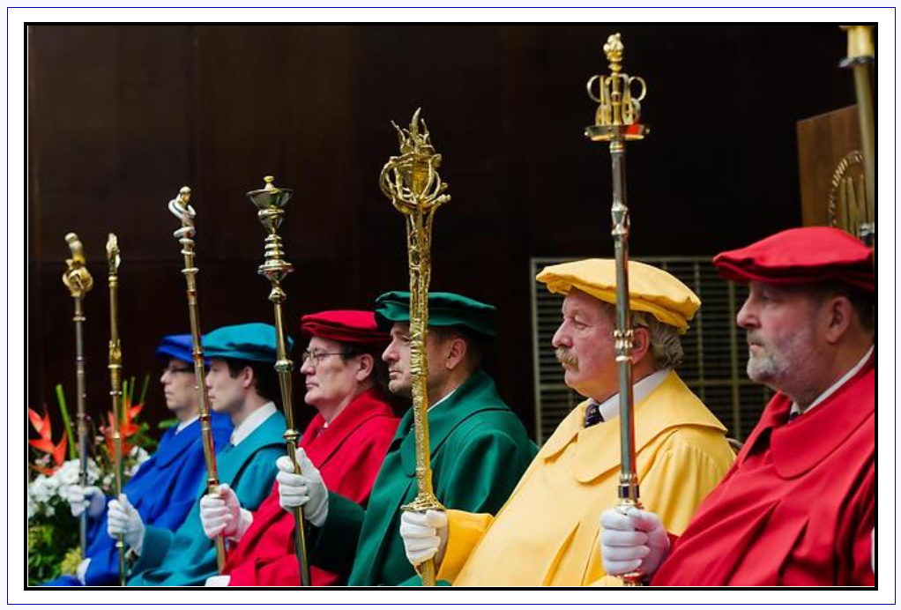
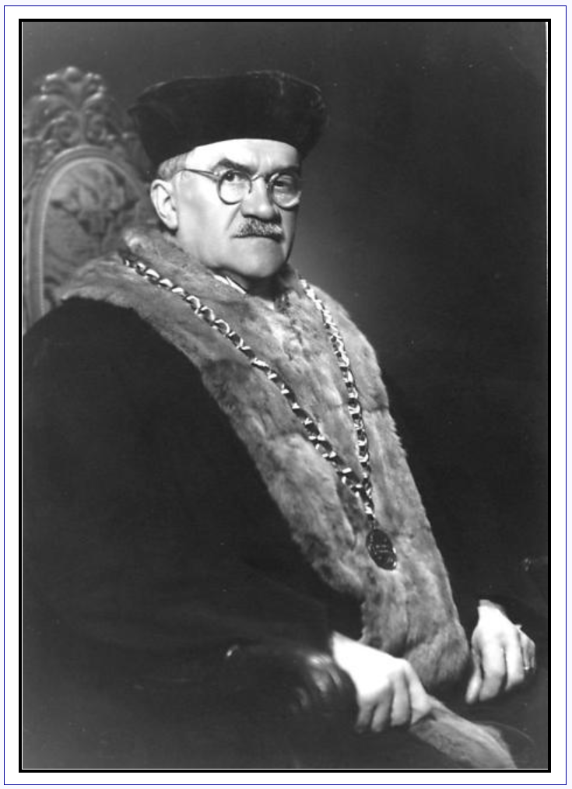
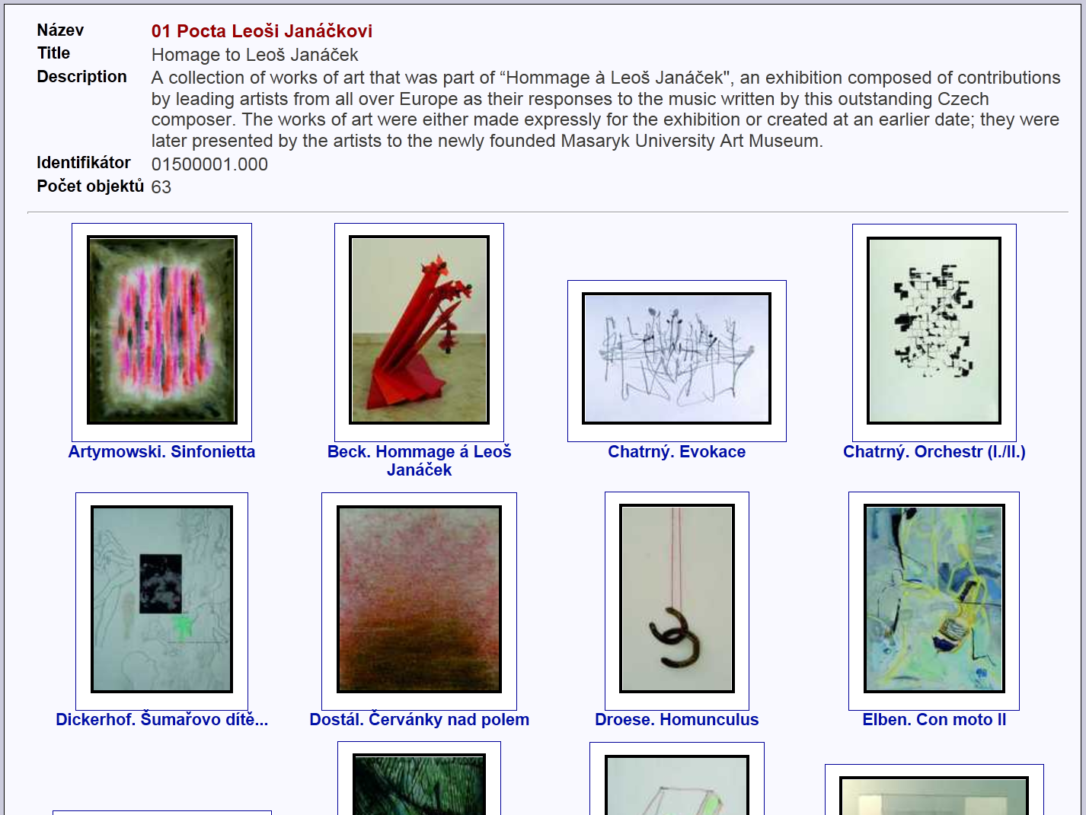
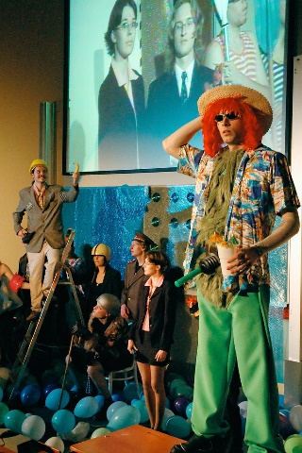
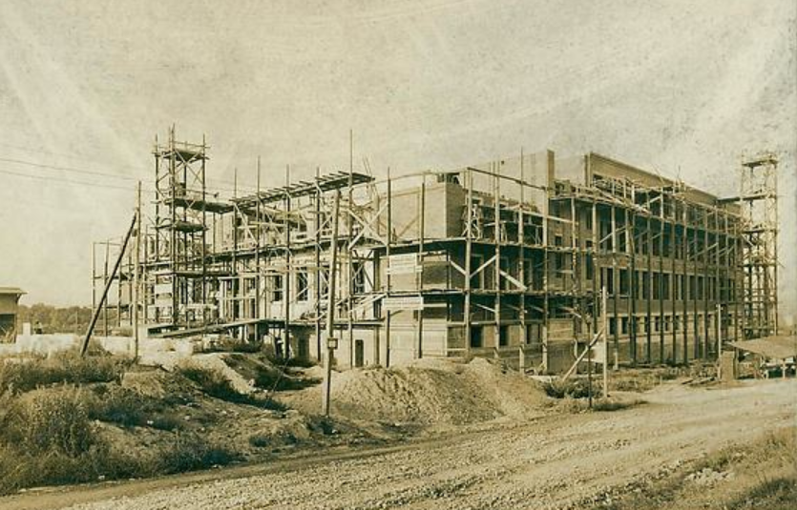
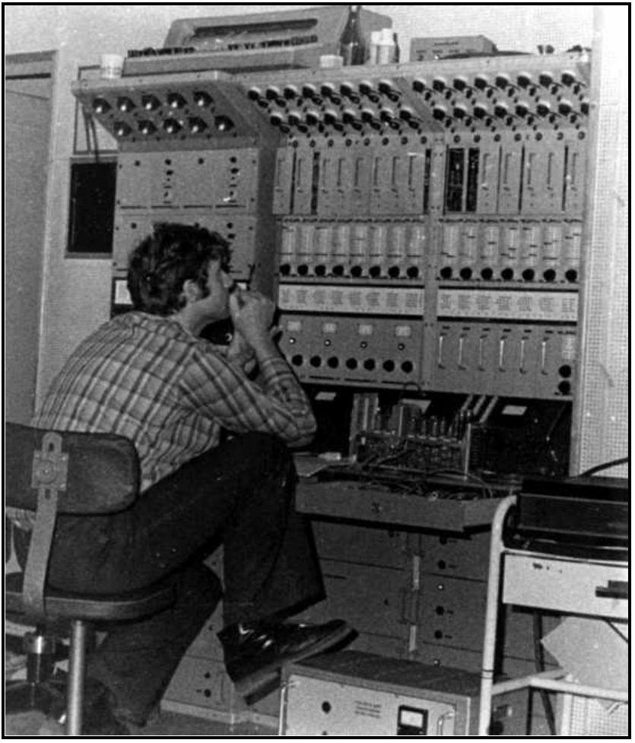
63.526 photographs
in 33 collections

Slide 23
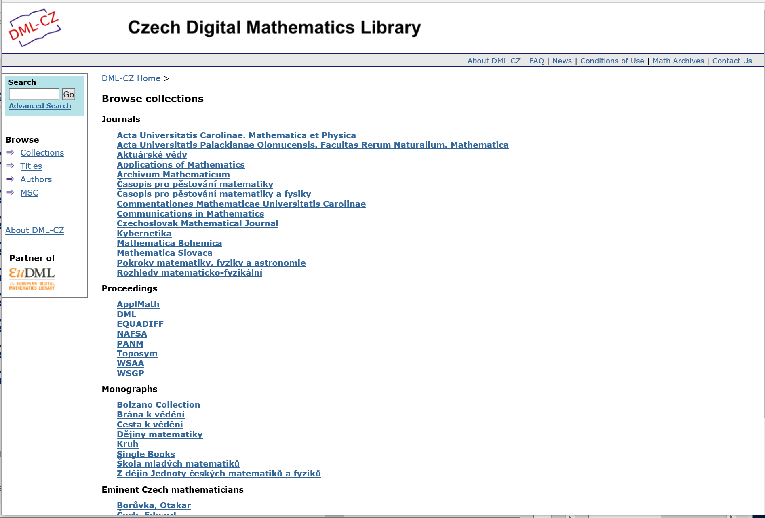
All mathematics published
throughout history in the
Czech lands
-- 38.117 articles
-- 441.851 pages

Slide 24

5. Open Access
2006 MU e-theses & dissertation in OA
2010 MU signed Berlin Declaration
2011 MU green OA mandate
2012 Institutional repository
2013 great OA dispute -> voluntary deposit policy
2014 Digital Preservation (Archivematica pilot, ARCLib)
2016 Open data – first attempts (H2020)
2017 National OA strategy

Slide 25
Questions ?

