Slide 1
Citation analyses at the University Campus Library

Slide 2
Citation analysis
Since ca. 2000 for researchers aspiring for position of Associate professor or professor
Data requested by the rector‘s directive
Also analysis for grant applications, to proof a scientific activity etc.

Slide 3
Types of the citation analysis
Complete analysis
Complete analysis without citing records
Author´s publications with times cited, impact factors and h-index
Author´s publications with times cited
Checking impact factor

Slide 4
Complete analysis
The rector‘s directive
List of all publications including patents, software etc.
The library prepares only list of publications in WoS and Scopus

Slide 5
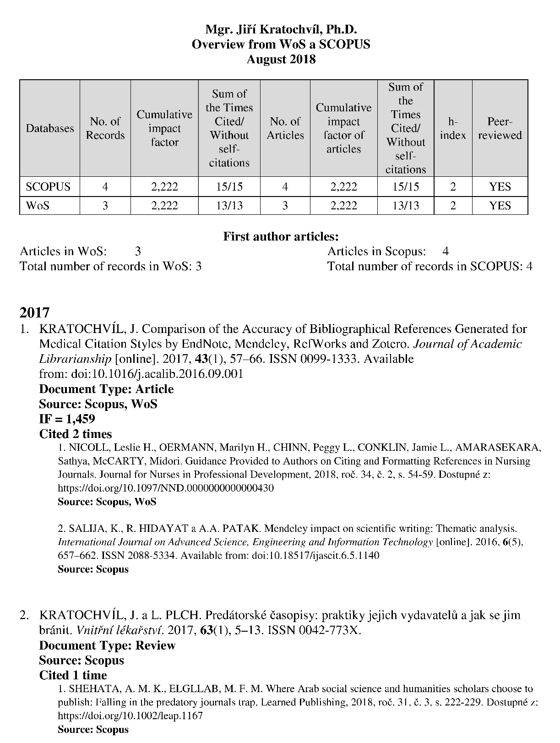

Slide 6
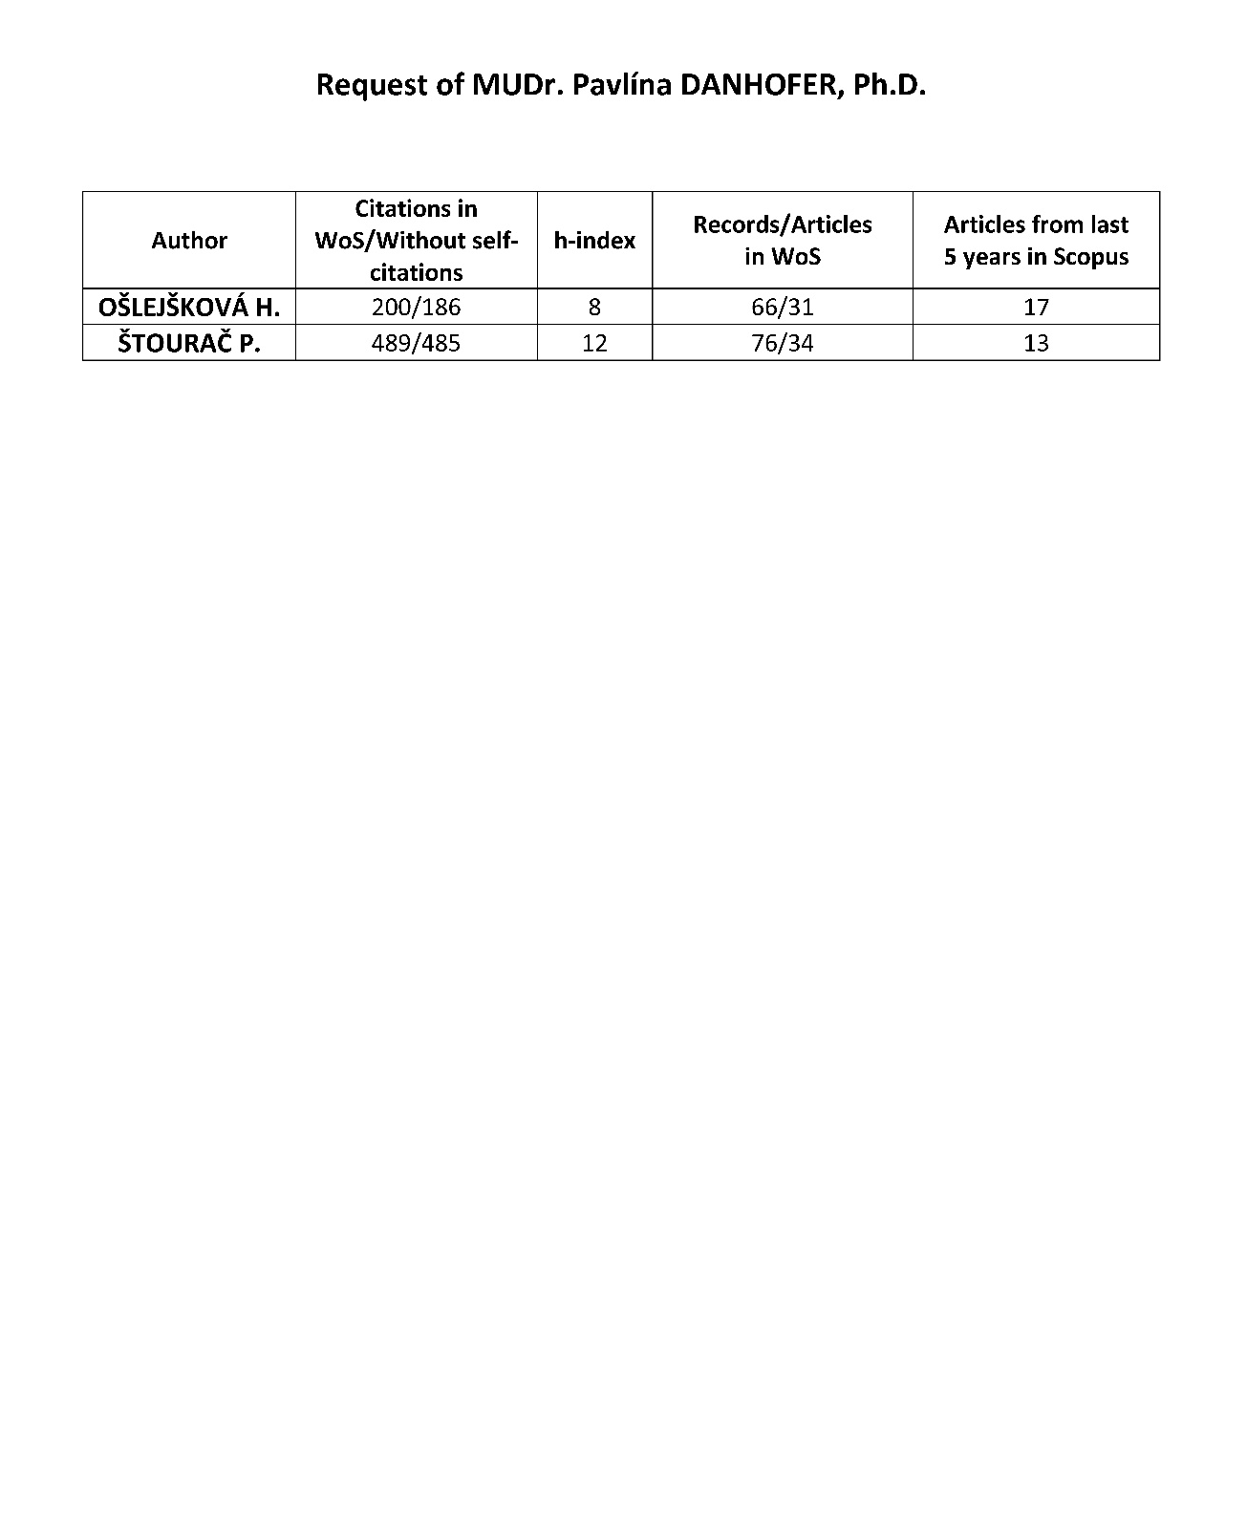
Other analysis

Slide 7
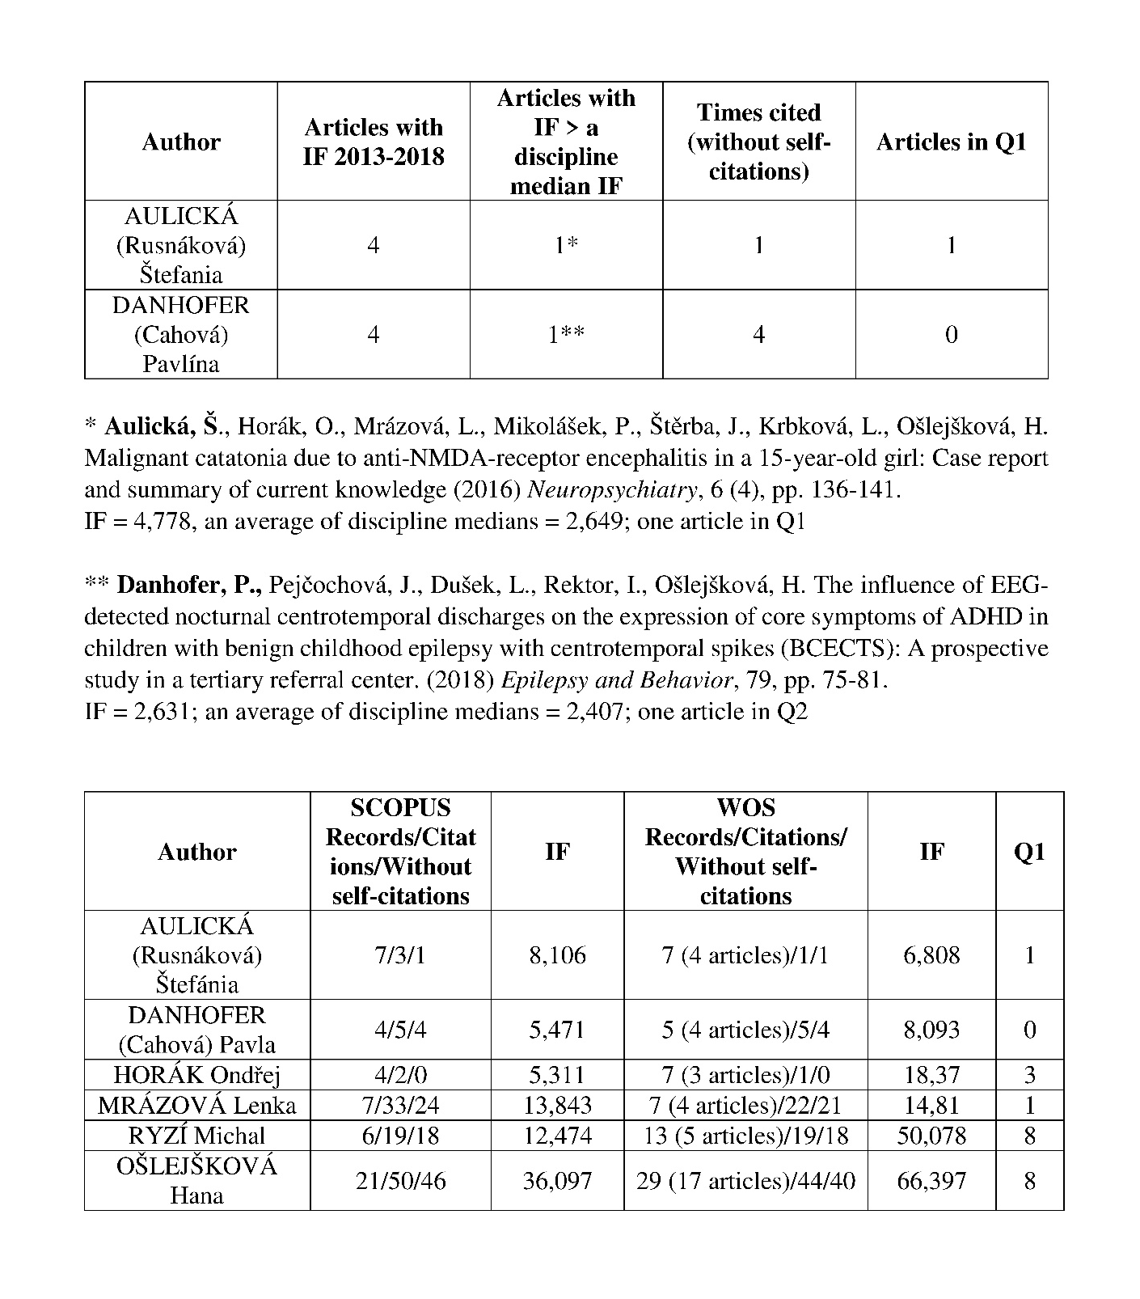
Other analysis

Slide 8
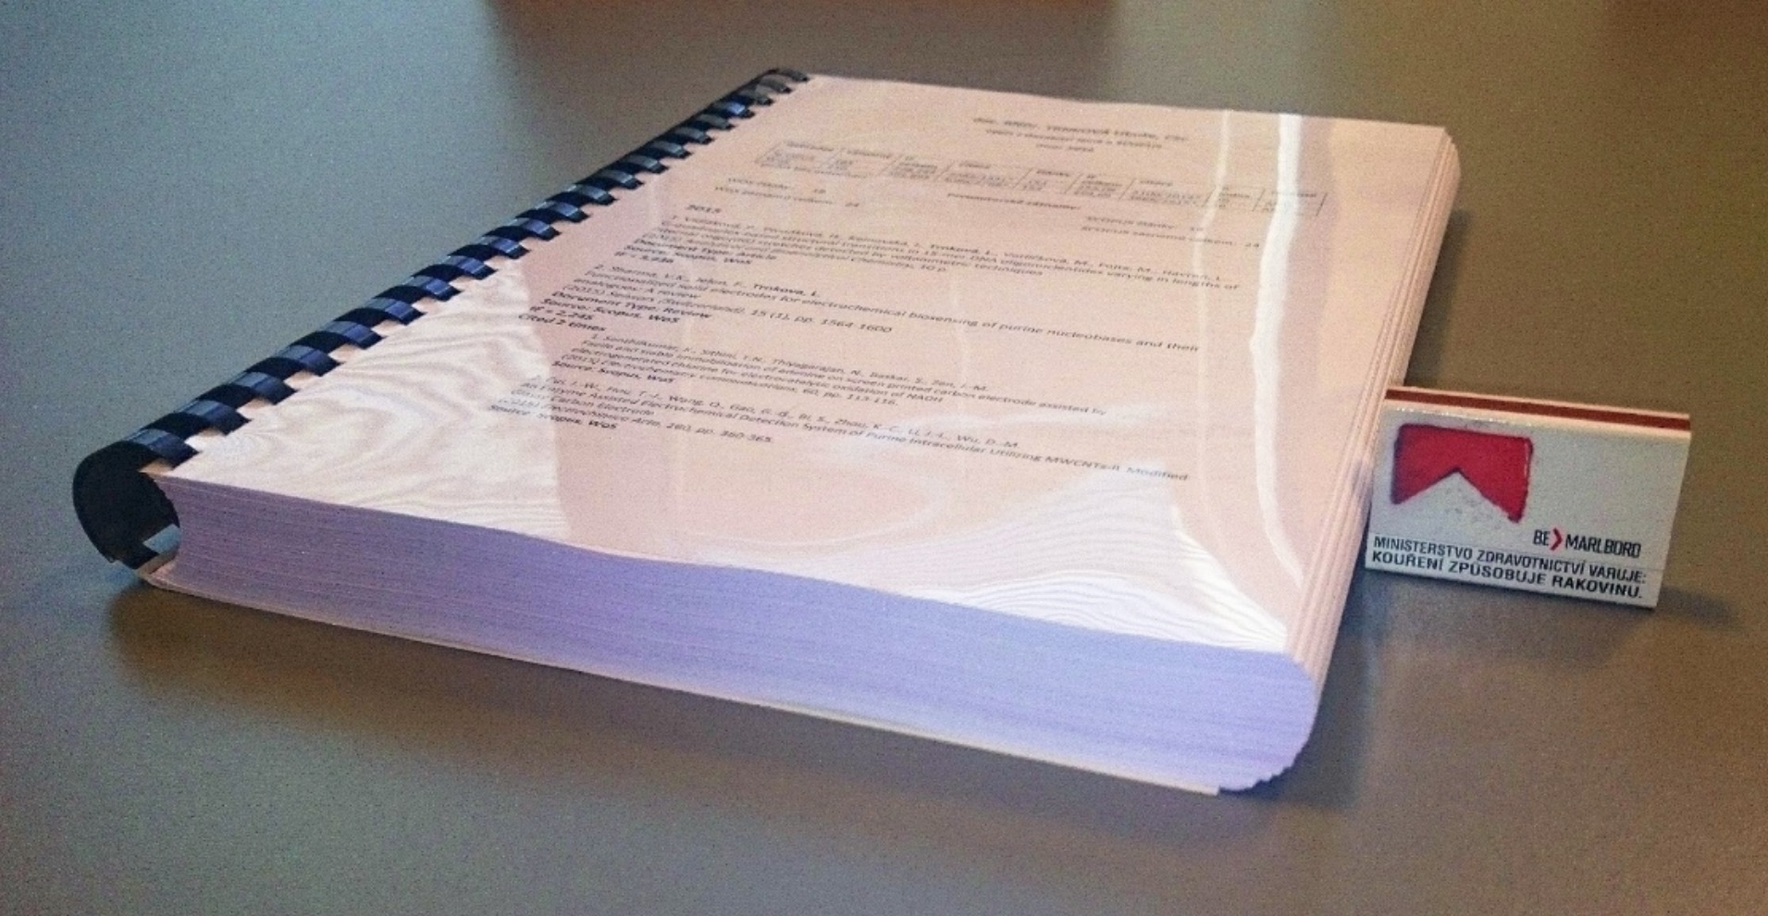
Support – Citation analysis
Type of analysis | 2015 | Hrs | 2016 | Hrs | 2017 | Hrs
Complete analysis | 2 | 13 | 13 | 459 | 12 | 69
Complete analysis without citing records | 20 | 44 | 3 | 5
Author´s publications with times cited, impact factors and h-index | 1 | 3 |  |  | 3 | 3,5
Author´s publications with times cited | 1 | 1 | 1 | 4 | 9 | 12
Checking impact factor | 1 | 0,25 | 3 | 4,5 | 9 | 22
TOTAL | 25 | 61,25 | 20 | 472,5 | 33 | 106,5

Slide 9
Thank you for your attention
Jiří Kratochvíl
kratec@ukb.muni.cz

