Slide 1
CEITEC at Masaryk University
Mgr. Jana Otoupalíková
3/9/2018
Notes:
Hello and welcome
My name is xxx and I am xxx of CEITEC.
It is my great pleasure to welcome you today and to introduce CEITEC – Central European Institute of Technology.
The story of CEITEC is much like science itself – exciting and in some ways unpredictable. So let me share with you some key moments of CEITEC’s history, its key achievements of the present and the outlook for its future.

Slide 2
Built on a foundation of 6 core institutions
Notes:
CEITEC was established in 2011 on the strong foundation of six prominent universities and research institutes. The combined knowledge and resources have allowed us to create synergies across departments facilitate interdisciplinary collaboration and promote cross-pollination of opinions and ideas which is so important for quality research. It also ensures higher levels of involvement from the application sphere.
In the rest of the presentation we will focus specifically on CEITEC MASARYK University as the leading member of the CEITEC consortium.

Slide 3
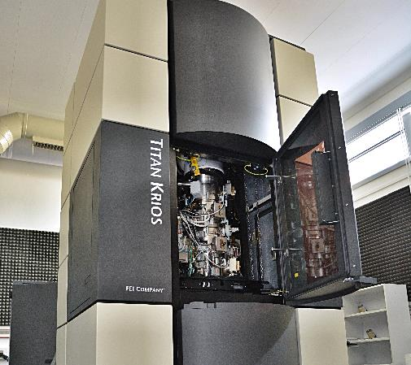
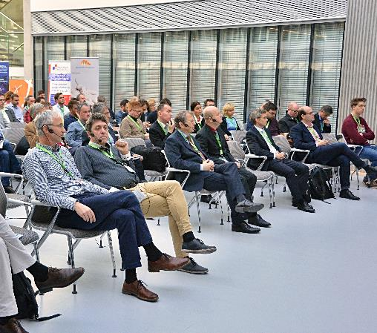
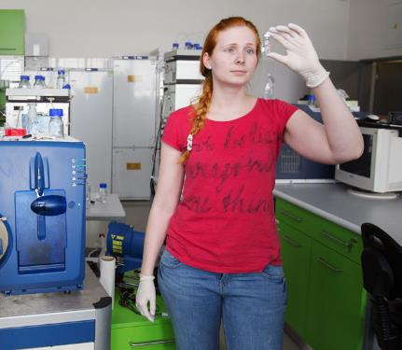
Improving quality of life through scientific research
State of the art infrastructure
Vibrant scientific community
People
Notes:
And how have we accomplished that?
CEITEC’s success stands on three pillars:
First, our institution offers state of the art infrastructure which facilitates high-level research projects
Second, its our people. We are lucky to have a great number of professionals who cooperate across disciplines to deliver results. This is a strength very unique to CEITEC.
Third we facilitate a strong connection between these two that allows us to create a vibrant, lively scientific community
This gives us a solid foundation to pursue our mission of improving quality of life through Scientific research

Slide 4
CEITEC MU highlights (2017)
32.5
mil. EUR
total budget
316
scientists
36
research
groups
Notes:
Lets’ take a look at CEITEC MU through some numbers:
We operate with a total budget of more than 21 mil. EUR, most of which originates in competitive sourcing
Our multinational, English speaking staff counts 323 people
Our research professionals are split into 35 research groups

Slide 5
Addressing global challenges
CEITEC agricultural
sustainability
9
billion people
in 2040
CEITEC biomedicine
Notes:
Our research teams that I have just talked about are on an important mission. Our purpose at CEITEC MU is to help address global challenges in two key areas of our everyday lives / sustainable agriculture and new generation of medicine.
What does this mean in the context of our everyday lives? How does the science we conduct here at CEITEC apply to real life problems?
First, let’s look at agricultural sustainability. It is estimated that by 2040 there will be 9 billion people on Earth, which is more than triple from 100 years ago. How will we be able to feed such great number of people without destroying the natural resources of our planet? Our research teams help provide answers to these questions.
Our second focus is on the field of new generation biomedicine, which applies biological and physiological principles to clinical practice. Our researches facilitate developments of the next-generation diagnostic and therapeutic strategies for the treatment of human diseases, many of which have a genetic background.

Slide 6
Main research areas
Structural Biology
Plant Biology
Molecular Medicine
Neurosciences
Notes:
To address these global challenges, our teams conduct research in these four key areas:

Slide 7
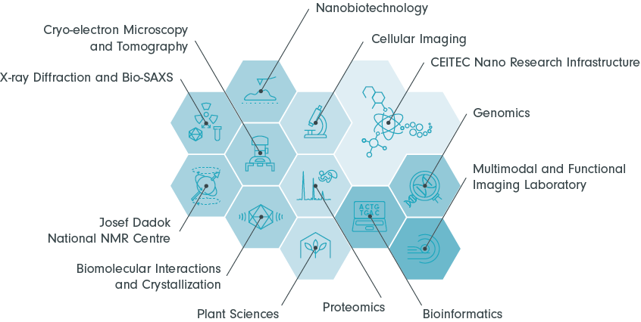
Research facilities
Notes:
State of the art research facilities are the first pillar of CEITEC and a key to high quality research.
The CEITEC core facilities are spread on more than 25000 square meters and offer the research community access to cutting edge equipment. These resources are shared and provide our scientific investigators the opportunity to leverage the instrumentation and access to technology development and services.

Slide 8
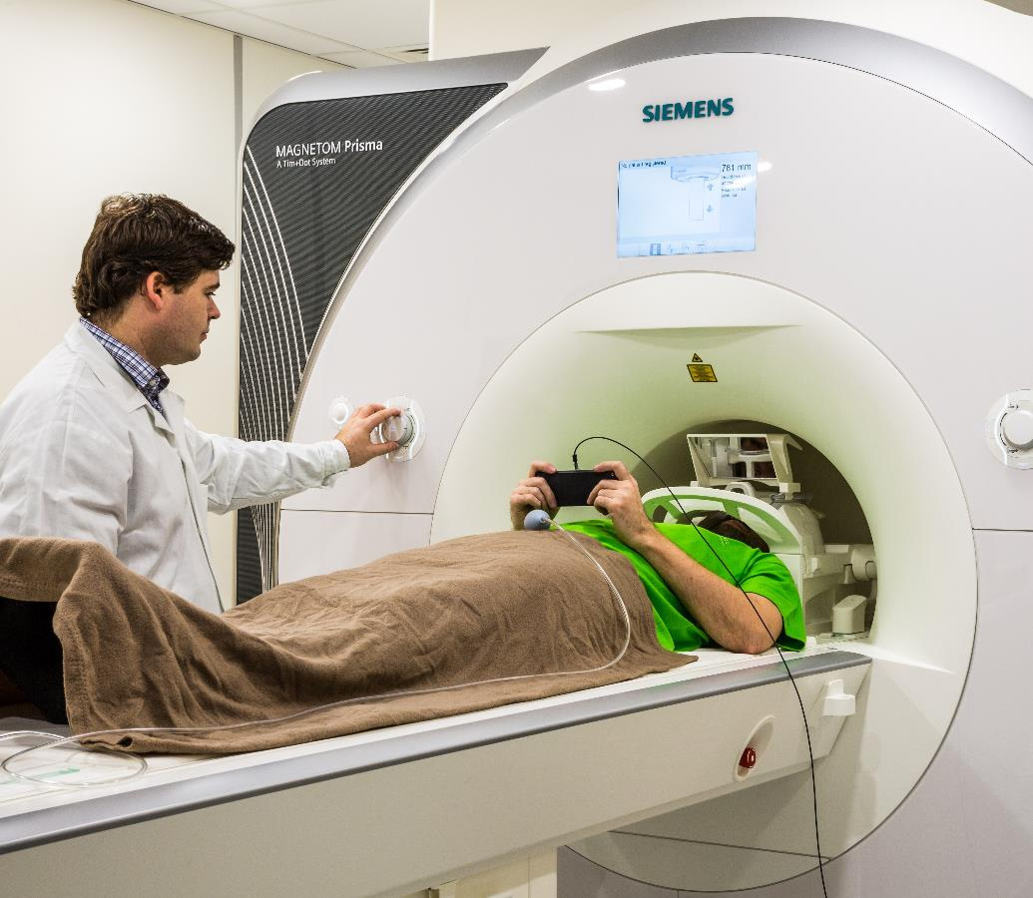
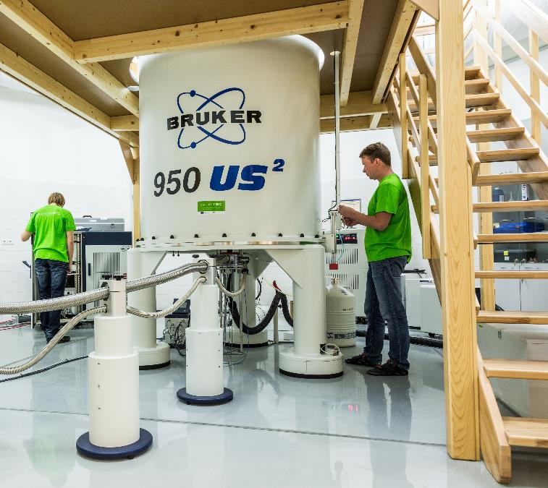
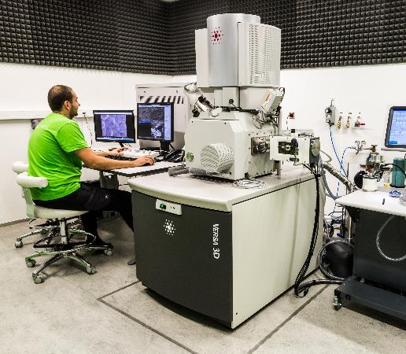
Notes:
Notes

Slide 9
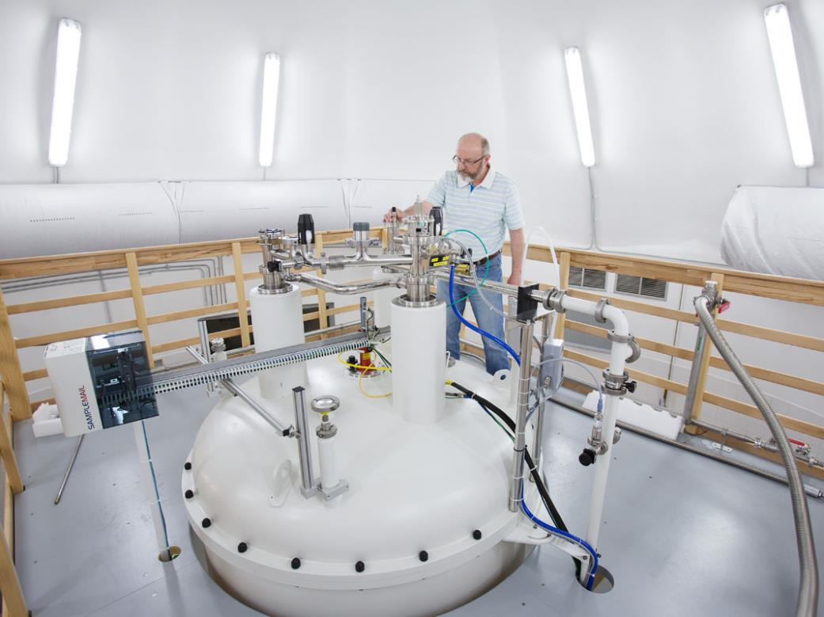
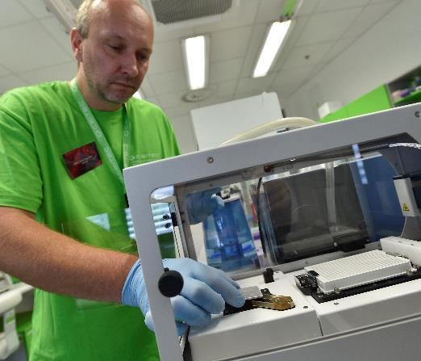
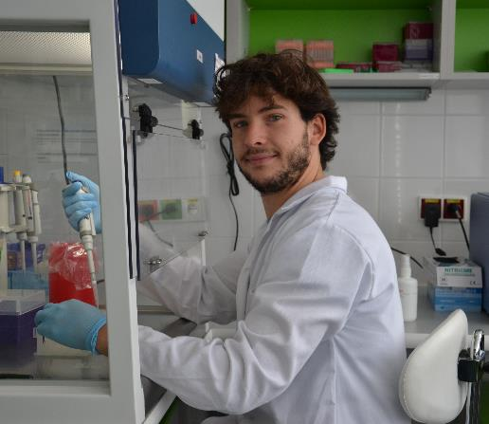
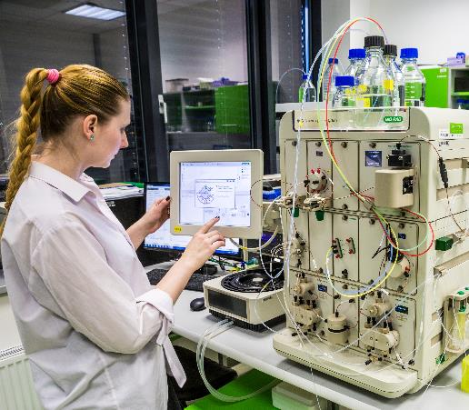
Our people
Notes:
While we are very proud of the technologies and equipment available at CEITEC, it is our people that make the research facilities come alive.
The great number of technological equipment allows collaboration across different specialties and fields of study and facilitates synergies between them. Our research teams inspire each other, ask the right questions and offer their own, different perspective in the topics under discussion – and this creates a special force of creativity and scientific inquiry which is very unique to CEITEC.

Slide 10


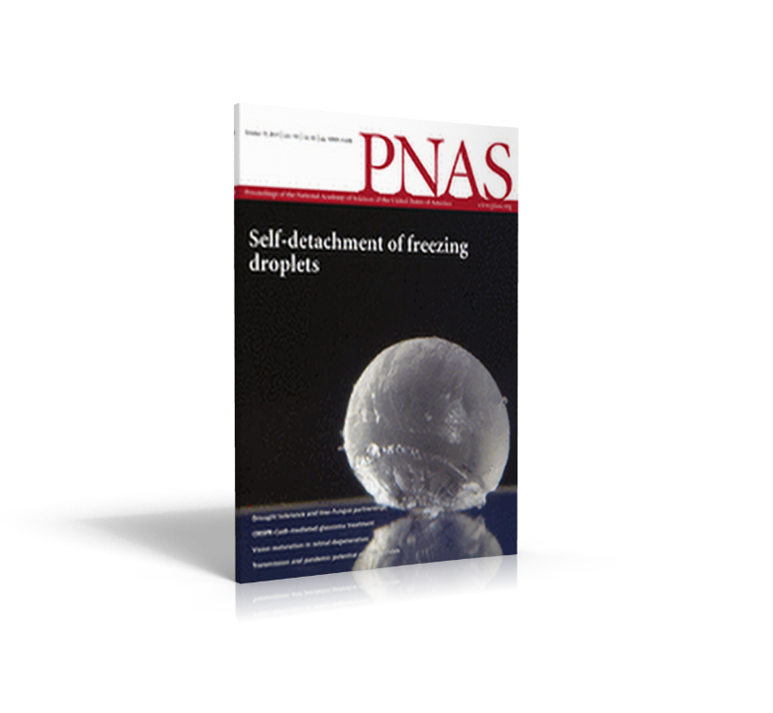
Impressive scientific results
Publications
Monophyletic origin and evolution of the largest crucifer genomes
Nanoparticle-Based Immunochemical Biosensors and Assays: Recent Advances and Challenges
Structure and dynamics of the RNAPII CTDsome with Rtt103
Notes:
We are proud to say that in these areas we have already been able to accomplish some impressive results and will continue to do so in the future.

Slide 11
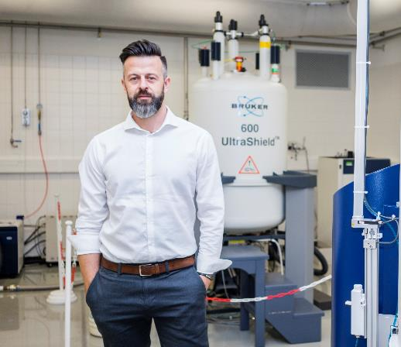
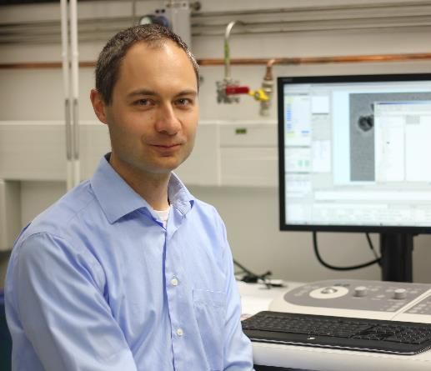
Impressive scientific results
Consolidator Grant Richard Štefl
– Dynamic assembly and exchange of RNA polymerase II CTD factors
Grants
Starting Grant Pavel Plevka
– Structural Study of Human Picornaviruses
Notes:
We are proud to say that in these areas we have already been able to accomplish some impressive results and will continue to do so in the future.

Slide 12













Vibrant scientific community at CEITEC
Collaboration & partnerships
Notes:
We realize that the only way to fulfill our promise and our mission and to fully exploit the potential of our state of the art technologies is to create an environment in which a vibrant scientific community will thrive.
At CEITEC we take this very seriously and are proud of making our facilities literally come alive.
Every year we organize a great number of quality scientific events in various fields of study attended with researches from all over the world.
We foster collaboration with important partner institutions and exchange of ideas among our teams.
And last but certainly not least, we offer an acclaimed International PhD program to entice researches from other parts of the world to come to CEITEC and conduct their research here.
So far, we have talked about CEITEC’s scientific heritage, about its state of the art facilities, its pool of talented research professionals and the fields of study that allows
Vibrant, international scientific community
Collaboration / departmental , with partners, etc. / internationally, FN Bohunice
PhD program

Slide 13
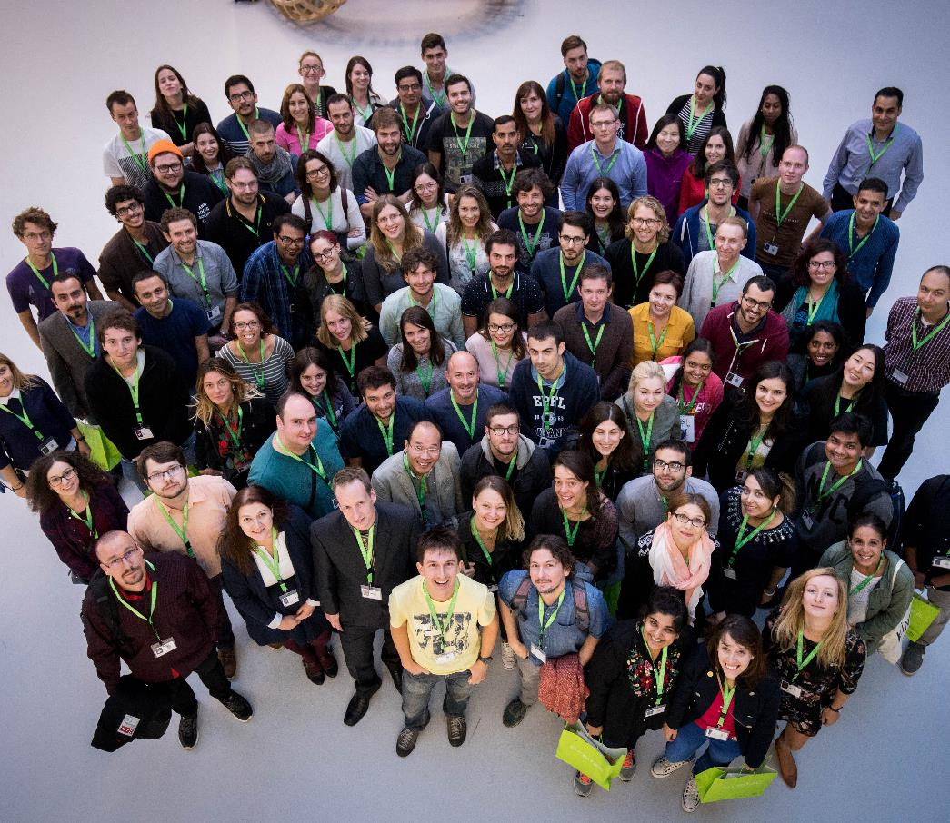
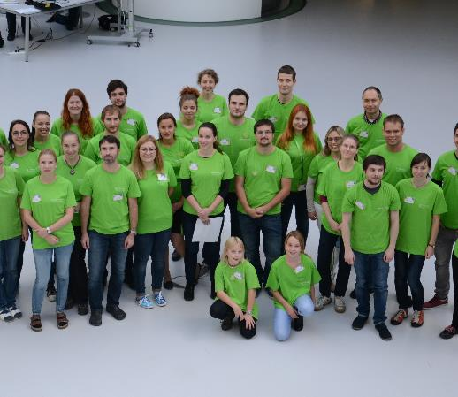
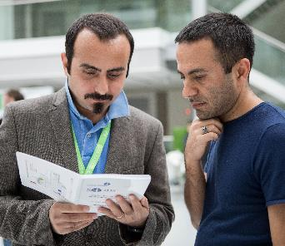
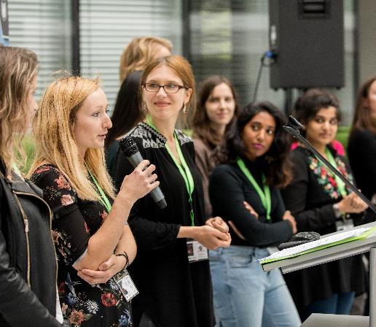
Vibrant scientific community at CEITEC
International Staff & PhD Program
Notes:
We realize that the only way to fulfill our promise and our mission and to fully exploit the potential of our state of the art technologies is to create an environment in which a vibrant scientific community will thrive.
At CEITEC we take this very seriously and are proud of making our facilities literally come alive.
Every year we organize a great number of quality scientific events in various fields of study attended with researches from all over the world.
We foster collaboration with important partner institutions and exchange of ideas among our teams.
And last but certainly not least, we offer an acclaimed International PhD program to entice researches from other parts of the world to come to CEITEC and conduct their research here.
So far, we have talked about CEITEC’s scientific heritage, about its state of the art facilities, its pool of talented research professionals and the fields of study that allows
Vibrant, international scientific community
Collaboration / departmental , with partners, etc. / internationally, FN Bohunice
PhD program

Slide 14
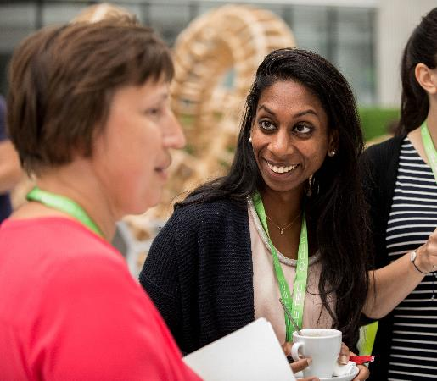
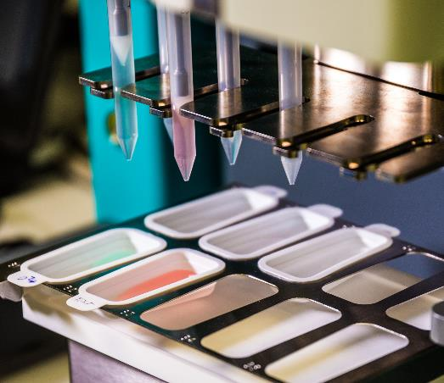
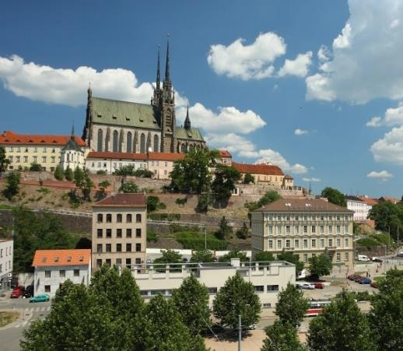
Reasons to choose CEITEC
International scientific community
Breakthrough technologies
High quality of life
Notes:
There are good reasons why so many research talents choose CEITEC for their chosen field of study.
We already talked about the state of the art technologies available.
We have just talked about the vibrant, international scientific community of researches that conduct their research at CEITEC.
But we should also mention the excellent quality of life in Brno and the Czech republic, because it is a big draw not only to our employees but their families as well, who often join them for this important career move.

Slide 15
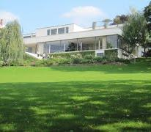
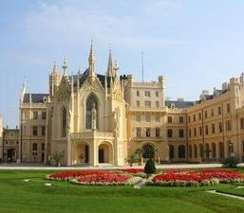
Brno for living – safe, vibrant & convenient
#6 safest country in EU
Prague
#1 best city for EXPAT support
Excellent health-care coverage
3.8% of GDP for sciences and research
BRNO
Bratislava
Mild climate
Vienna
Notes:
Notes

Slide 16





PR and Marketing
External communication
  press releases
  articles and references in media
  website
  social media
  events
Internal communication
  newsletter (internal, ?external)
  annual report
  new visual style
www.ceitec.eu

Slide 17
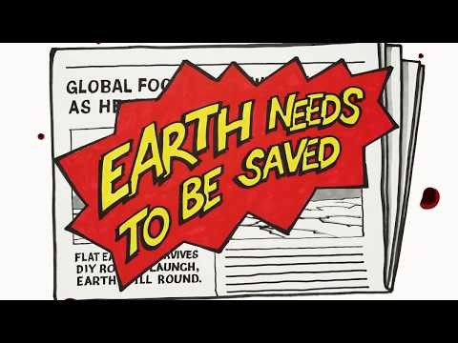

Slide 18
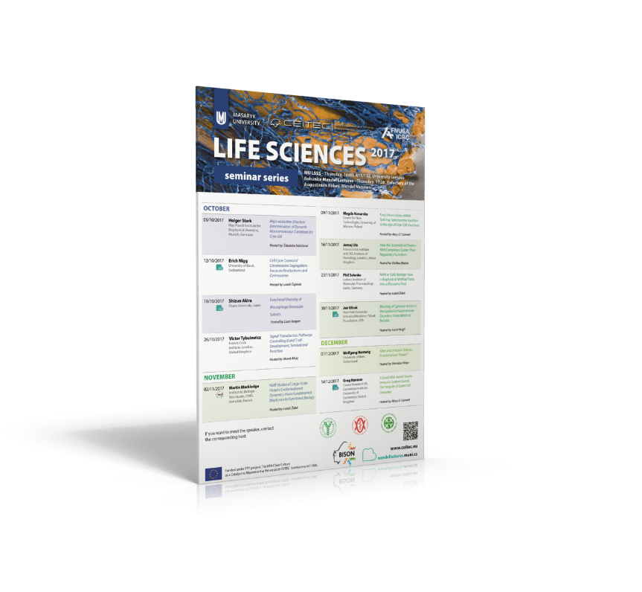
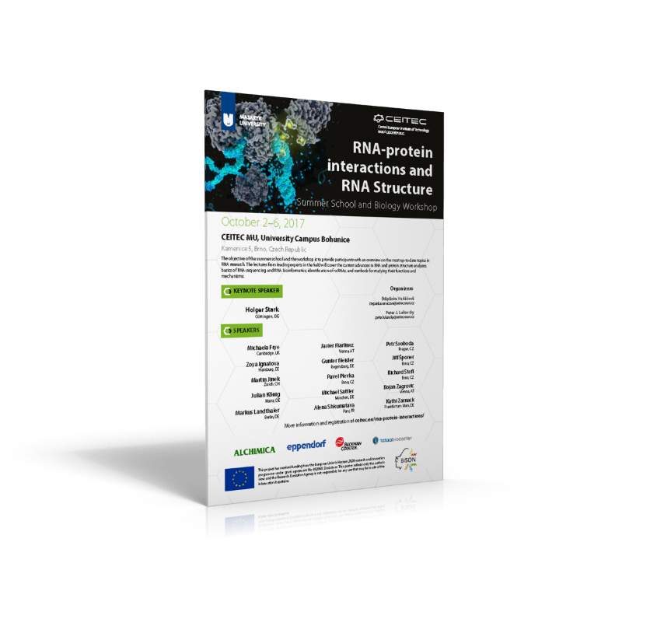
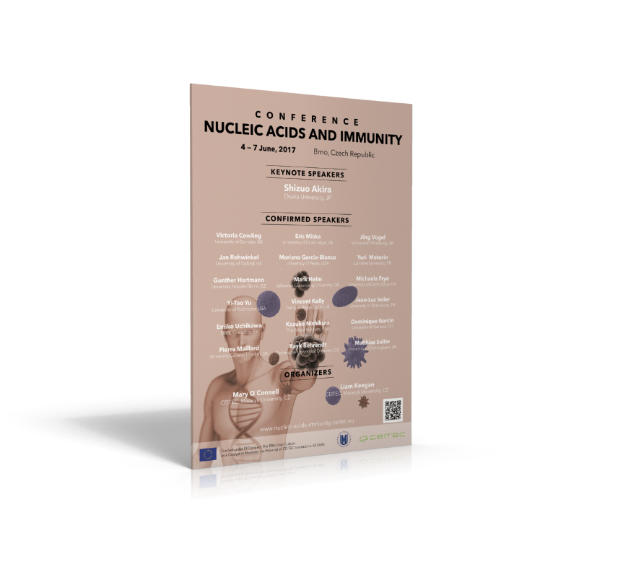
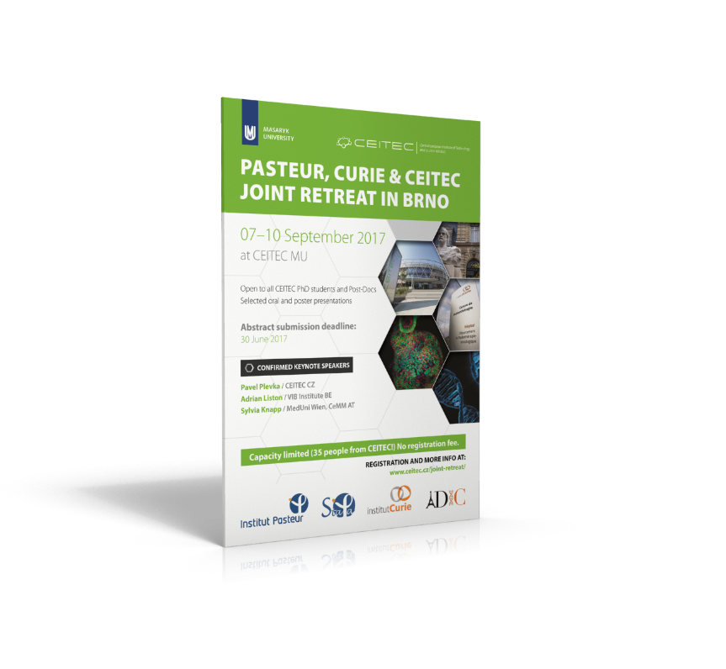
Vibrant scientific community at CEITEC
Scientific events
Notes:
We realize that the only way to fulfill our promise and our mission and to fully exploit the potential of our state of the art technologies is to create an environment in which a vibrant scientific community will thrive.
At CEITEC we take this very seriously and are proud of making our facilities literally come alive.
Every year we organize a great number of quality scientific events in various fields of study attended with researches from all over the world.
We foster collaboration with important partner institutions and exchange of ideas among our teams.
And last but certainly not least, we offer an acclaimed International PhD program to entice researches from other parts of the world to come to CEITEC and conduct their research here.
So far, we have talked about CEITEC’s scientific heritage, about its state of the art facilities, its pool of talented research professionals and the fields of study that allows
Vibrant, international scientific community
Collaboration / departmental , with partners, etc. / internationally, FN Bohunice
PhD program

Slide 19
PR and Marketing
External communication
  press releases
  articles and references in media
  website
  social media
  events
Internal communication
  newsletter (internal, ?external)
  annual report
  new visual style
www.ceitec.eu

Slide 20
Follow us!
CEITEC (2875 fans)
CEITEC_Brno (621 followers)
CEITEC - Central European Institute of Technology (2 502 followers)
ceitec_brno (306 followers)
CEITECcz (46 subscribers)

Slide 21
CEITEC
@CEITEC_Brno
Thanks for your attention!
Jana Otoupalíková
jana.otoupalikova@ceitec.muni.cz
www.ceitec.eu
Notes:
Notes

