Slide 1
Rdm services
Faculty library
Rdm support
Startup and future / Inge Rutsaert / dd-09-2018

Slide 2
introduction

Slide 3
institution
Ghent University (Belgium)
42 000 students
> 6200 researchers*
Faculty of Economics and Business Administration
Students
5 bachelor & master’s programmes
2 subesequent master’s programmes
3 complementary studies
2 post graduates
4 doctoral degrees
Total : 6138 students (2017-2018)
Academic staff
9 departments
Total : ± 468 researchers
* 2017

Slide 4
library
Faculty Library
of Economics and Business Administration
Services
Books and journals
Information literacy skills for students
Study area (± 175 seats)
Research Data Management Support for researchers
Website
https://www.ugent.be/eb/en/services/library/
Staff
4,2 FTE library staff

Slide 5
library
University Library – Book Tower
Before
Book Tower
+/- 240 department libraries
Now
Book Tower (historic archive)
Faculty Libraries
Library network

Slide 6
Who am i?
Inge Rutsaert
Faculty library
2009 : front desk
2010 – 2015: front desk, back office and communication
2015 – nov. 2016: research data management project
2016 – now: RDM Support Officer
What is ‘Research Data Management’?
Ghent University: “RDM covers the planning and implementation of the collection, processing, analysis, organization, storage, documentation, archiving, sharing, and reuse of data”.

Slide 7
Startup rdm service @ feb

Slide 8
History
Within the story of scientific integrity and open science, data management is just a sub-division.
02/05/2013: WG Data management (UGent)
30/06/2015: Dissertation RDM Inge R. (library school)
02/09/2016: UGent RDM Policy Framework
15/11/2016: FEB joins WG RDM +
Appointment RDM support officer

Slide 9
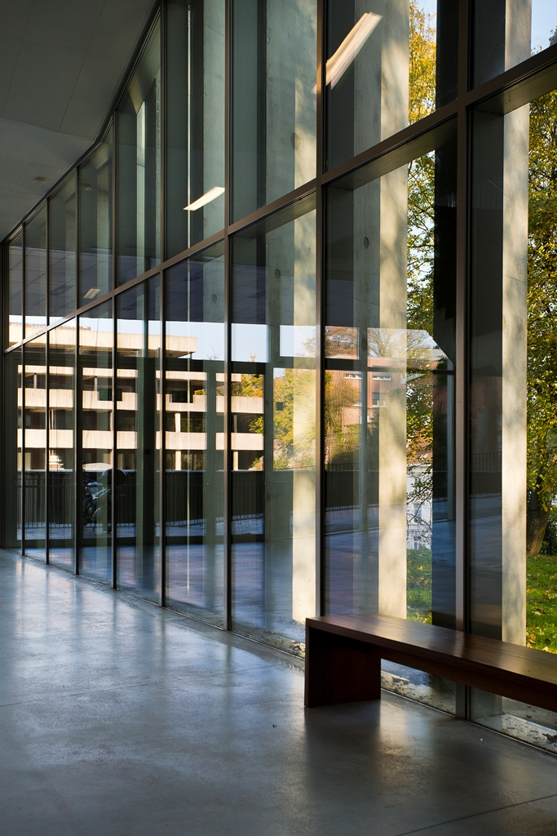
How to start?
9 Departments
Total of ± 468 academic staff members
1. General economics
2. Financial economics
3. Social economics
4. Accounting, corporate finance and taxation
5. Marketing
6. Business informatics and operations management
7. Innovation, entrepreneurship and service management
8. Public governance, management and finance
9. Human resource management and organizational behaviour
Questions?
What data are they using/creating?
How do they manage that data?
January 2017
Survey on research data
management sent to the whole academic staff
SURVEY

Slide 10
Results survey
Data types:
Spreadsheets, texts, graphics, databases, source code, etc.
Data volumes:
Most datasets are <50GB, but the data analytics research unit works with big data and have a few PBs in storage
Storage
Favorites: external hard drives and laptops
Backup
Only a few have an organized backup system in place

Slide 11
Results survey
First level support:
Guidelines, checklists, best practices, etc.
Specific support:
DMPs, Open Access, etc.

Slide 12
Plan of action

Slide 13
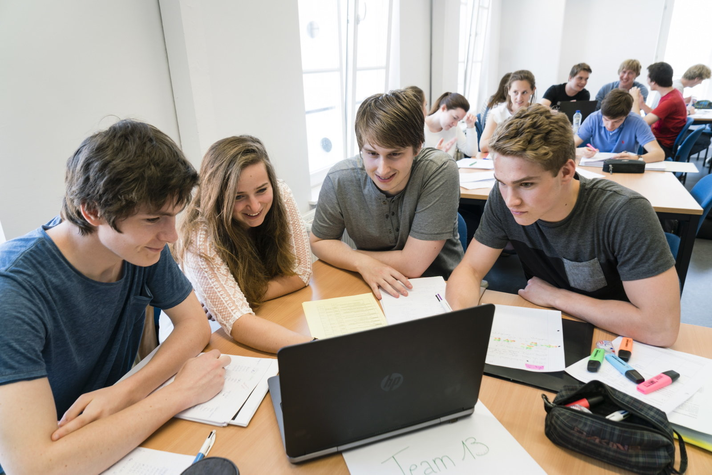
Services
Which services do we want to provide?
First level support
Specific guidance
Training courses
Training materials (train the trainer)

Slide 14
First level support
Website
Development website on RDM as a go-to-point for information (findable through Google)
Content
It contains relevant information on most aspects of research data management for economic research, like:
What is research data management?
All relevant policies
RDM tools, f.e. DMPonline, storage possibilities, etc.
Information on ethical and legal issues
Advice
Constant updates

Slide 15
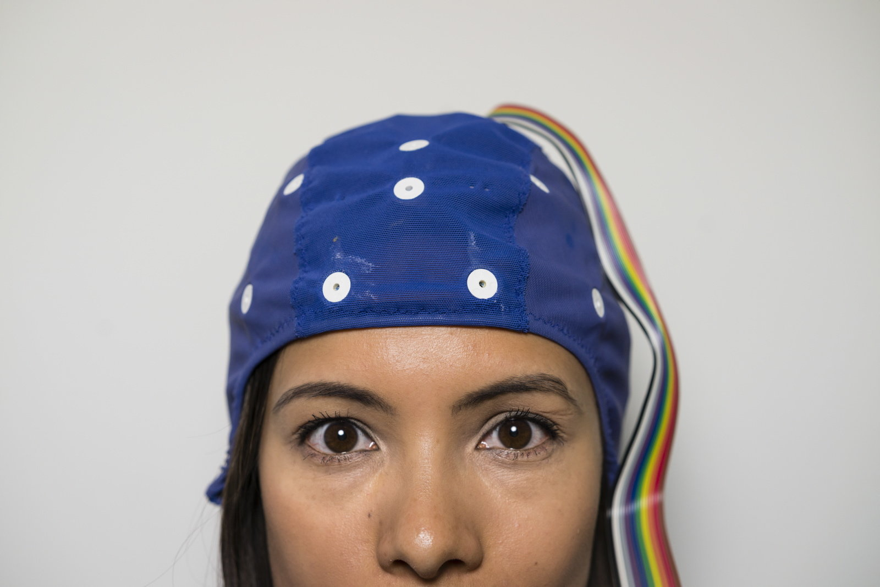
First level support
Researcher
RDM Service (Website)
Didn’t work:
they didn’t make the effort
So we turned it around
RDM Service (Website)
Researcher

Slide 16
RDM goes academic
How can I reach the researchers?
I got more involved in their world
I joined the research communication team
I help organizing social activities for staff members (f.e. After Work)
I was present at the FEB Research Day
And I went on tour ☺
Goal
To earn their TRUST
So they know that their research data is in safe hands

Slide 17
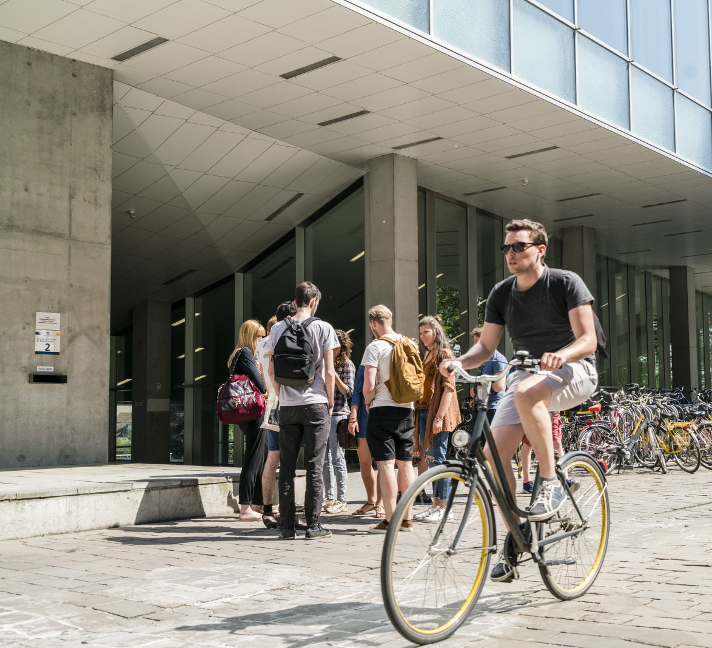
RDM on tour
Necessary
Very specific information on data management they need and want to know
Flemish funding agency made a DMP mandatory
GDPR (lots of questions)
Tour
Visited every department for a short presentation on these topics
Chance to introduce myself as the RDM support officer
Showing the way towards the website

Slide 18
future

Slide 19
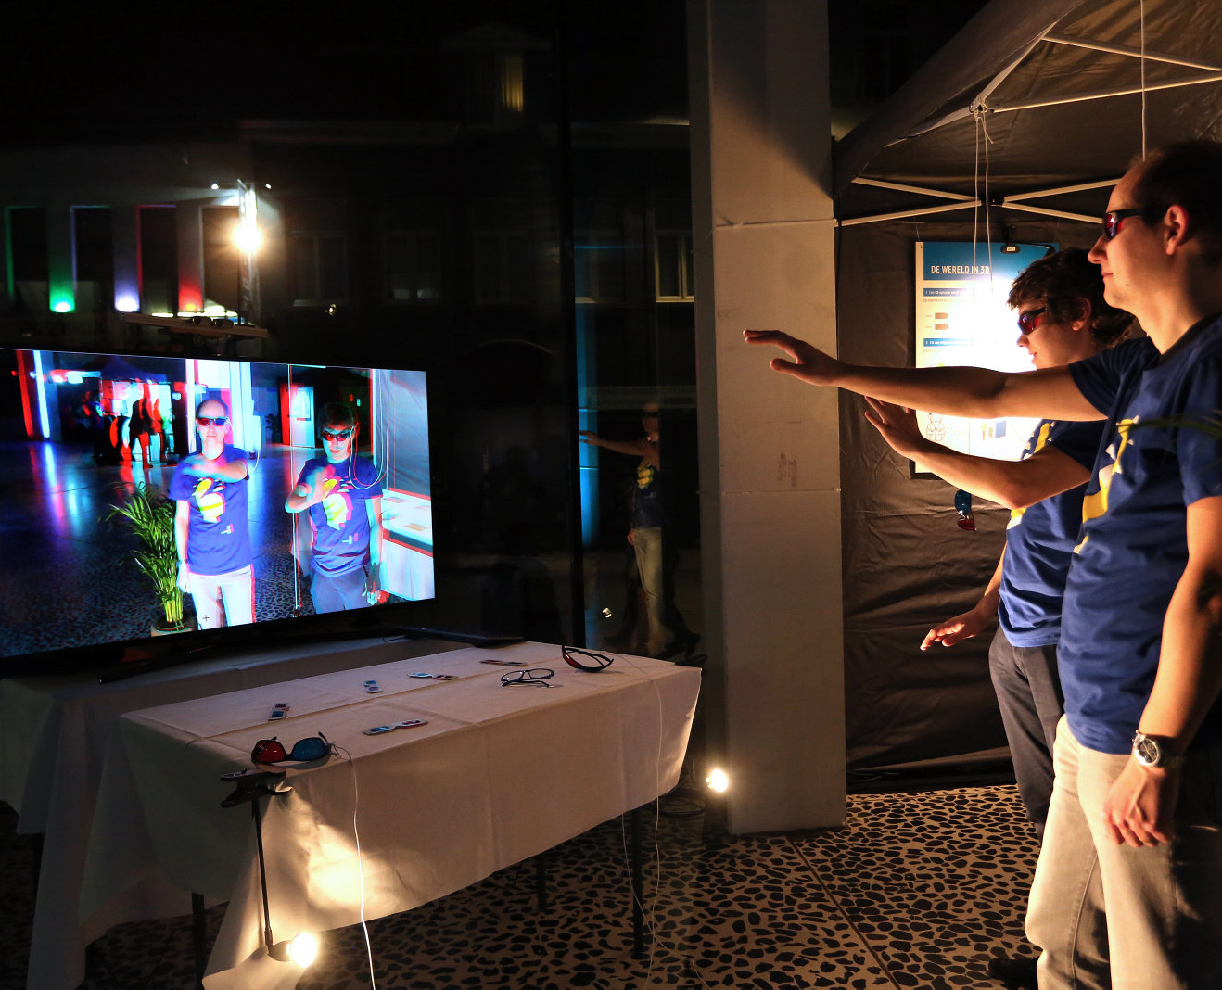
tomorrow
In depth
DMPonline: specific templates for economic research
Information: Data Archiving Policies for economic journals
Personal guidance:
More one-on-one guidance
Workshops on specific topics

Slide 20
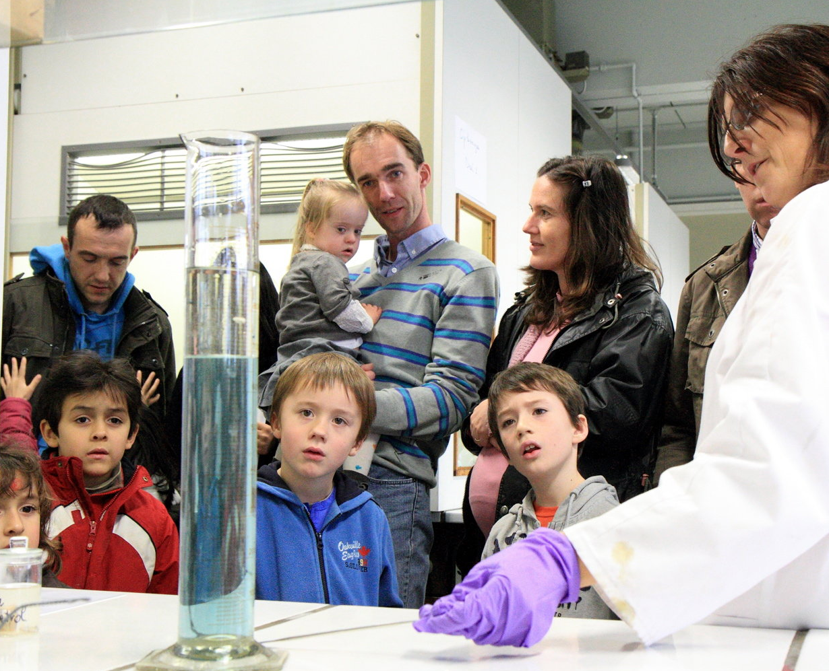
Questions ?
Thank you for your time !
If you have questions, please don’t hesitate to ask ☺

Slide 21
Inge Rutsaert RDM Support Officer Faculty library of economics and business administration E inge.Rutsaert@ugent.be T +32 9 264 34 73 M +32 486 02 63 63 www.ugent.be/eb/en/services/library
@ingerutsaert @ugent

