Slide 1
How can the library help the research staff?
Support to Research
UCLM Library
Nuria Alonso Soto
UCLM Library. Albacete Campus

Slide 2
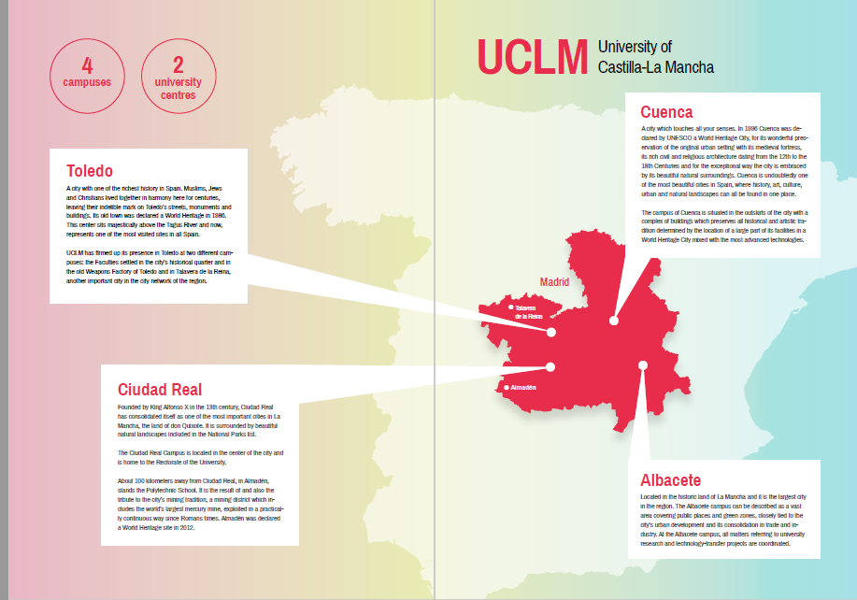
Where
is
UCLM
located?
http://www.uclm.es
UCLM Guide

Slide 3
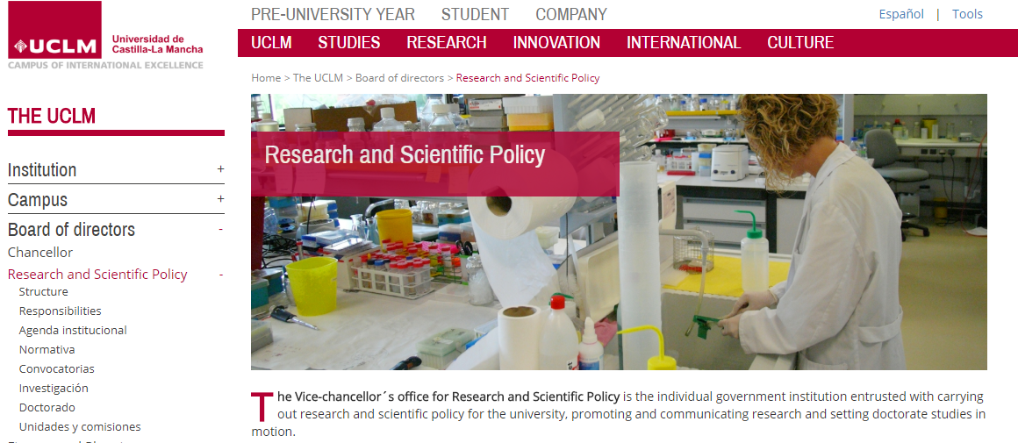
Research in UCLM

Slide 4
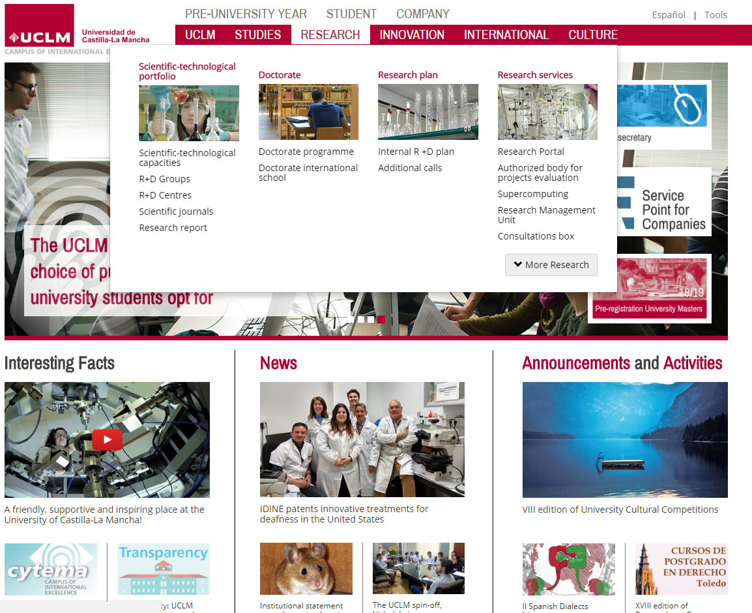
Research in
UCLM

Slide 5
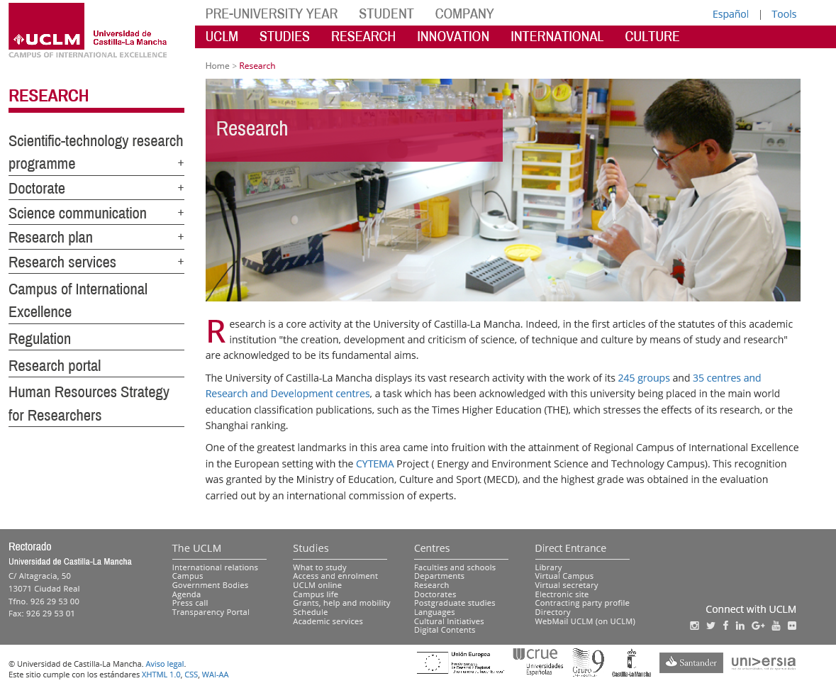
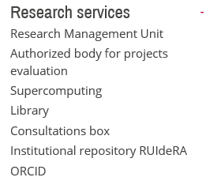

Slide 6
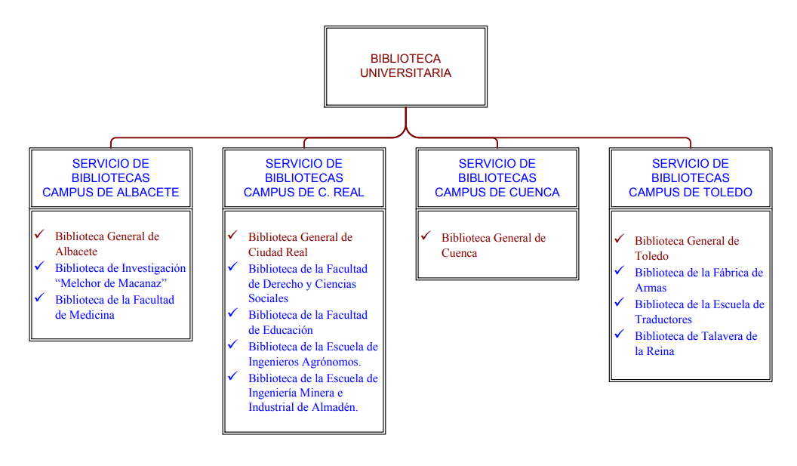
University Library UCLM
Memoria 2016

Slide 7
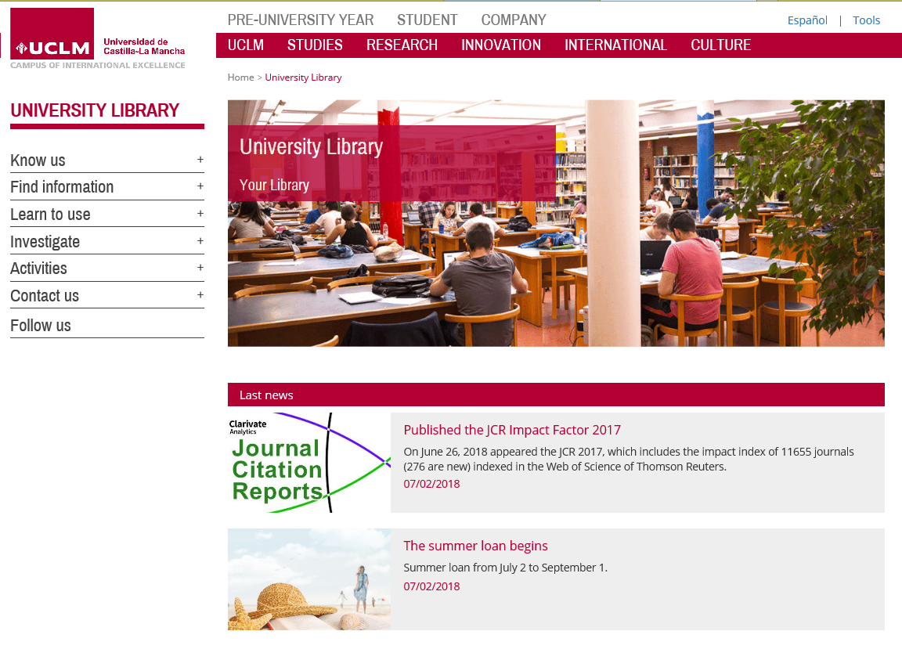
Select “Investigate”
http://biblioteca.uclm.es

Slide 8
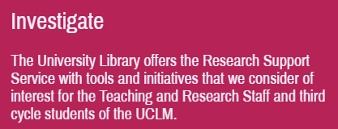
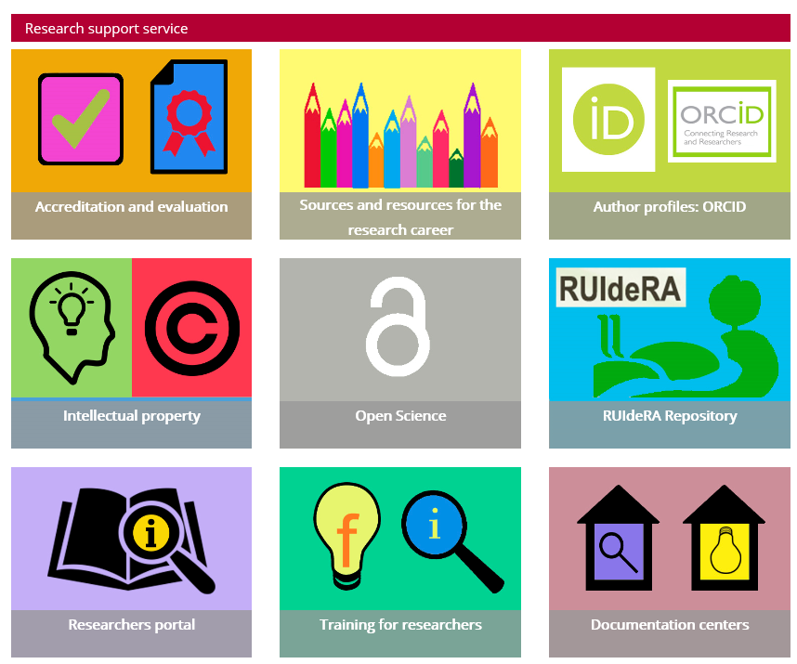
RESEARCH SUPPORT SERVICE
Research Support Service started as a Project in 2013, and it was implemented in 2014.
There is a General Coordinator of the Service and one coordinator and a team in each campus library.
The main issues that it manages are: advise to researchers concerning accreditation processes, publication and visibility, use of ORCID and RUIDERA.

Slide 9
Research Support
Advising about accreditation
and evaluation processes
Dissemination and visibility
Online and face to face
Training
Tools: JCR, Scopus, SJR. EndNote Basic
ORCID and other
author identifiers.
INFORMATION LITERACY Courses
RESEARCH SUPPORT Courses
FECYT training
Copyright issues
Open Access
RUIdeRA
Solving ORCID enquiries.
Helping to publish in
Dialnet portal

Slide 10
Research in Spain framework
Ministry of Science, Innovation and Universities
ANECA (National Agency for Quality Assessment and Acreditation of Spain)
CNEAI (Spanish National Commision for Research Evaluation)

Slide 11
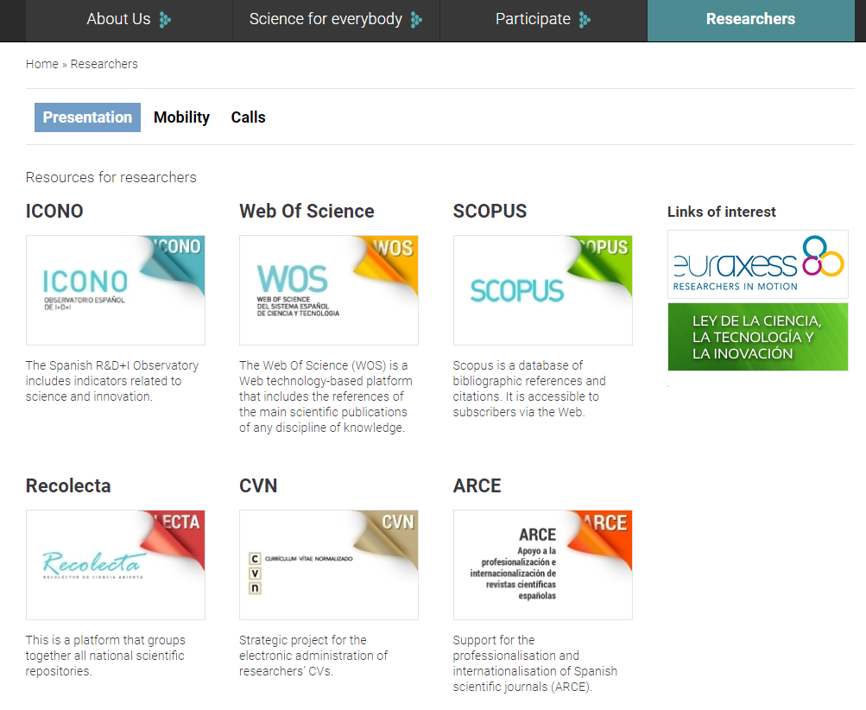
Science, Technology and Innovation Act 14/2011

Slide 12
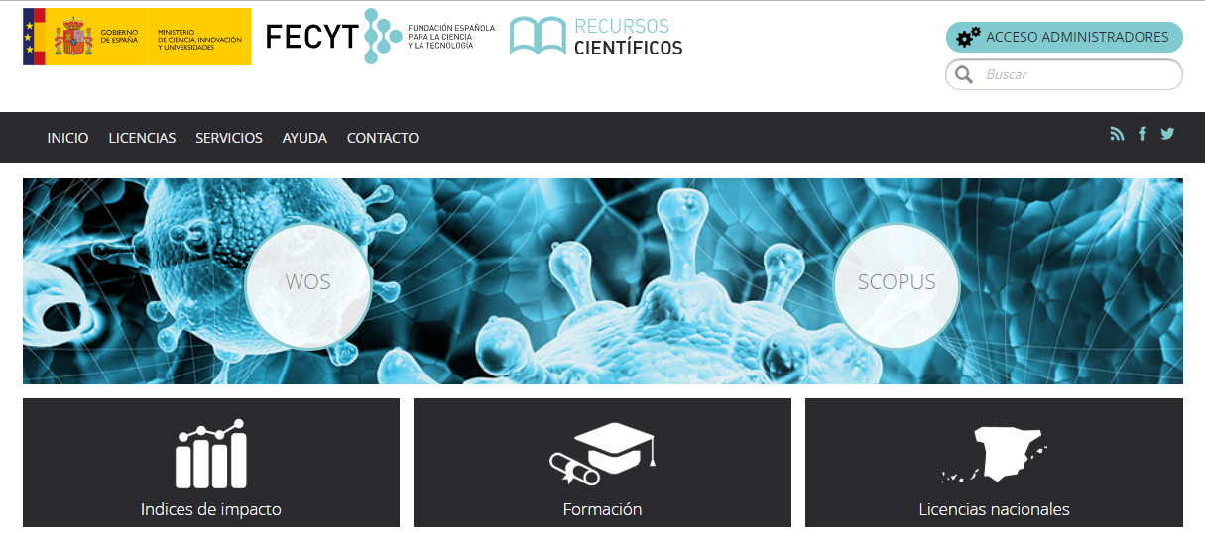
The Spanish Foundation for Science and Technology (FECYT) depends on the Spanish Ministry of Science, Innovation and Universities. It is the main provider of research resources and tools for Spanish universities.
11363
http://recursoscientificos.fecyt.es
https://www.fecyt.es/es/publicacion/researcher-career-path-spain-glance-3rd-edition

Slide 13
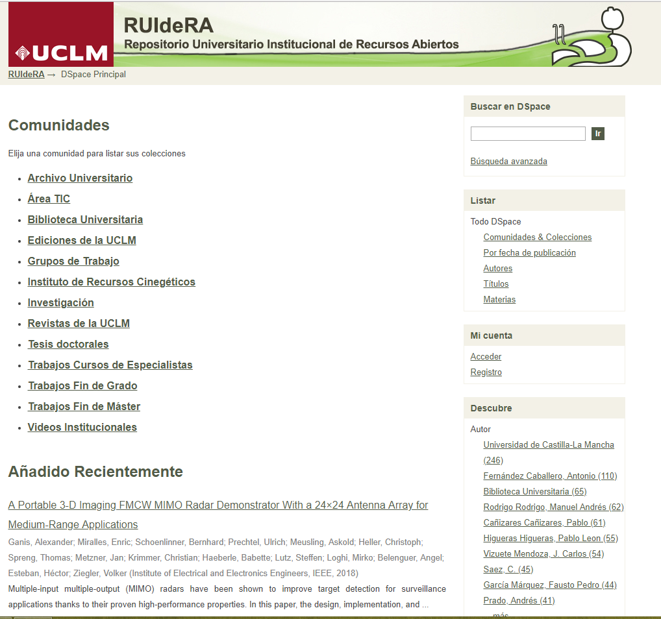
RUIdeRA
Repository
RUIDERA GROUP
Institutional Repository RUIdeRA started as a Project in 2011, and developed until 2015, when it was consolidated.
There is a communitiy called “Investigación” where research outputs are uploaded by researchers or by library staff.

Slide 14
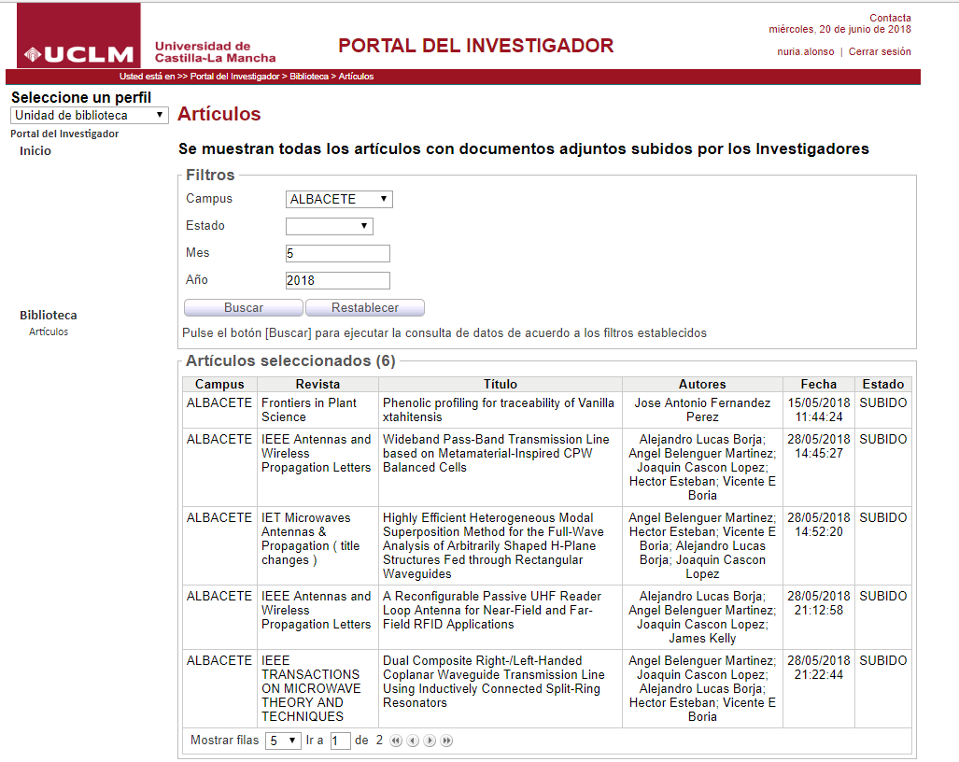
Identified user as librarian

Slide 15
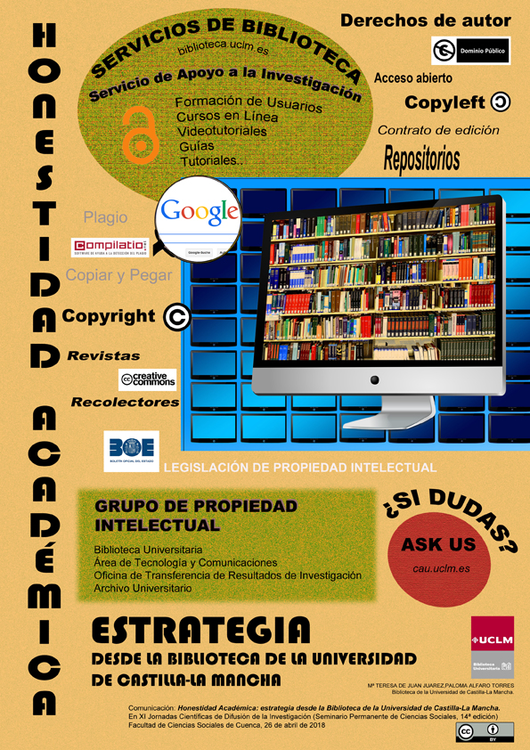
Intellectual Property
Intellectual Property and Knowledge Management Group
- University Library
- Technology and Communications Area
- Office for the Transference of Research Results
- University Archive
Intellectual Property and Knowledge Management Group
Academic honestity: strategy from the Library of the University of Castilla-La Mancha. In: XI Jornadas Científicas de la Investigación. Cuenca, 26th April 2018

Slide 16
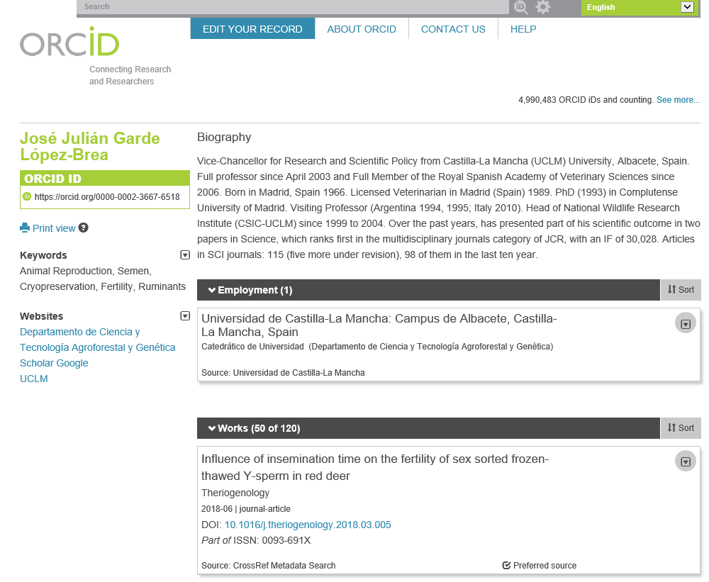
ORCID
ORCID
ORCID was stablished as standardised author identifier code by UCLM Governement Council in 2015.
orcid@uclm.es

Slide 17
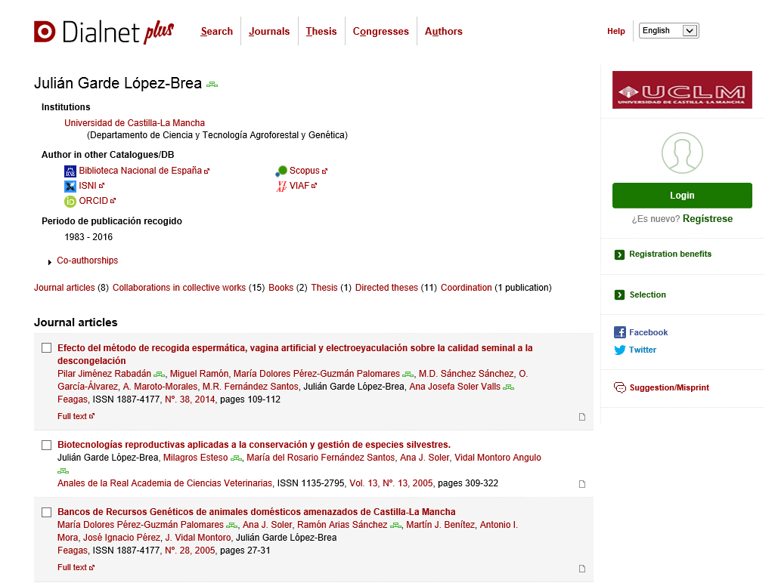
Dialnet for authors
As a member of Dialnet Plus, UCLM academic staff are provided with an author register, where their articles are collected.

Slide 18
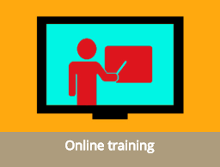
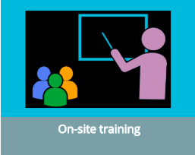
Research Support Group
Research Support Course for Academic and Research Staff
Research Support Course for Postgraduate, Master and Doctorate Students (early career researchers)
Good practices for researchers Workshop
Training
ALFIN Group (Information Literacy Group)
Learning to search and use information (Beginners and Advanced)
Information Competences
FECYT Online and face to face training
Web of Science Resources (JCR, ESI, etc.)
Scopus for beginners and advanced users
References Manager EndNote Basic

Slide 19
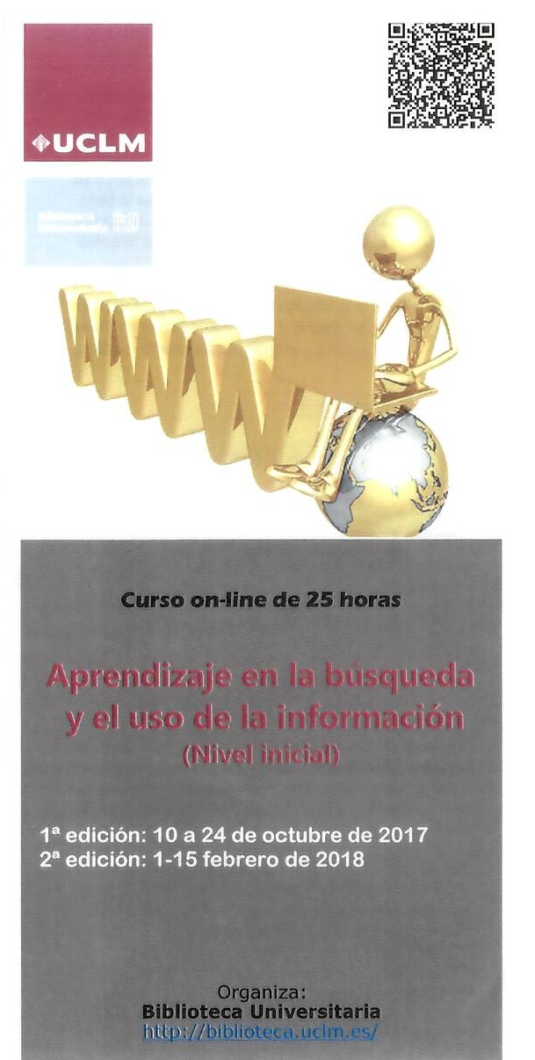
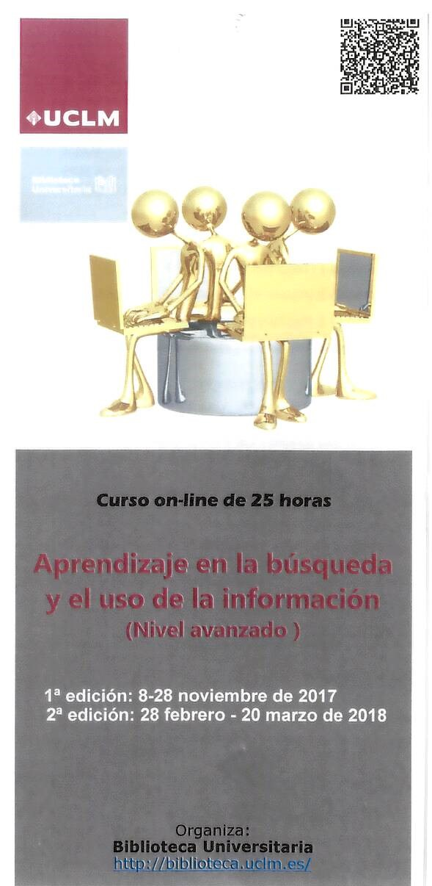
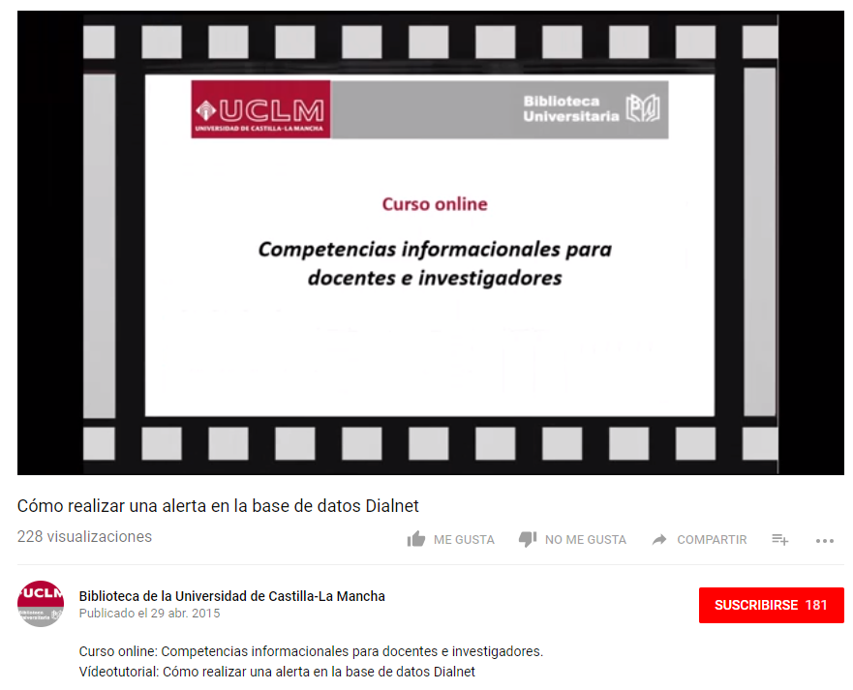
ALFIN Group (Information Literacy Group)
Learning to search and use information (Beginners and Advanced). For undergraduate students.
Information Competences for Academic Staff (Training for Professors and Researchers)

Slide 20
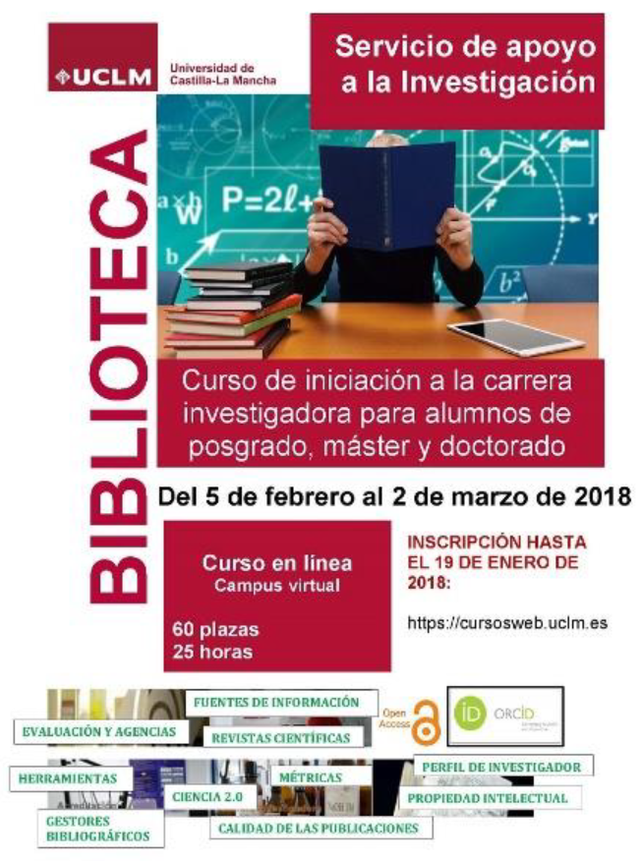
Research Support Group
Research Support Course for Postgraduate, Master and Doctorate Students (early career researchers) since 2018
Four units:
0. Introduction
Starting the research career path
Supporting tools
Information sources
Dissemination and visibility strategies for scientific outputs
Research Support Course for Professors and Research Staff, since 2015
Same topics as the course for early career researchers, but studied more in-depth.

Slide 21
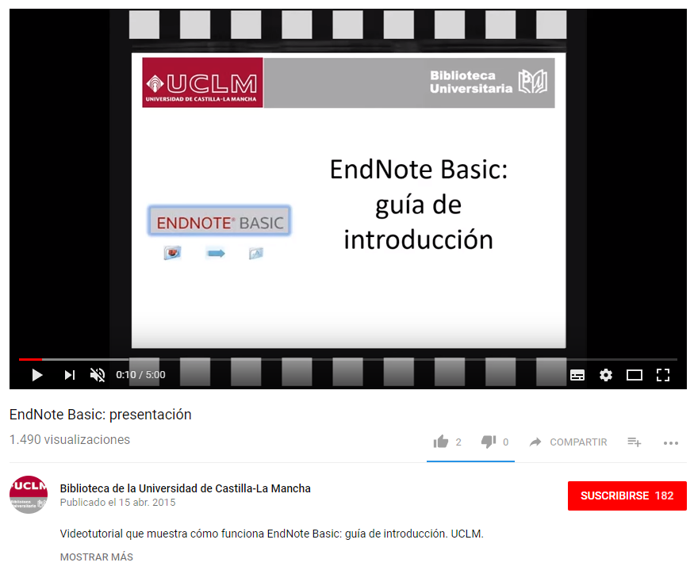
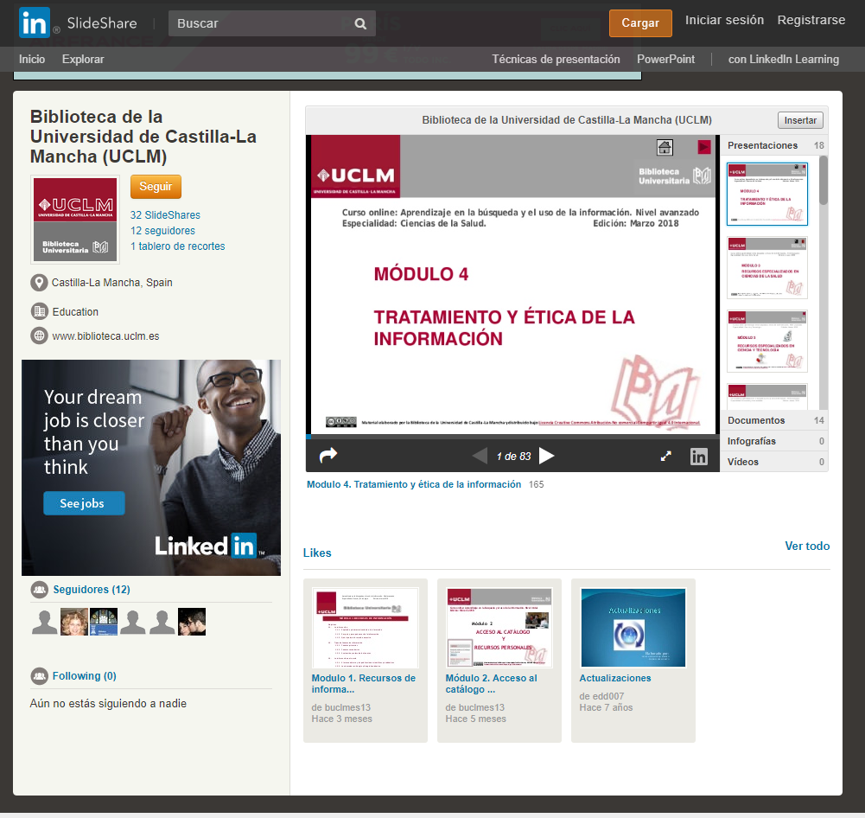
BUCLM SlideShare
BUCLM Youtube

Slide 22
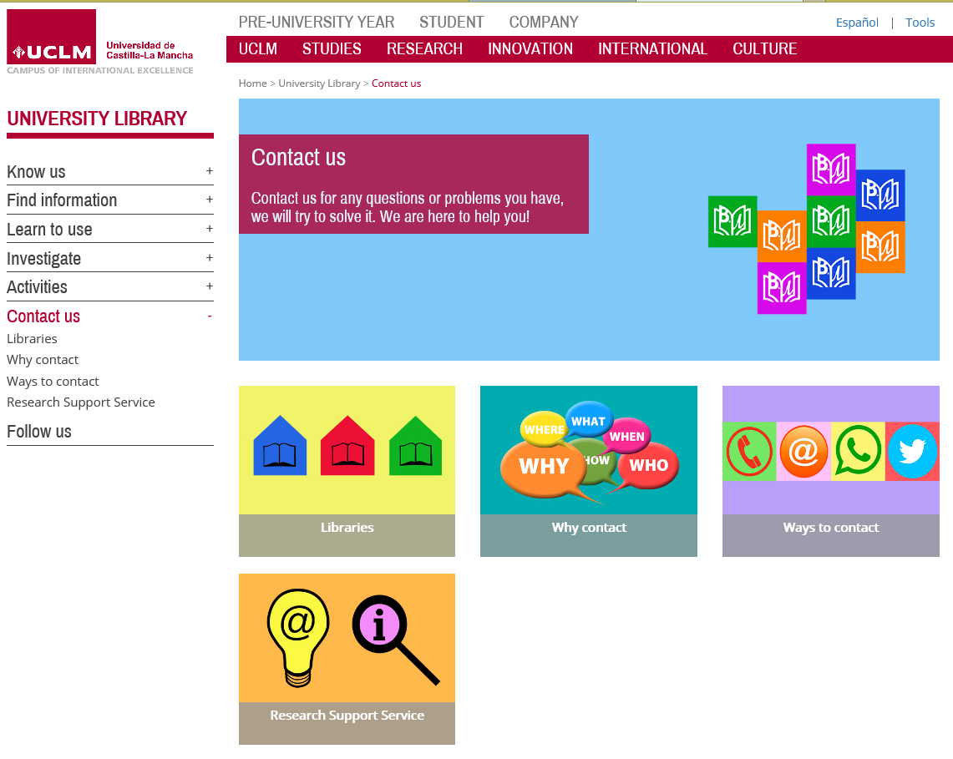
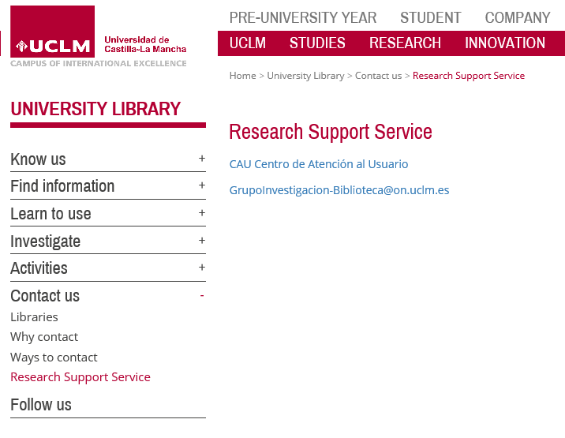
Customer Relationship Management (CRM) Customer Support (CAU)

Slide 23
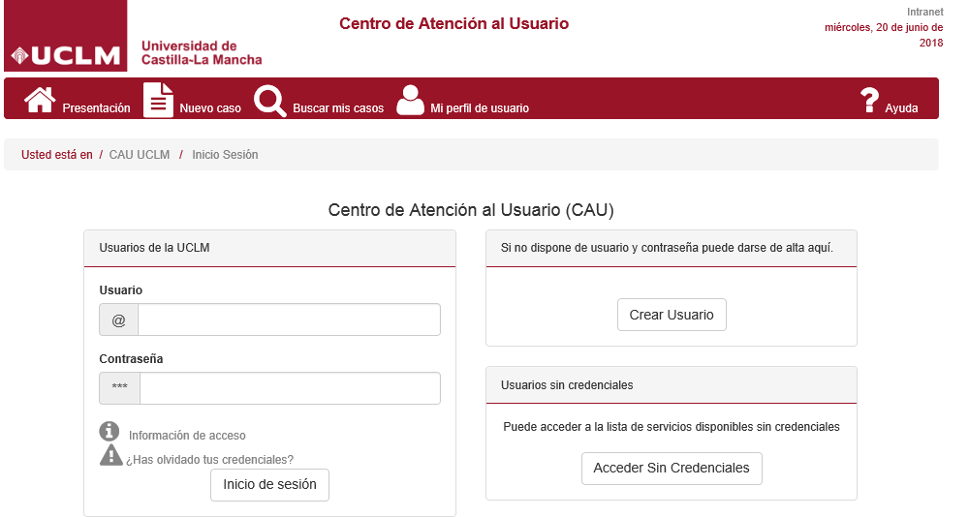
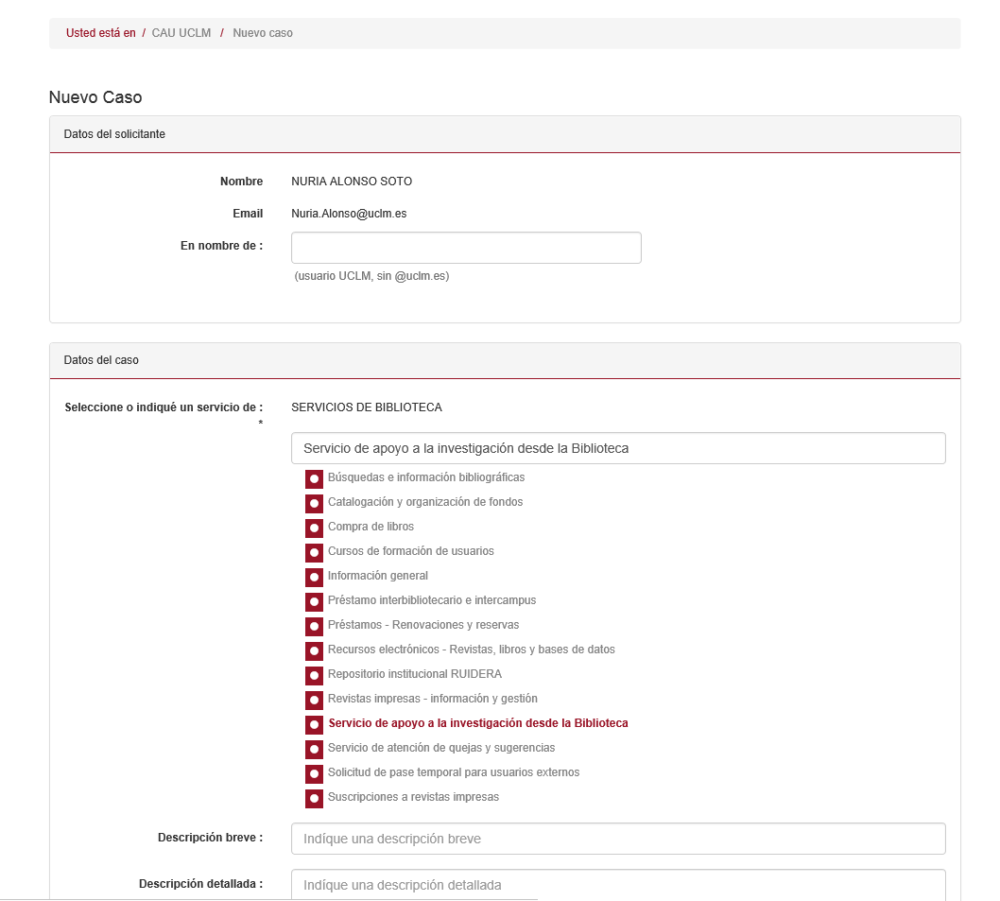
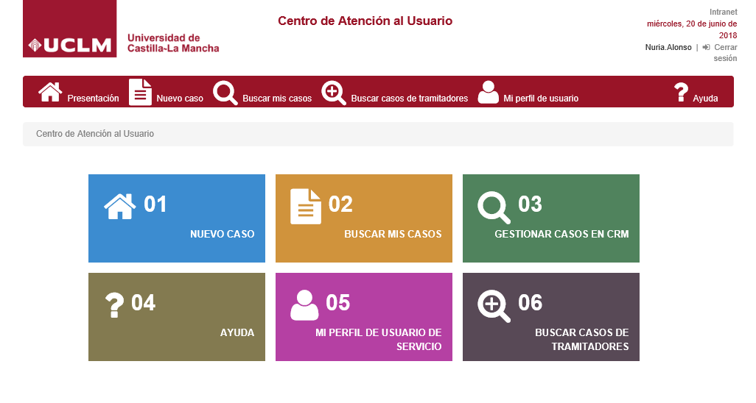
Write your login and password
Click “new case”
Select “Research Support Service”

Slide 24
Questions?

Slide 25
Thank you for your attention!
Nuria Alonso Soto
E-mail: Nuria.Alonso@uclm.es
LinkedIn: www.linkedin.com/in/nuria-alonso-soto-aabbab7
Library videoclip

